Slide 1

Section 9-3: Inferences About Two Means (Independent)
College Prep Stats

Slide 2
Learning Targets
This section presents methods for using sample data from two independent samples to test hypotheses made about two population means or to construct confidence interval estimates of the difference between two population means.
We discuss situation in which the standard deviations of the two populations are unknown and are not assumed to be equal.

Slide 3
Definitions
Two samples are independent if the sample values selected from one population are not related to or somehow paired or matched with the sample values from the other population.
Two samples are dependent if the sample values are paired. (That is, each pair of sample values consists of two measurements from the same subject (such as before/after data), or each pair of sample values consists of matched pairs (such as husband/wife data), where the matching is based on some inherent relationship.)

Slide 4
Examples
Independent or Dependent?
  210 randomly selected men, 186 randomly select women
  67 students’ weights in September, the same 67 students’ weights in April

Slide 5
What’s today’s goal?
We want to determine if there is a difference between the means from two independent populations. (are they different, same, one bigger, etc.)
Why?
  Many practical applications
    Is a drug working?
    Do different genders, races, ages, etc. require different amounts of something?
  Simple analyses of differences for the sake of comparison

Slide 6
Independent Samples with σ₁ and σ₂ Unknown and Not Assumed Equal

Slide 7
Notation
μ₁ = population 1 mean
σ₁ = population 1 standard deviation
n₁ = size of the first sample
= first sample mean
s₁ = first sample standard deviation
Corresponding notations for μ₂, σ₂, s₂, and n₂ apply to population 2.
Notes:
page 470 of Elementary Statistics, 10th Edition

Slide 8
Requirements
1. σ₁ and σ₂ are unknown and no assumption is made about the equality of σ₁ and σ₂ .
2. The two samples are independent.
3. Both samples are simple random samples.
4. Either or both of these conditions are satisfied: The two sample sizes are both large (with n₁ > 30 and n₂ > 30) or both samples come from populations having normal distributions.
Notes:
page 470 of Elementary Statistics, 10th Edition

Slide 9
Hypothesis Test for Two Means: Independent Samples
(where μ₁ – μ₂ is often assumed to be 0)

Slide 10
Hypothesis Test - cont
Degrees of freedom: In this book we use this simple and conservative estimate:
df = the smaller of n₁ – 1 and n₂ – 1.
P-values: Use the tcdf feature on your calculator, with degrees of freedom (df) = the smaller of n₁ – 1 and n₂ – 1.
*For right-tailed tests: To find this probability in your calculator, type:
tcdf(t test statistic, 9999, df)
*For left-tailed tests: To find this probability in your calculator, type:
tcdf(–9999, –t test statistic, df)
***Don’t forget if your test is two-sided, double your P-value.***

Slide 11
Caution
Before conducting a hypothesis test, consider the context of the data, the source of the data, the sampling method, and explore the data with graphs and descriptive statistics. Be sure to verify that the requirements are satisfied.

Slide 12
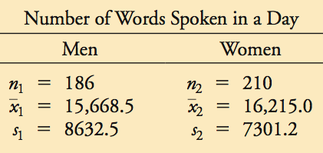
Example:
A headline in USA Today proclaimed that “Men, women are equal talkers.” That headline referred to a study of the numbers of words that samples of men and women spoke in a day. Given below are the results from the study. Use a 0.05 significance level to test the claim that men and women speak the same mean number of words in a day. Does there appear to be a difference?

Slide 13
Example:
Step 1: Requirements are satisfied: two population standard deviations are not known and not assumed to be equal, independent samples, simple random samples, both samples are large.
Step 2:
H₀ : μ₁ = μ₂ (original claim) H₁ : μ₁ ≠ μ₂
Step 3: Significance level is 0.05

Slide 14
Example:
Step 4: Calculate the test statistic

Slide 15
Example:
Step 5: (P-Value Method) Find the P-value in calculator with df = 185,
P-value = 2 ⋅ tcdf(–9999, –0.6755, 185) = 2(0.2501)
= 0.5002 > 0.05
Fail to reject H₀ .

Slide 16
Example:
Step 6: There is not sufficient evidence to warrant rejection of the claim that men and women speak the same mean number of words in a day. There does not appear to be a significant difference between the two means.

Slide 17
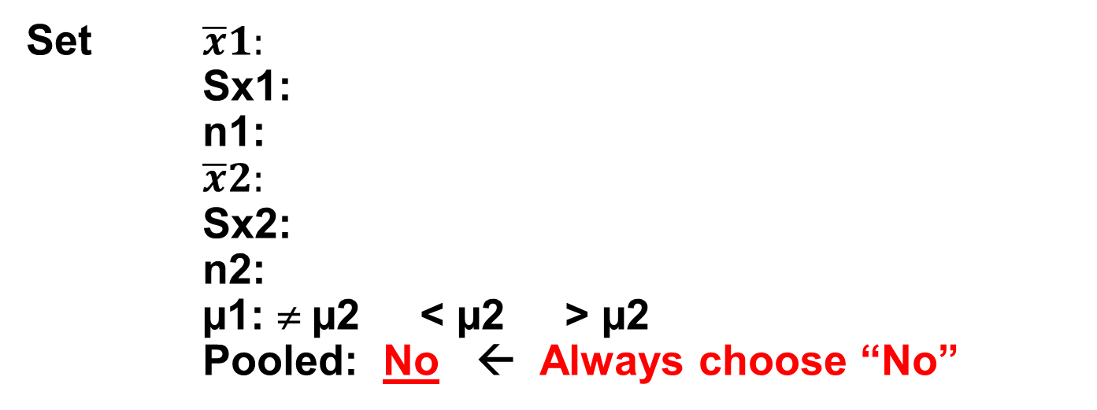
Short Cut:
Stat → Tests → 2-SampTTest
Two different input modes:
Data: If you have two sets of data values
Stats: If you have two sets of summary data values
Set $\overline{x}1:$
Sx1:
n1:
$\overline{x}2:$
Sx2:
n2:
µ1: ≠ µ2 < µ2 > µ2
Pooled: No ← Always choose “No”

Slide 18
Your Turn :
A researcher wishes to determine whether people with high blood pressure can reduce their blood pressure, measured in mm/Hg, by following a particular diet. Use a significance level of 0.01 to test the claim that the treatment group is from a population with a smaller mean than the control group.
a) State the null hypothesis and the alternative hypothesis.
H₀: μ₁ = μ₂
H₁: μ₁ < μ₂
b) What is/are the critical value(s)?
t* = invT(0.01, 99) = –2.364
Treatment Group | Control Group
n₁ = 101 | n₂ = 105
s₁ = 17.4 | s₂ = 30.2

Slide 19
c) Calculate the test statistic.
d) What is the P-value?
P-value = tcdf (–9999, –8.4256, 100) = 0 < 0.01
Reject H₀.
e) What is the conclusion?
There is sufficient evidence to support the claim that the treatment group is from a population with a smaller mean than the control group.

Slide 20
Your Turn: A researcher was interested in comparing the resting pulse rates of people who exercise regularly and of those who do not exercise regularly. Independent simple random samples of 16 people who do not exercise regularly and 12 people who exercise regularly were selected, and the resting pulse rates (in beats per minute) were recorded. The summary statistics are as follows.
Assume that human’s pulse rates are normally distributed. Use a 0.05 significance level to test the claim that the mean resting pulse rate of people who do not exercise regularly is larger than the mean resting pulse rate of people who exercise regularly.
a) State the null hypothesis and the alternative hypothesis.
H₀: μ₁ = μ₂
H₁: μ₁ > μ₂
b) What is/are the critical value(s)?
t* = invT(1 – 0.025, 11) = 2.201
Do not exercise regularly | Exercise regularly
n₁ = 16 | n₂ = 12
s₁ = 10.9 beats/min | s₂ = 8.2 beats/min

Slide 21
c) Calculate the test statistic.
d) What is the P-value?
P-value = tcdf (1.4683, 9999, 11) = 0.085 > 0.05
Fail to reject H₀.
e) What is the conclusion?
There is not sufficient evidence to support the claim that the mean resting pulse rate of people who do not exercise regularly is larger than the mean resting pulse rate of people who exercise regularly.

