Slide 1

Confidence Interval Estimate of μ₁ – μ₂: Independent Samples
Calculator Shortcut
STAT → TEST → 2-SampTInt
Input: Data -- for 2 data sets input
Input: Stats -- for 2 sets of summary
values
Always choose “NO” in “Pooled”

Slide 2
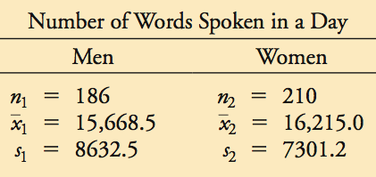
Example:
Using the sample data given in the previous Example, construct a 95% confidence interval estimate of the difference between the mean number of words spoken by men and the mean number of words spoken by women.

Slide 3
Example:
Requirements are satisfied as it is the same data as the previous example.
Find the margin of Error, E; We know df = 185,
then t_{α/2} = 1.9729,
Construct the confidence interval use
E = 1596.0637 and

Slide 4
Your Turn:
Using the sample data given in the following table, construct a 98% confidence interval estimate of the difference between the mean number of words spoken by men and the mean number of words spoken by women.
Treatment Group | Control Group
n₁ = 101 | n₂ = 105
s₁ = 17.4 | s₂ = 30.2
STAT → TEST → 2-SampTInt
The 98% CI for μ ₁ – μ ₂: ( –36.83, –20.77)
If we use the formula to find E and then to calculate CI, we get the 98% CI for μ ₁ – μ ₂: ( –36.8812, –20.7188).

Slide 5
Your Turn:
Using the sample data given in previous Example, construct a 95% confidence interval estimate of the difference between the mean number of words spoken by men and the mean number of words spoken by women.
Do not exercise regularly | Exercise regularly
n₁ = 16 | n₂ = 12
s₁ = 10.9 beats/min | s₂ = 8.2 beats/min
STAT → TEST → 2-SampTInt
The 95% CI for μ ₁ – μ ₂: ( –2.12, 12.72)
If we use the formula to find E and then to calculate CI, we get the 95% CI for μ ₁ – μ ₂: ( –2.6446, 13.2446).

Slide 6
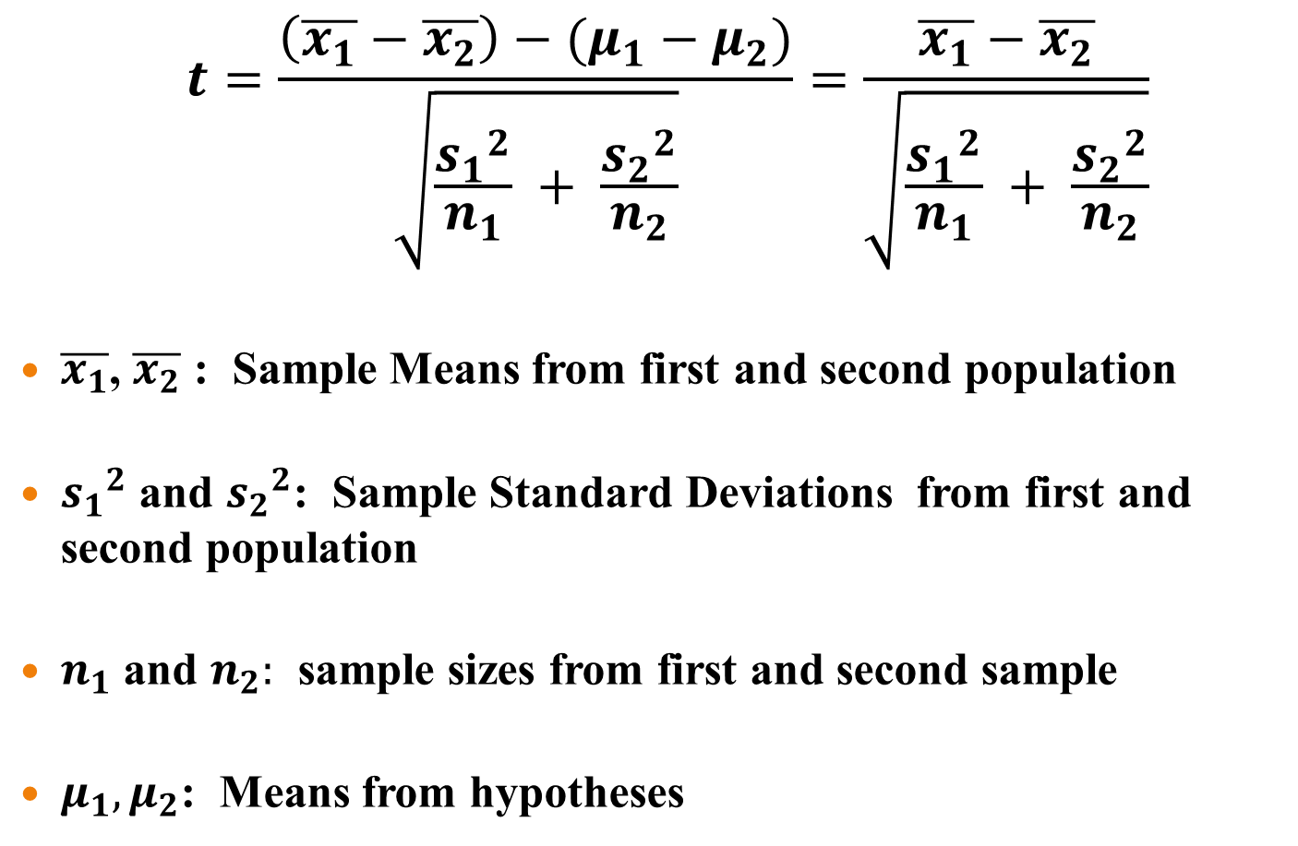
Test Statistic
        $$t=\frac{\left(\overline{x_{1}}−\overline{x_{2}}\right)−(μ_{1}−μ_{2})}{\sqrt{\frac{{s_{1}}^{2}}{n_{1}} + \frac{{s_{2}}^{2}}{n_{2}}}}=\frac{\overline{x_{1}}−\overline{x_{2}}}{\sqrt{\frac{{s_{1}}^{2}}{n_{1}} + \frac{{s_{2}}^{2}}{n_{2}}}}$$
$\overline{x_{1}}$, $\overline{x_{2}}$ : Sample Means from first and second population
${s_{1}}^{2}$ and ${s_{2}}^{2}$: Sample Standard Deviations from first and second population
$n_{1}$ and $n_{2}:$ sample sizes from first and second sample
$μ_{1}, μ_{2}$: Means from hypotheses

Slide 7
Example
As part of the National Health Survey, data were collected on the weights of men in two different age groups. For 804 men between 25-34, the mean is 176 pounds and the standard deviation is 35 pounds. For 1657 men aged 65-74, the mean and standard deviation are 164 pounds and 27 pounds.
Test (at .05 significance) the claim that old men weigh less than young men.

Slide 8
Example:
Requirements are satisfied since sample sizes are large enough.
Hypothesis: H₀: μ₁ = μ₂ H₁: μ₁ > μ₂
Significance level is α = 0.05
Use a t distribution
Calculate the test statistic

Slide 9
Example:
Find the P-value by test statistic.
tcdf(8.5636, 9999, 803) = 2.77E-17 ≈ 0
P-value = 2.77E-17 < 0.05
Because the P-value is less than the
significance level, reject the null hypothesis:
μ₁ = μ₂
There is sufficient evidence to support the claim that the mean weight of old men is less than that of young men.

Slide 10
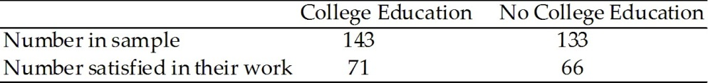
YOUR TURN!!!
The table below shows the number satisfied in their work in a sample of working adults with a college education and in a sample of working adults without a college education. Assume that you plan to use a significance level of α = 0.05 to test the claim that the proportion satisfied in their work in a sample of working adults with a college education is greater than the proportion satisfied in a sample of working adults without a college education. Assume both samples are simple random samples.

Slide 11
Your Turn:
Requirements are satisfied since SRS and 71, 66, 143 – 71 = 72, and 133 – 66 = 67 are all greater than 5.
Hypothesis: H₀: p₁ = p₂ H₁: p₁ > p₂
Significance level is α = 0.05
Use a normal distribution as an approximation to the binomial distribution.
Calculate the one of the test statistic

Slide 12
Your Turn:
Find the value of the test statistic.

Slide 13
Example:
Find the P-value by test statistic.
normalcdf(0.0044, 9999, 0, 1) = 0.4983
P-value = 0.4983 > 0.05
Because the P-value is greater than the
significance level, fail to reject the null hypothesis:
p₁ = p₂
There is not sufficient evidence to support the claim that working adults with a college education is greater than the proportion satisfied in a sample of working adults without a college education.

Slide 14
Your Turn:
A simple random sample of high-interest (8.9%) mortgages and low-interest (6.3%) mortgages were obtained. For the 40 high-interest mortgages, the borrowers had a mean FICO credit score of 594.8 and a standard deviation of 12.2. For the 40 low-interest mortgages, the borrowers had a mean FICO credit score of 785.2 and a standard deviation of 16.3 (based on data from USA Today). Use a 0.01 significance level to test the claim that the mean FICO score of the borrowers with high-interest mortgages is lower than the mean FICO score of the borrowers with low-interest mortgages.
a) State the null and alternative hypothesis.
H₀: μ₁ = μ₂
H₁: μ₁ < μ₂
b) Determine the critical value(s).
t* = invT(0.005, 39) = – 2.7079

Slide 15
c) Calculate the test statistic.
d) Determine the P – value.
P-value = tcdf (– 9999, –59.1451, 39) = 0 < 0.01
Reject H₀.
e) What is the conclusion?
There is sufficient evidence to support the claim that the mean FICO score of the borrowers with high-interest mortgages is lower than the mean FICO score of the borrowers with low-interest mortgages.

Slide 16
f) Determine
g) Find the margin of error.
h) Construct a 98% confidence interval estimate of the difference between the mean FICO credit score of borrowers with high interest rates and the mean FICO credit score of borrowers with low interest rates.
STAT → TEST → 2-SampTInt
The 98% CI for μ ₁ – μ ₂: ( –198.1, –182.7)
If we use the formula to find E and then to calculate CI, we get the 98% CI for μ ₁ – μ ₂: ( –199.1173, –181.6827).

Slide 17
Recap
In this section we have discussed:
Independent samples with the standard deviations unknown and not assumed equal.
Alternative method where standard deviations are known
Alternative method where standard deviations are assumed equal and sample variances are pooled.

Slide 18
Homework
P.482: 9, 13, 15, 20

