Slide 1

9-4: Inferences from Two Dependent Populations
College Prep Stats

Slide 2
Learning Targets
In this section we develop methods for testing hypotheses and constructing confidence intervals involving the mean of the differences of the values from two dependent populations.
With dependent samples, there is some relationship whereby each value in one sample is paired with a corresponding value in the other sample.

Slide 3
Dependent Populations
Specific situation in which each data value from one population is paired with another data value from the other population
Guarantees that the two populations are the same size
Considers the difference of the pairs to create a special new “difference population”
Instead of looking at each population separately

Slide 4
Notation for Dependent Samples
d = individual difference between the two values of a single matched pair
NOTE: ALWAYS SUBTRACT OLD DATA VALUES FROM NEW
µ_{d} = mean value of the differences d for the population of paired data
d = mean value of the differences d for the paired sample data (equal to the mean of the x – y values)
s_{d} = standard deviation of the differences d for the paired sample data
n = number of pairs of data.

Slide 5
Requirements
1. The sample data are dependent.
2. The samples are simple random samples.
3. Either or both of these conditions is satisfied: The number of pairs of sample data is large (n > 30) or the pairs of values have differences that are from a population having a distribution that is approximately normal.
Notes:
page 485 of Elementary Statistics, 10th Edition

Slide 6
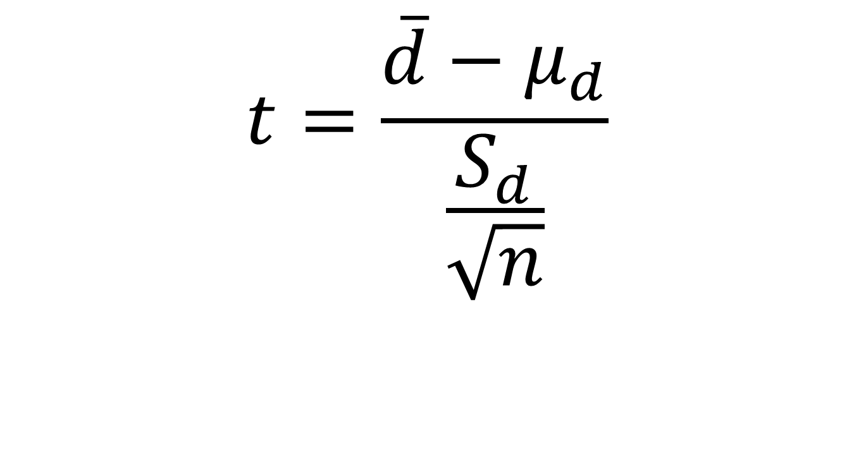
Test Statistic for Matched Pairs
The average difference between pairs (statistic)
Test Statistic (Tells you distribution for P-value)
The average difference between pairs (parameter)
Comes from hypotheses
Sample standard deviation of the differences from sample
The size of the two samples (remember they are each the same size)
where degrees of freedom = n – 1

Slide 7
P-values
Use Calculator to find the P-Value (t-distribution).
Notes:
page 485 of Elementary Statistics, 10th Edition
Hypothesis example given on this page

Slide 8
Confidence Intervals for Matched Pairs
d – E < µ_{d} < d + E
where E = t_{α / 2}
s_{d}
n
Critical values of t_{α/2} : Use Calculator with n – 1 degrees of freedom.

Slide 9
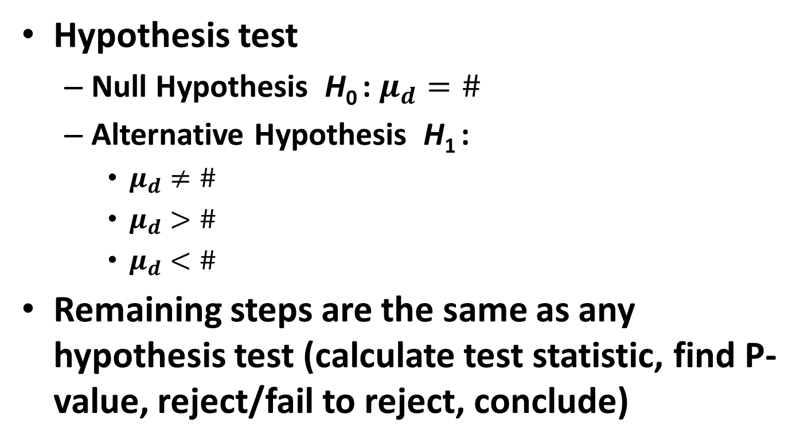
Method
The average difference between pairs (parameter)
Hypothesis test
Null Hypothesis H₀ : $μ_{d}=\#$
Alternative Hypothesis H₁ :
$μ_{d}≠\#$
$μ_{d}>\#$
$μ_{d}<\#$
Remaining steps are the same as any hypothesis test (calculate test statistic, find P-value, reject/fail to reject, conclude)
0 unless given a specific difference to consider

Slide 10
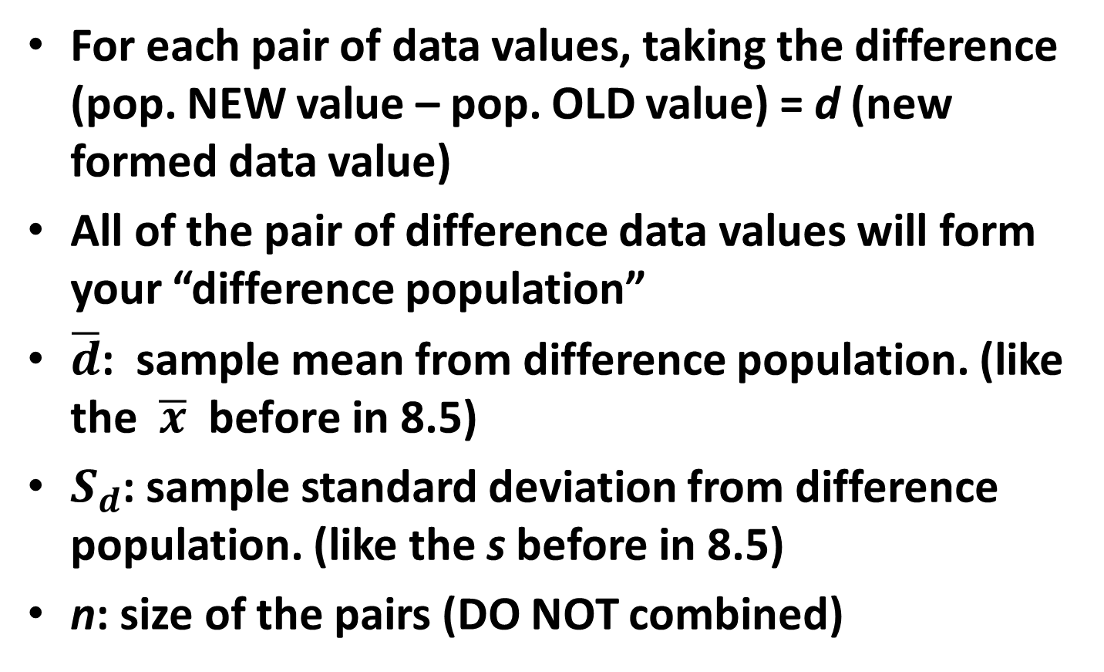
How to find parts of test statistic
For each pair of data values, taking the difference (pop. NEW value – pop. OLD value) = d (new formed data value)
All of the pair of difference data values will form your “difference population”
$\overline{d}$: sample mean from difference population. (like the $\overline{x} \text{before} \text{in}\text{ 8.5)}$
$S_{d}$: sample standard deviation from difference population. (like the s before in 8.5)
n: size of the pairs (DO NOT combined)

Slide 11
P-values and Critical Values
P-values: Use the tcdf feature on your calculator, with degrees of freedom (df) = n – 1.
For right-tailed tests:
*To find this probability in your calculator, type: tcdf(t test statistic, 9999, df)
For left-tailed tests:
*To find this probability in your calculator, type: tcdf(–9999, t test statistic , df)
***Don’t forget if your test is two-sided, double your P-value.***
Critical Values: Use the invT feature on your calculator, with degrees of freedom (df) = n – 1.
For right-tailed tests:
*α is in the right tail, invT(1 – α, df)
For left-tailed tests:
*α is in the left tail, invT(α, df)
For two-tailed tests:
*α is split evenly in the two tails, invT(α/2, df)
(remember that this t* value is ±, not the negative that the calculator gives you)
Notes:
page 485 of Elementary Statistics, 10th Edition
Hypothesis example given on this page

Slide 12
Example 1:
Data Set 3 in Appendix B includes measured weights of college students in September and April of their freshman year. Table 9-1 lists a small portion of those sample values. (Here we use only a small portion of the available data so that we can better illustrate the method of hypothesis testing.) Use the sample data in Table 9-1 with a 0.05 significance level to test the claim that for the population of students, the mean change in weight from September to April is equal to 0 kg.

Slide 13
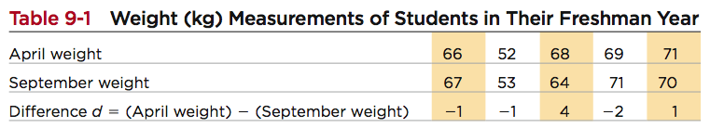
Example 1:
Step 1: Requirements are satisfied: samples are dependent, values paired from each student; although a volunteer study, we’ll proceed as if simple random sample and deal with this in the interpretation; calculator displays a histogram of difference data values that is approximately normal.

Slide 14
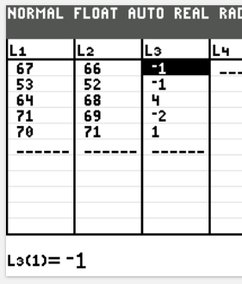
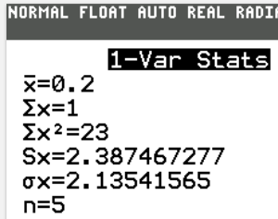
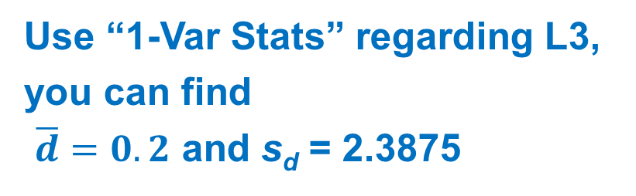
Example 1:
Weight gained = April weight – Sept. weight
μ_{d} denotes the mean of the “April – Sept.” differences in weight; the claim is μ_{d} = 0 kg
In your calculator, input Sept. weight
into L1, input April weight into L2
Go to L3 and highlighted L3, then type:
L2 – L1
L3 now is your difference data values d
Use “1-Var Stats” regarding L3,
you can find
$\overline{d}=0.2$ and s_{d} = 2.3875

Slide 15
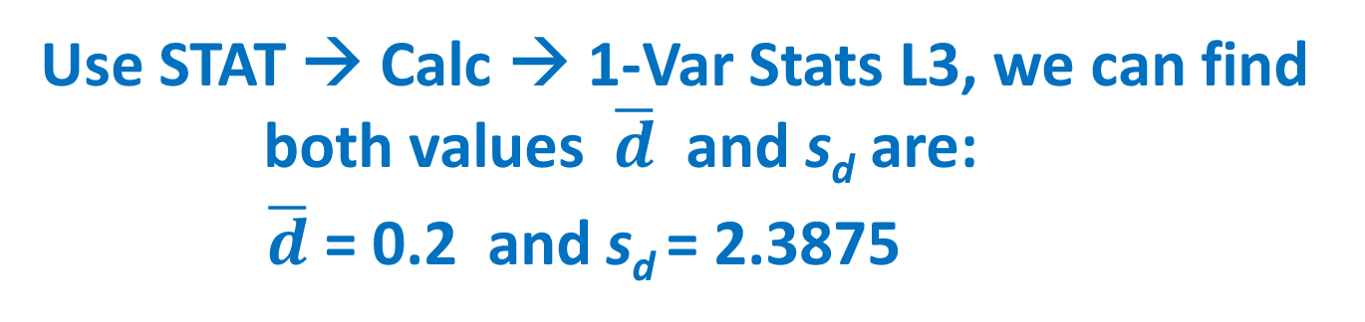
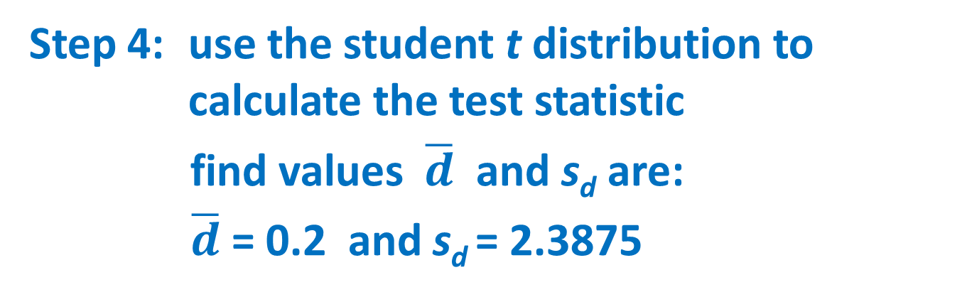
Example 1:
Step 2: H₀: μ_{d} = 0 kg (original claim) H₁: μ_{d} ≠ 0 kg
Step 3: significance level is α = 0.05
Step 4: use the student t distribution to calculate the test statistic
find values $\overline{d}$ and s_{d} are:
$\overline{d}$ = 0.2 and s_{d} = 2.3875
Use STAT → Calc → 1-Var Stats L3, we can find both values $\overline{d}$ and s_{d} are:
$\overline{d}$ = 0.2 and s_{d} = 2.3875

Slide 16
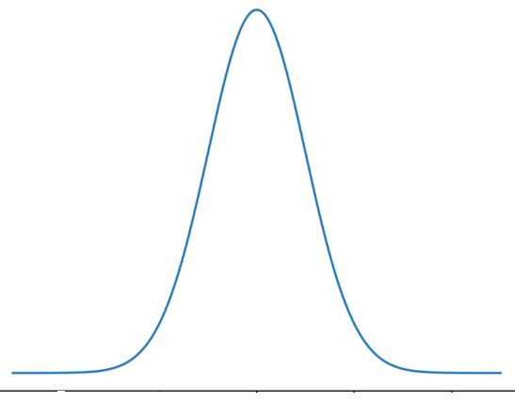
Example 1:
Step 4: find the test statistic
Calculator: df = n – 1 = 4, label the test
statistic on the diagram
0.1873

Slide 17
Example 1:
Step 5: find P-values of test statistic.
tcdf(0.1873, 9999, 4) = 0.4303
Calculator: df = n – 1 = 4, label
the test statistic on the diagram
Two tailed test
P-value = 0.4303 *2 = 0.8606 > 0.05
0.1873
Because the P-value is greater than the
significance level, fail to reject the null
hypothesis:
H₀: μ_{d} = 0 kg

Slide 18
Example 1:
Step 6: We conclude that there is not sufficient evidence to warrant rejection of the claim that for the population of students, the mean change in weight from September to April is equal to 0 kg. Based on the sample results listed in Table 9-1, there does not appear to be a significant weight gain from September to April.

Slide 19
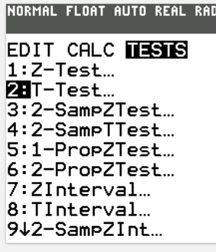
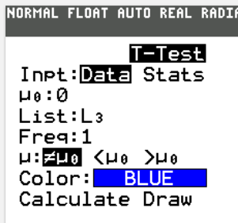
Short Cut in the calculator
This type of test usually is based on the two sets of dependent data values. We usually store the old/early data values into L1, and store the new/later data values into L2.
Then store L2 – L1 into L3. Or,
L3 = L2 – L1
STAT → TESTS → T-Test use the
“data” input mode pointing to L3

Slide 20
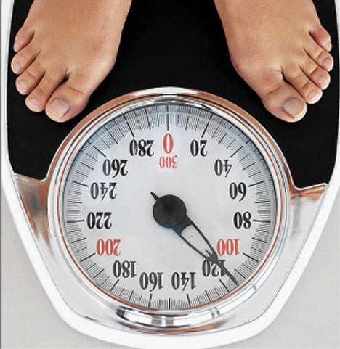
Example 2
A sample of Freshman at Rutgers University were weighed in both August and May to determine if the “freshmen 15” is true. The data values are paired with August weight and May weight. Test the claim (at 0.05 significance) that the amount of weight gained is equal to 15 pounds (6.8 kg). Assume
the difference of weight of
students is normally distributed.

Slide 21
Data for Example 2 (kg’s)
August | May
72 | 59
97 | 86
74 | 69
93 | 88
68 | 64
59 | 55
64 | 60
56 | 53
70 | 68
58 | 56
50 | 47
71 | 69
August | May
67 | 66
56 | 55
70 | 68
61 | 60
53 | 52
92 | 92
57 | 58
67 | 67
58 | 58
49 | 50
68 | 68
69 | 69
1 kg = 1000 g, 1 Lb = 454 g

Slide 22
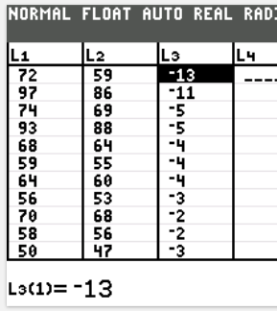
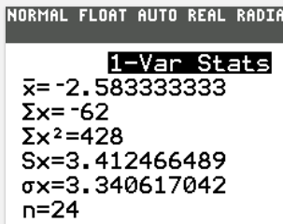
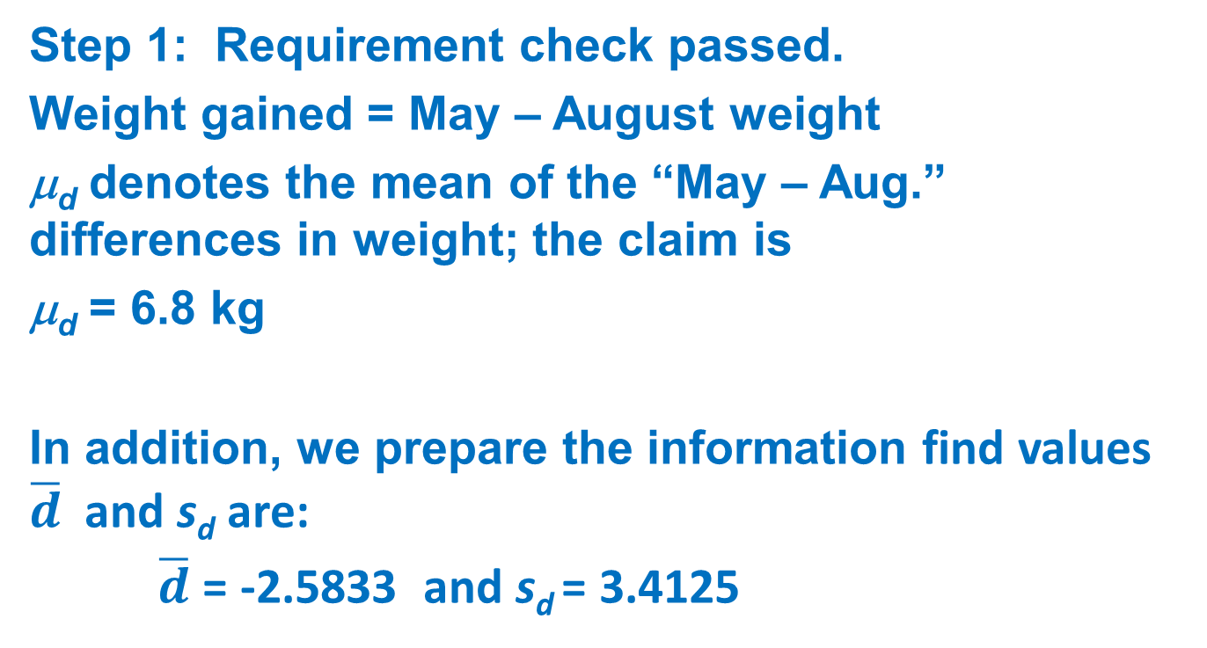
Example 2:
Step 1: Requirement check passed.
Weight gained = May – August weight
μ_{d} denotes the mean of the “May – Aug.” differences in weight; the claim is
μ_{d} = 6.8 kg
In addition, we prepare the information find values $\overline{d}$ and s_{d} are:
$\overline{d}$ = -2.5833 and s_{d} = 3.4125

Slide 23

Example 2:
Step 2: claim is μ_{d} = 6.8 kg
Step 2: H₀: μ_{d} = 6.8 kg original claim H₁: μ_{d} ≠ 6.8 kg
Step 3: significance level is α = 0.05
Step 4: find values $\overline{d}$ and s_{d} are:
$\overline{d}$ = -2.5833 and s_{d} = 3.4125

Slide 24
Example 2:
Step 5: find P-values of test statistic.
tcdf(–9999, –13.4708, 23) ≈ 1.06E-12 ≈ 0
P-value ≈ 1.06E-12 * 2 = 2.12E-12 ≈ 0 < 0.05
Because the P-value is less than the
significance level, reject the null hypothesis: H₀: μ_{d} = 6.8 kg
Step 6: We conclude that there is sufficient evidence to warrant rejection of the claim that the amount of weight gained is equal to 15 pounds(6.8 kg).

Slide 25
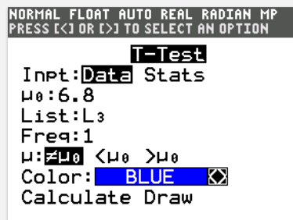
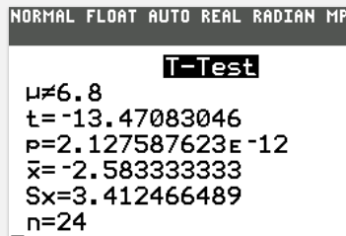
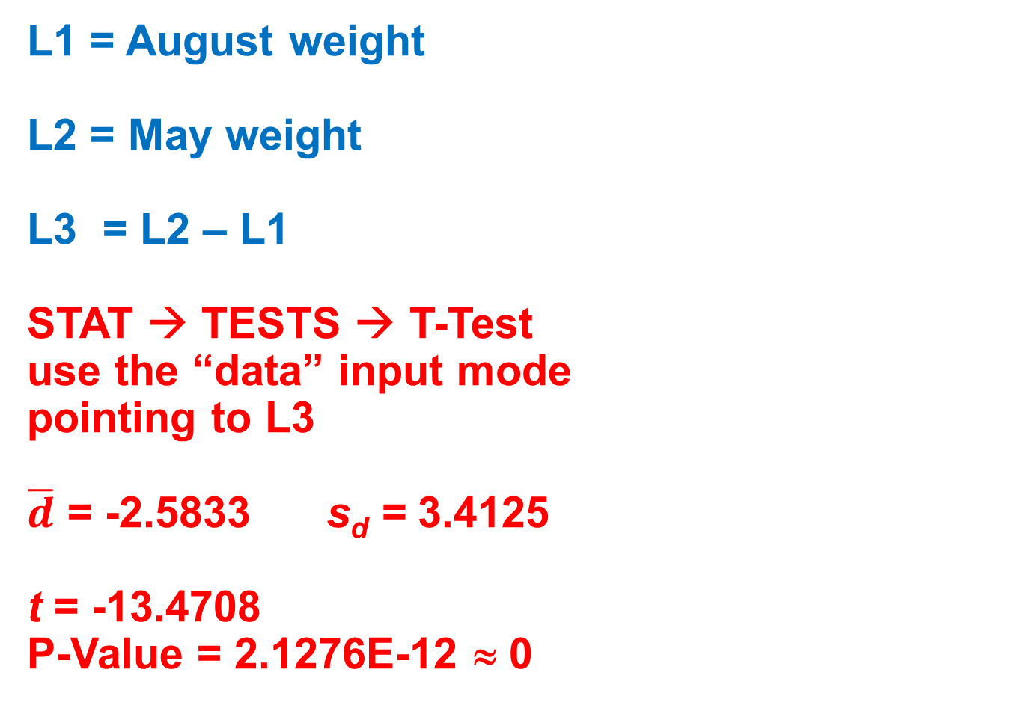
Example 2:
Use the “Short Cut” to do it again:
L1 = August weight
L2 = May weight
L3 = L2 – L1
STAT → TESTS → T-Test
use the “data” input mode
pointing to L3
$\overline{d}$ = -2.5833 s_{d} = 3.4125
t = -13.4708
P-Value = 2.1276E-12 ≈ 0

