Slide 1
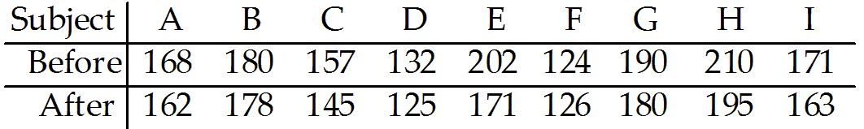
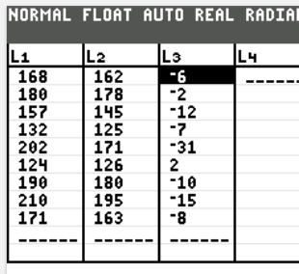

Your Turn:
The following table shows the weights of nine subjects from SRS before and after following a particular diet for two months. You wish to test the claim that the diet is effective in helping people lose weight at the 0.01 significance level. Assume the difference of the sample data from an approximately normal distribution.
a) State the null hypothesis and the alternative hypothesis.
H₀: μ_{d} = 0
H₁: μ_{d} < 0

Slide 2
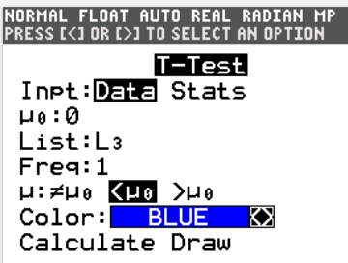
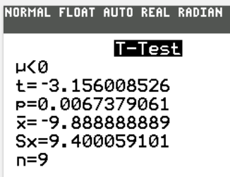
c) Find the critical value(s).
invT(0.01, 8) = –2.8965
d) Find the test statistic.
e) Find the p-value.
P-value = tcdf(– 9999, – 3.156, 8) = 0.0067,
Reject H₀.
f) What is the conclusion?
There is sufficient evidence to support the claim that the diet is effective in helping people lose weight.

Slide 3
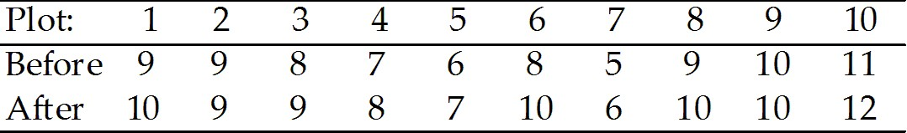
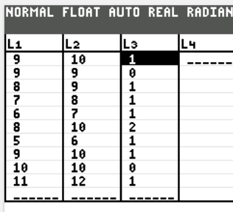
Your Tuen:
A farmer has decided to use a new additive to grow his crops. He divided his farm into 10 plots and kept records of the corn yield (in bushels) before and after using the additive. The results are shown below.
Assume the difference of the sample data from a SRS and follows an approximately normal distribution. The farmer wants to test the new additive is effective at the 0.01 level of significance.
a) State the null hypothesis and the alternative hypothesis.
H₀: μ_{d} = 0
H₁: μ_{d} > 0

Slide 4
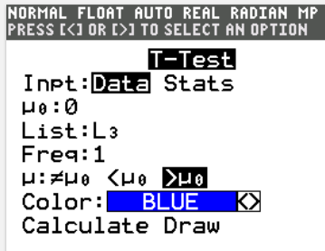
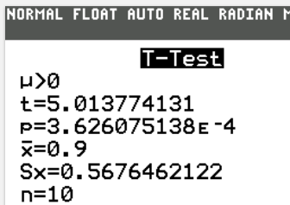
c) Find the critical value(s).
invT(1 – 0.01, 9) = 2.821
d) Find the test statistic.
e) Find the p-value.
P-value ≈ 0.00036 < 0.01,
Reject H₀.
f) What is the conclusion?
There is sufficient evidence to support that the new additive is effective.

Slide 5
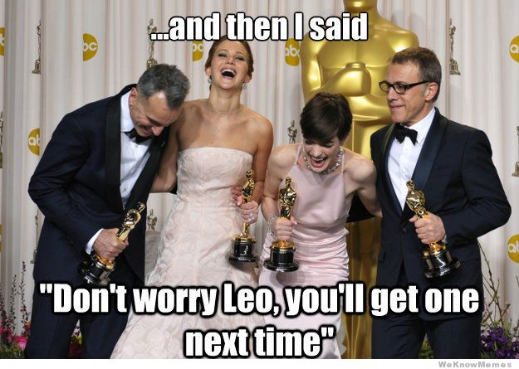
Example 3
Are best actresses younger than best actors? ( = average of (actresses age – actors age) < 0)
At the 0.05 significance level, test the claim that best actresses are younger than best actors. The age at the time of winning the award is given paired with the other winner from the same year.

Slide 6
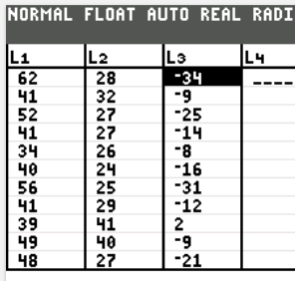
Data for Example 3
Actress: 28, 32, 27, 27, 26, 24, 25, 29, 41, 40, 27, 42, 33, 21, 35
Actor: 62, 41, 52, 41, 34, 40, 56, 41, 39, 49, 48, 56, 42, 62, 29
Assume that the pairs of ages have differences that are from an SRS and a population having a distribution that is approximately normal.

Slide 7
Example 3:
Step 1: Requirements are satisfied. Note: the pairs of data are not the same person or same movie, but each pair relates to the same year’s award.
Age difference = Actress age – Actor age,
μ_{d} denotes the mean of the age differences between actors and actresses, the claim means μ_{d} < 0
Step 2: H₀: μ_{d} = 0 yr.
H₁: μ_{d} < 0 yr. (original claim)
Step 3: significance level is α = 0.05
Step 4: find the test statistic

Slide 8
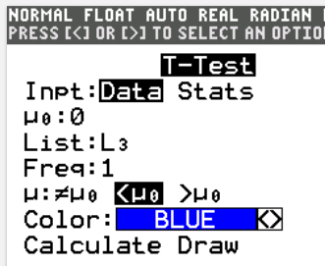
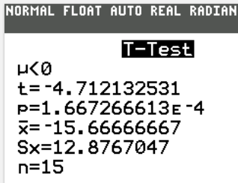

Example 3:
Step 4: find values $\overline{d}$ and s_{d} are:
$\overline{d}$ = -15.6667 and s_{d} = 12.8767

Slide 9
Example 3:
Step 5: find P-values of test statistic.
tcdf(- 9999, - 4.7121, 14) = 0.00017
P-value = 0.00017 < 0.05
Because the P-value is less than the
significance level, reject the null hypothesis: H₀: μ_{d} = 0 yr.
Step 6: We conclude that there is sufficient evidence to support the claim that best actresses are younger than best actors at the time of winning the award.

Slide 10
Confidence Intervals for Matched Pairs

Slide 11
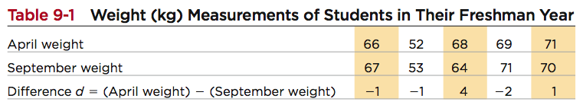
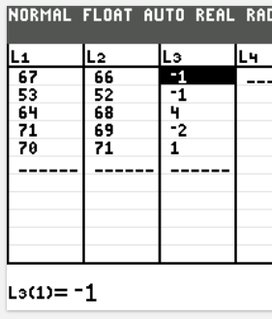
Example 4: Example 1 data
Construct a 95% confidence interval estimate of μ_{d} , which is the mean of the “April–September” weight differences of
college students in their freshman year.
= 0.2, s_{d} = 2.4, n = 5, t_{α /2} = 2.7764
Find the margin of error, E

Slide 12
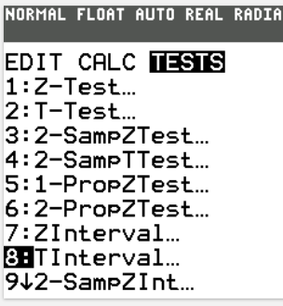
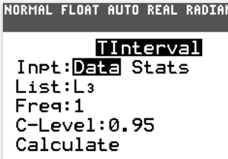
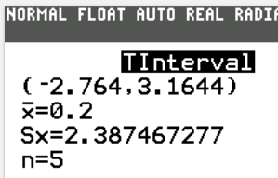
Confidence Intervals for Matched Pairs
Construct the confidence interval:
We have 95% confidence that the
limits of 2.8 kg and 3.2 kg contain
the true value of the mean weight
change from September to April.
In the long run, 95% of such samples
will lead to confidence interval limits
that actually do contain the true
population mean of the differences.

Slide 13
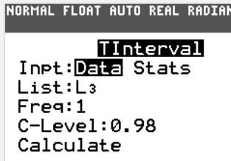
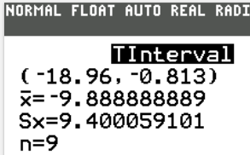
Your Turn:
The following table shows the weights of nine subjects from SRS before and after following a particular diet for two months. You wish to construct a 98% confidence interval estimate of µ_{d}, which is the mean of the weight differences for a particular diet. Assume the difference of
the sample data from an approximately normal distribution.
Remember that your critical value must be POSITIVE!!
t_{α/2} = invT(1 – 0.01, 8) = 2.8965
(–9.8889 – 9.0756, –9.8889 + 9.0756)
(–18.9645, –0.8133)

Slide 14
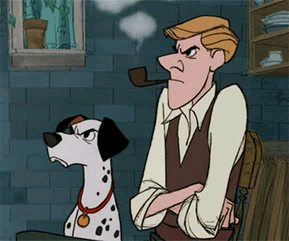
Your Turn
Below is paired data the amount of seconds in which tobacco or alcohol is used in selected Disney films (from the same movie). At 0.05 significance, test the claim that there is more tobacco use than alcohol use.
Assume requirements are all satisfied.
Is there more tobacco use than alcohol use in Disney movies?
Tobacco | 176 | 51 | 0 | 299 | 74 | 2 | 23 | 205 | 6 | 155
Alcohol | 88 | 33 | 113 | 51 | 0 | 3 | 46 | 73 | 5 | 74

Slide 15
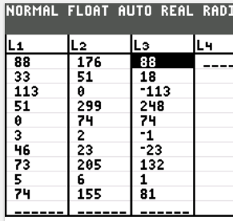
Your Turn
Step 1: Time difference = Tobacco time – Alcohol time,
μ_{d} denotes the mean of the time
differences between tobacco and
alcohol in second.
Note: “more tobacco time than alcohol time” means μ_{d} > 0
Step 2: H₀: μ_{d} = 0 sec. H₁: μ_{d} > 0 sec. (original claim)
Step 3: significance level is α = 0.05
Step 4: find the test statistic

Slide 16
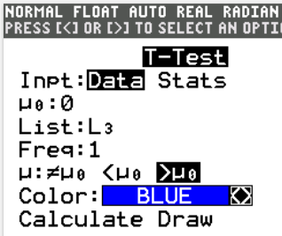
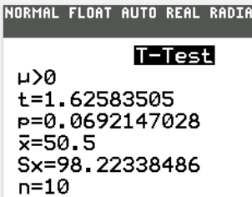

Your Turn
Step 4: find values $\overline{d}$ and s_{d} are:
$\overline{d}$ = 50.5 and s_{d} = 98.2234

Slide 17
Your Turn
Step 5: find P-values of test statistic.
tcdf(1.6258, 9999, 9) = 0.0692
P-value = 0.0692 > 0.05
Because the P-value is greater than
the significance level, fail to reject the null
hypothesis: H₀: μ_{d} = 0 sec.
Step 6: There is not sufficient evidence to support the claim that tobacco use is longer than alcohol use in the Disney movie.

Slide 18
Recap
In this section we have discussed:
Requirements for inferences from matched pairs.
Notation.
Hypothesis test.
Confidence intervals.

Slide 19
Homework
P.495: #14, 15, 18a

