Slide 1
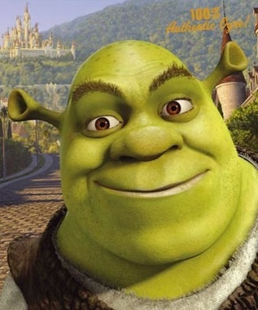
Satire (high comedy)
Shrek

Slide 2
Shrek – Clip https://www.youtube.com/watch?v=bkJxK2V8fHY
The clip depicts the capture of Princess Fiona by Robin Hood, who mistakenly thinks that the Princess has been taken against her will by the ogre, Shrek. After "rescuing" the princess, Robin Hood and his Merry Men pause to introduce themselves by performing a ridiculous song and dance number. In the middle of the routine, Princess Fiona screams, "That's enough!" and single handedly attacks and subdues Robin Hood and all of his Merry Men.

Slide 3
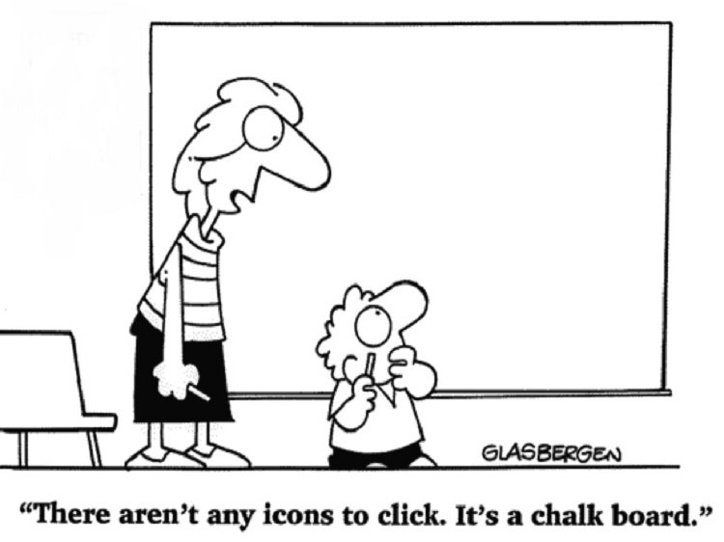
Satire
A literary work
that ridicules its
subject through
the use of techniques such as exaggeration, reversal, incongruity, and/or parody in order to make a comment or criticism about it.

Slide 4
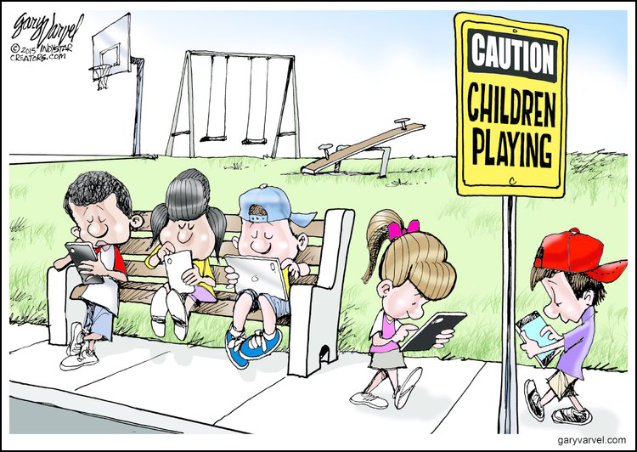
Four Techniques of Satire
Exaggeration
To enlarge,
increase,
or represent
something
beyond normal bounds so that it becomes ridiculous and its faults can be seen.

Slide 5
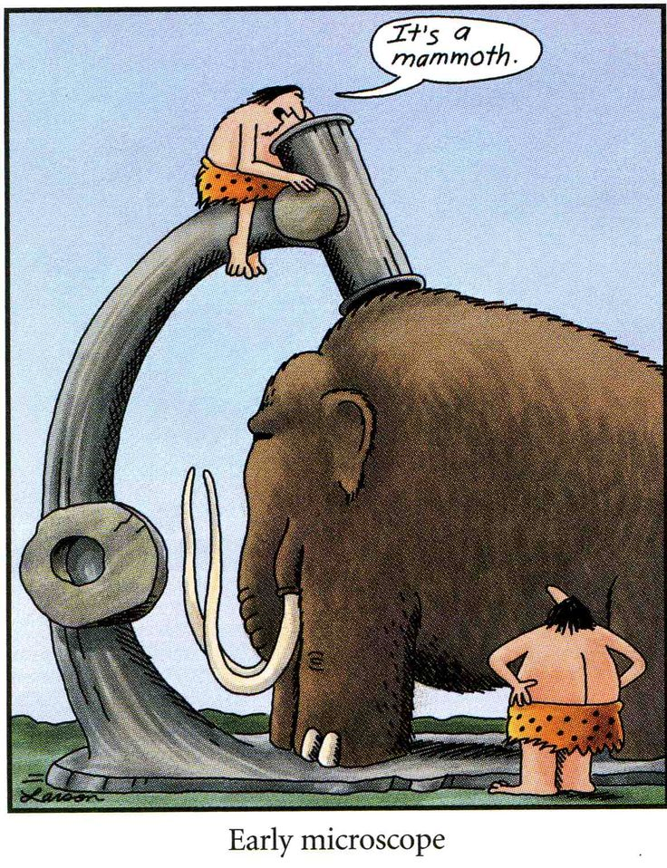
Incongruity
To present
things that
are out of
place or are
absurd in
relation to its surroundings.

Slide 6
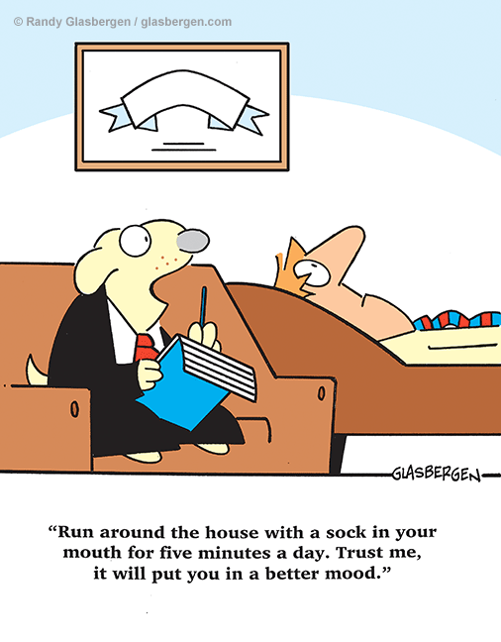
Reversal
To present the
opposite of
the normal
order (e.g.,
the order of
events,
hierarchical
order).

Slide 7
Parody
To imitate the techniques and/or style of some person, place, or thing, normally for comic effect.
(note: A satire is intended to do more than just entertain – it tries to improve humanity and its institutions.

Slide 8
Shrek clip - https://www.youtube.com/watch?v=bkJxK2V8fHY
How are each of the techniques used in the video clip?
Exaggeration
Incongruity
Reversal
Parody

Slide 9
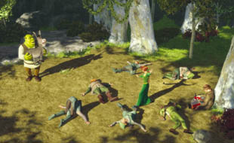
Satire answers
Exaggeration
Princess Fiona fights and successfully defeats Robin Hood and all of his Merry Men without any help and without any weapons.

Slide 10
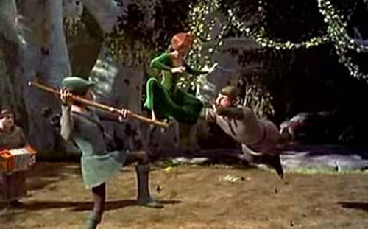
Incongruity
Princess Fiona uses her ponytail to deliver a knockout punch to one of the Merry Men. While frozen in a mid-air martial arts kick, Princess Fiona pauses to fix her disheveled hair before knocking out two of the Merry Men.

Slide 11
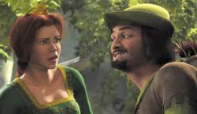
Reversal
The roles of the hero and the damsel in distress have been reversed. In this clip, it is Princess Fiona, the rescuee, who fights and defeats the foe.

Slide 12
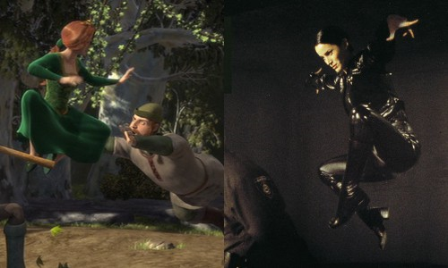
Parody
The fight scene is an exaggerated imitation of the martial arts style and special effects used in movies such as The Matrix and Crouching Tiger, Hidden Dragon.

Slide 13
What is the primary comment or criticism about society that is being made by the satirical techniques in this clip from Shrek?

Slide 14
Possible Answers
The traditional story of the knight rescuing the damsel-in-distress is not a realistic depiction of the roles filled by men and women in modern society.
Current Hollywood action movies like The Matrix have become ridiculous because they are too focused on special effects.

