Slide 1
Evidence for Common Decent (Macroevolution)
All living things on earth are related and come from a common ancestor

Slide 2
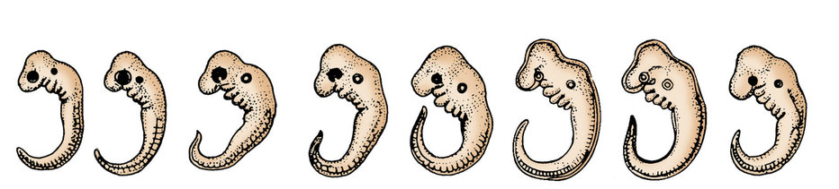
Comparative Embryology: comparing and contrasting embryos of different organs
A B C D E F G H

Slide 3
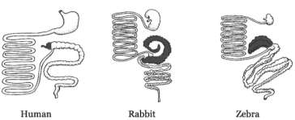
Vestigial Organs: organs from evolution that are no longer important, but were important to their ancestors

Slide 4
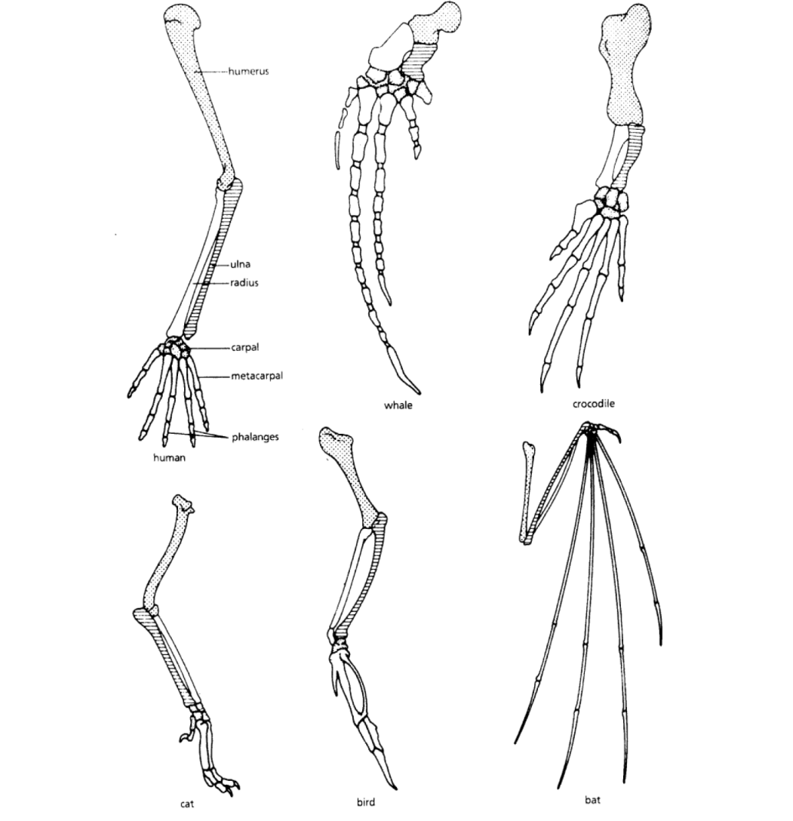
Homologous Structures: organs or bones that are common in different organisms

Slide 5
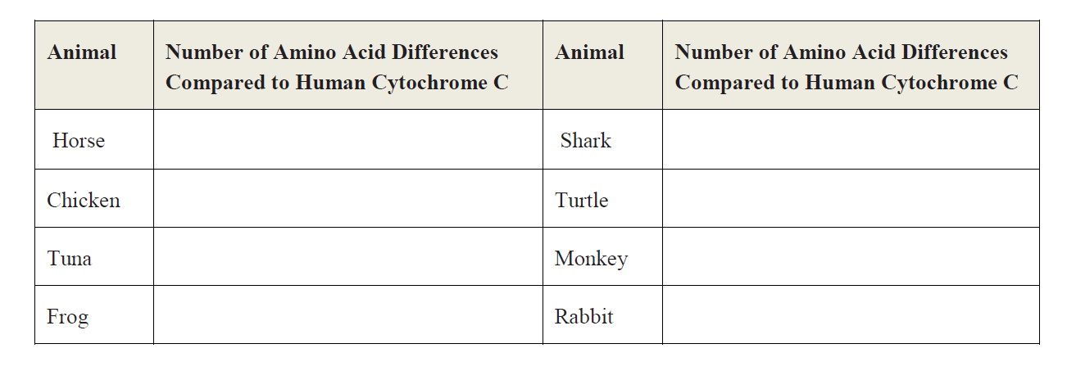
Comparative DNA: comparing DNA, genes, amino acids and proteins

