Slide 1
Medical Terminology
Therm/o/meter

Slide 2
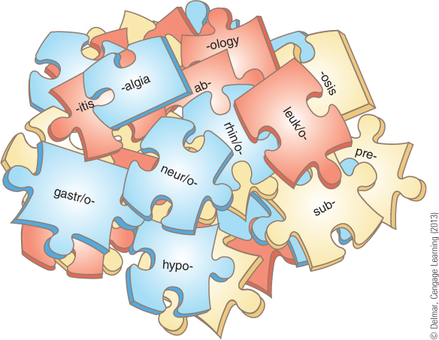
Word Parts are the Key
Four basic types of word parts are used to
create complex medical terms:
    Word roots
    Combining forms
    Suffixes
    Prefixes

Slide 3
Word Roots:
usually indicate the part of the body involved
Examples:
cardi = heart
gastr = stomach
  neur = nerve

Slide 4
Combining Forms
Created by adding a vowel (usually the letter “o”) to the end of a word root.
Examples:
Gastr/o Stomach
Cardi/o Heart
Arthr/o Joint
Cephal/o Head

Slide 5
Prefixes
Added to the beginning of a term
Prefixes are used to modify the meaning of the word usually, indicating location, time, number, or status.
Examples:
Hyper- (excessive)
Pre- (before)
Post- (after)
Homo- (same)
Hypo- (under)

Slide 6
Suffixes
Added to the end of a term
Suffixes are used to modify the meaning of the word indicating the procedure, condition, disorder, or disease.
Examples:
-itis inflammation
-logy study of
-tomo to cut

Slide 7
Adjective Suffixes
meaning –pertaining to
-ac
-al
-an
-ar
-ary
-atic
-eal
-iac
-ic
-ile
-ine
-ior
-nic
-ory
-ose
-ous
-tic

Slide 8
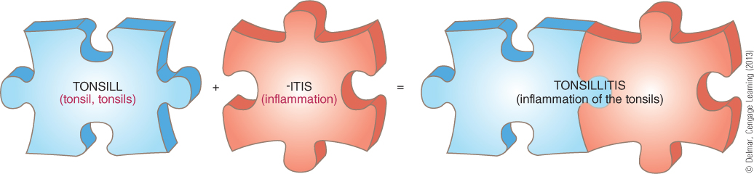

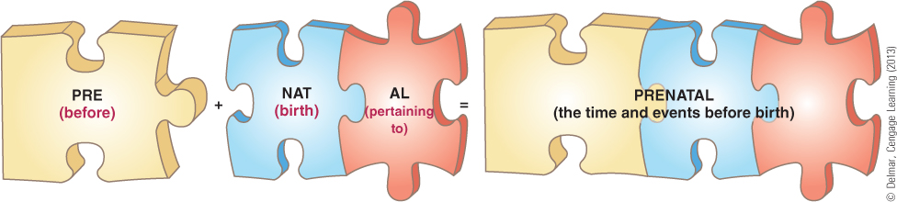

Slide 9
Sub/gastr/algia
sub-
+
gastr/
+
-algia
(under)
(stomach)
(pain)
prefix
root
suffix
2
3
1

Slide 10
Trans/cardi/o/pulmon/itis
trans-
+
cardi/o
+
pulmon/
+
-itis
(across)
(heart)
(lungs)
(inflam.)
prefix
root
root
suffix
2
3
4
1

Slide 11
Peri/oste/o/arthr/o/megaly
peri-
+
oste/o
+
arthr/o
+
-megaly
(around)
(bone)
(joints)
(enlargement)
prefix
root
root
suffix
2
4
1
3

