Slide 1
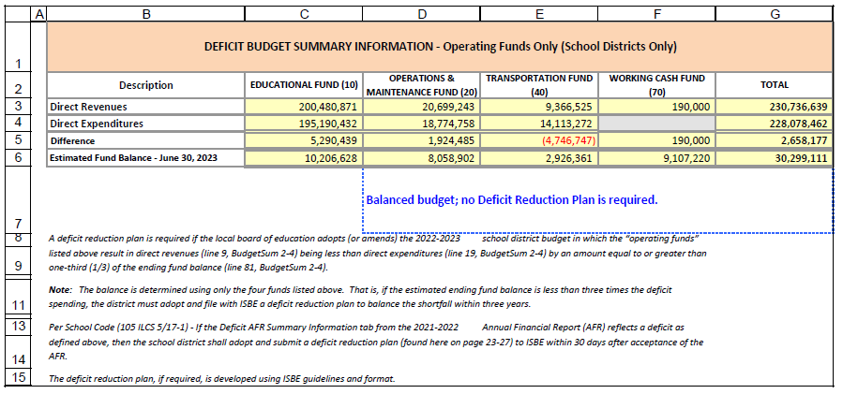
ISBE Budget Form: Budget Summary for FY23
1
Notes:
Presenter
2021-09-27 20:09:01
--------------------------------------------
Unique to our district

