Slide 1
African Imperialism
Objective:
→ Students will be able to analyuze the causes of imperialism in Africa
→ Students will be able to compare and contrast the different countries’ goals in imperializing

Slide 2
Let’s take a step back
Think back to our unit on Exploration.
What were the three motives for exploration?
--Hint: The three Gs

Slide 3
Exploration → Imperialism
What is imperialism?
When one country takes control of another country, A more powerful country dominates the political, economic, or cultural affairs of a weaker country
1- Gold → Economic, in some cases the countries were in search of gold but also for resources
2- Glory → Political, instead of one explorer gaining fame, countries started to gain more power
3- God → Cultural, countries felt responsible for spreading Christianity and their way of life

Slide 4
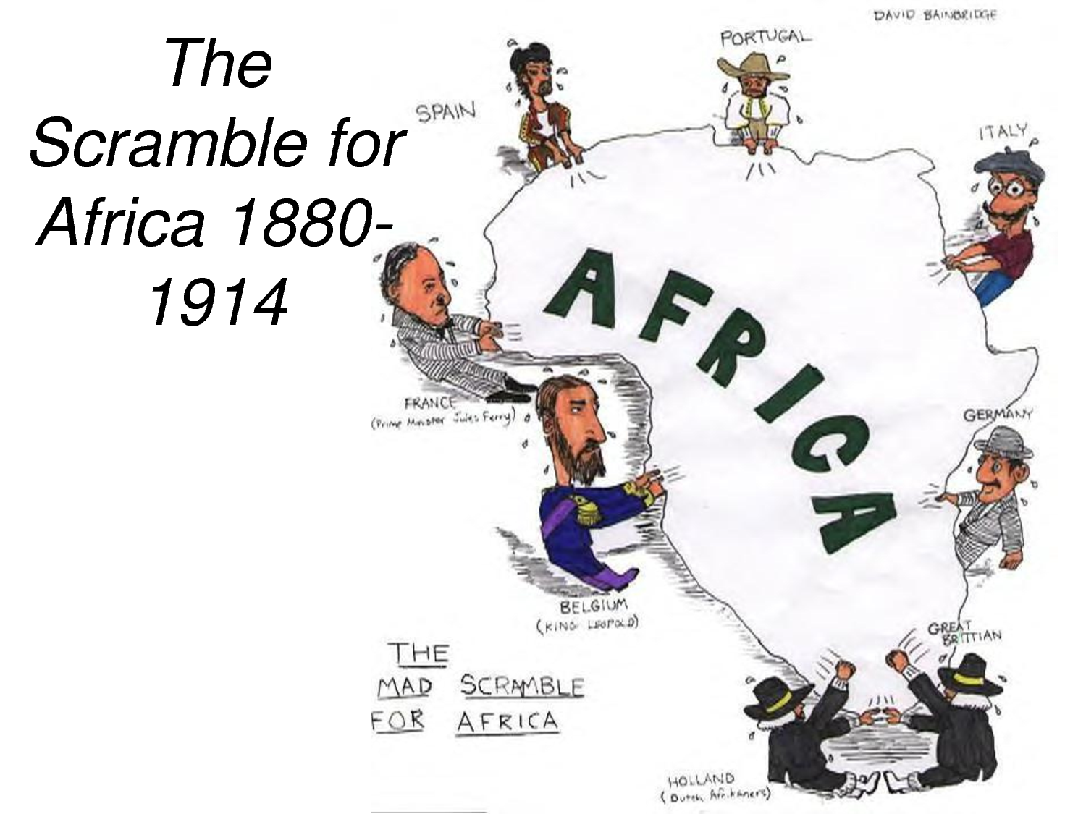

Slide 5
European
Nationalism
Source for
Raw
Materials
Industrial
Revolution
Missionary
Activity
European
Motives
For Colonization
Markets for
Finished
Goods
Military
& Naval
Bases
Social
Darwinism
European
Racism
Places to
Dump
Unwanted/
Excess Popul.
Humanitarian
Reasons
Soc. & Eco.
Opportunities
“White
Man’s
Burden”

Slide 6
Scramble for Africa
--European nations started to compete for resources and power in Asia and specifically Africa.
--In this simulation, you and your group members are going to have a chance to act as these European nations and divide up Africa.

Slide 7
Pre-Questions
Answer the pre-activity questions. Be sure to answer them completely.

Slide 8
Directions
It is the latter part of the 19th century. You are entering a scramble for colonies in Africa. In order to participate in this race, you must carefully consider the geography of Africa.
Countries will be claiming colonies in the order presented. Your goal is to get the best land, minerals, and resources that you can. Remember to choose places that will be easy to manage from a great distance, that will be profitable, or at least useful.

Slide 9
Directions
You and your partner will be given a map of Africa. As we read through the Imperialism Journey you and your partner will be given a certain number of squares per country to use in the most appropriate ways.
--Be sure to always have two or more squares together
--If you feel the need to cut squares in half, you may do so.
--Be sure to pay attention to the symbols on the map, these symbols represent resources that countries may desire

Slide 10
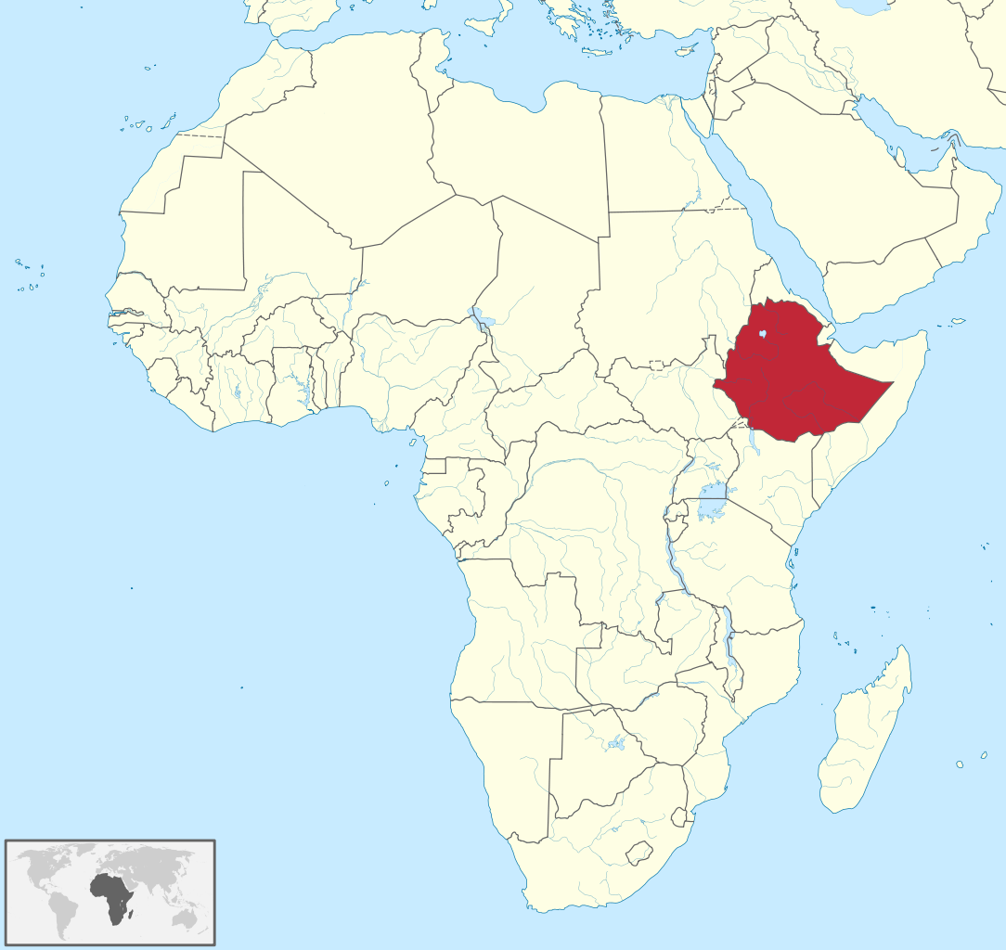
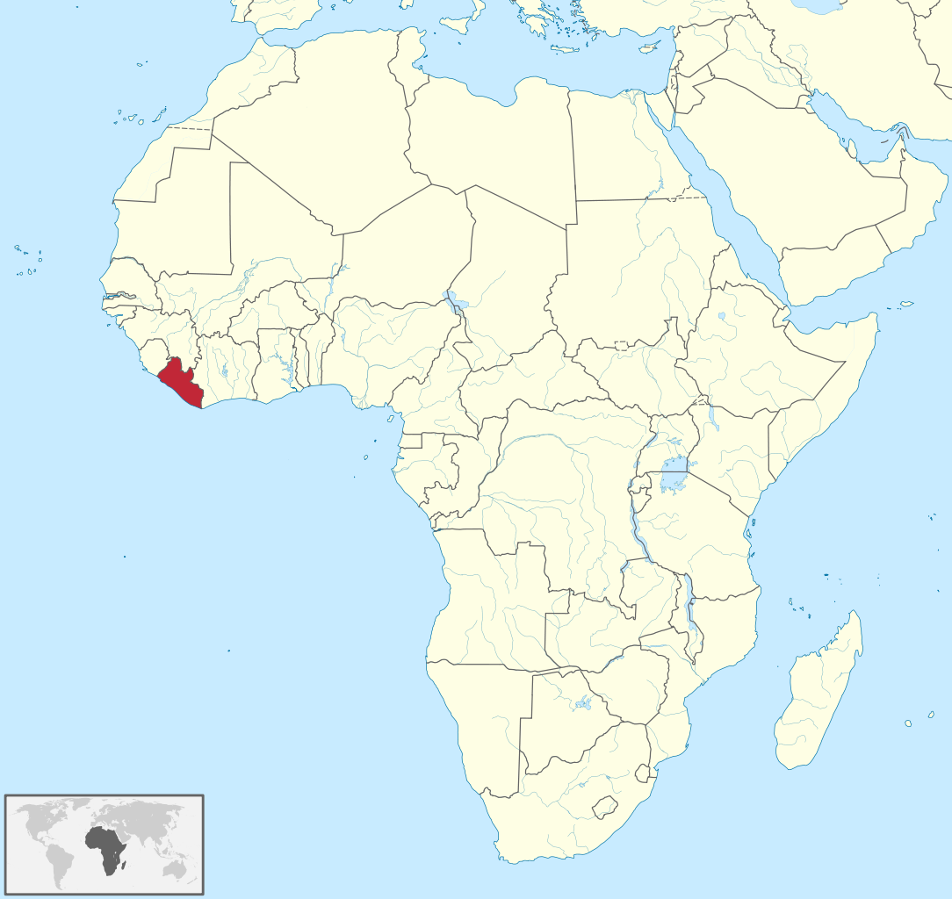
To start… using your black colored pencil
You need to mark off Ethiopia, since it is an independent
kingdom that is several thousands years old. (4 squares)
You also need to mark off Liberia since it was an
independent nation founded by freed American
slaves in 1847. (3 squares)

Slide 11
Portugal --- Using your red color pencil
You are the first to explore Africa.. Your goal is to establish your imperial colonies along the coastal areas. You wouldn’t want to explore too far inland due to diseases that you are not able to combat. This does not bother you much, since you primarily want good ports to further your trade with the Far East making ports below the equator most desirable.
Hint: you may want to establish your ports on opposite sides of the country.
13 ½ squares may be used. **Remember to keep them along the coast lines and below the equator**

Slide 12
England -- Using your blue colored pencil
You are a powerful nation with the greatest navy in the world, so go for minerals, ports, anything really. Because you are interested, however, not only in getting rich, but also in founding permanent colonies for your expanding population, you’ll want to make sure there is land for farming or grazing.
England, you have 35 squares to divide amongst Africa.

Slide 13
France -- Using your green colored pencil
Now that England has taken a large portion of land and Portugal has established successful trade below the equator, ALL of your land needs to be North of the equator. That is no issue since you want areas that are close to Europe and France so that you can administer them easily. Areas that are rich in natural oils and gases are of your desire.
France, you have 30 squares the divide amongst Africa.

Slide 14
Belgium -- using your yellow colored pencil
In establishing land you have on goal: diamonds. You do not have a lot of men to establish land but enough to make a presence in the diamond company.
Belgium, you have 8 and ½ squares to make your presence.

Slide 15
Germany -- using your pink colored pencil
You came into the scene late because you were not unified as a country until 1871, but once you are ready, you will go far. The problem is that despite all of your eagerness and new power, there isn’t much land left for you. Resources such as gold and oil will help you to become a powerful nation.
You have 13 and ½ squares to claim your territory in Africa.

Slide 16
Spain -- using your orange colored pencil
You have come to Africa later than most other colonizers because you focused many of your efforts in Central and Southern America. Your goal is to gain a great deal of iron.
You may use 4 squares in your hopes of establishing a strong colony for obtaining iron.

Slide 17
Italy -- using your purple colored pencil
Due to your late unification, much like Germany, you have also come into the race late and are not terribly powerful. You can take what you find left over. You are interested in the land near Ethiopia, however they may fight you to keep control over the land.
You have 9 and ½ squares to claim the land remaining in Africa.

Slide 18
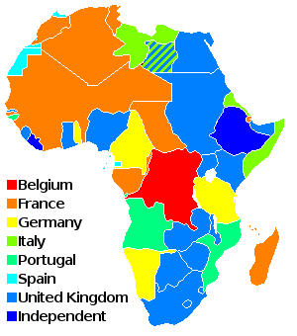
Let’s reflect
Looking over your map and the actual
map of Africa from 1875, answer
the reflection questions.

