Slide 1
Bell Work (10/22)
How is architecture an example of:
  Mentifacts (ideas/beliefs/values – religion)
  Sociofacts (the way people organize their society and relate to one another – families/social circles)
  Artifacts (that which is made, created, produced)
  Objective: Analyze different American Home styles throughout different time periods. Compare and contrast the styles.

Slide 2
Are US Homes influenced by
Folk Culture or Popular Culture?
Are the houses we have today products of diffusion from an American Hearth?
Explain how the following types of diffusion relate to architecture style:
  Hierarchical
  Relocation
  Stimulus

Slide 3
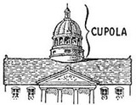

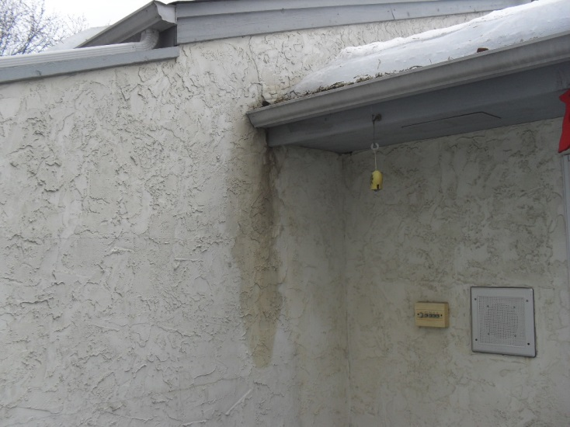
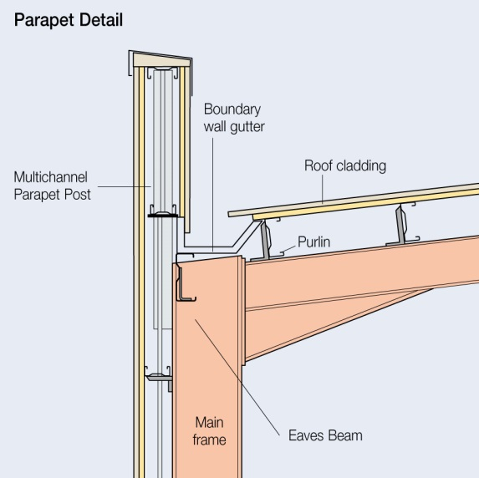

Important Architectural terms that might help.
Neo = New
Stucco
Dormer

Slide 4
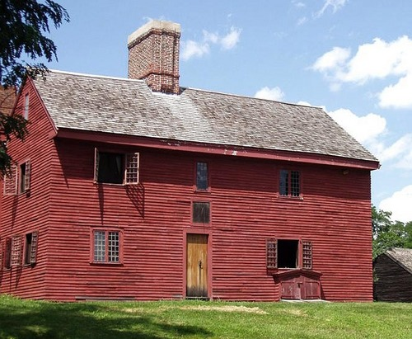
New England Colonial 1600-1740
Steep Roof – Massive chimney.
2 Story with side gables.
1

Slide 5
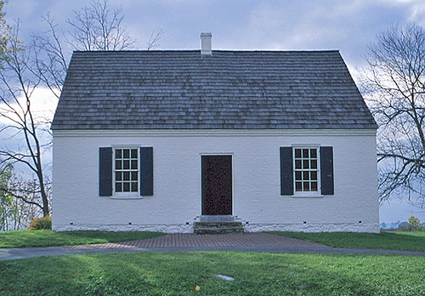
Colonial Cape Cod 1600-1950
Found in New England.
1-1.5 story with central chimney. Symmetrical appearance
Windows with shutters. Will be revived in 1930’s as cheap economical suburban house.
2

Slide 6
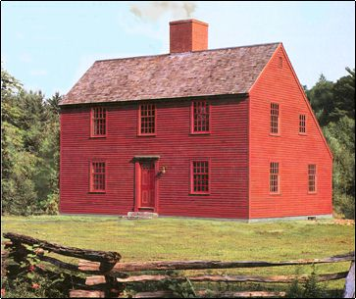
3
Saltbox 1600-1850
Central fireplace. Two story in front, one in back due to roof. (Avoided the two-story tax)

Slide 7
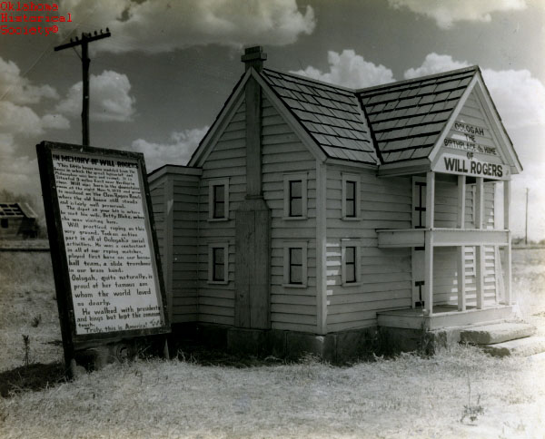
4
I-House 1600-1850
2 story with side gables. One room deep. Two rooms wide. Named for states it appeared in Illinois, Iowa, Indiana in rural areas.

Slide 8
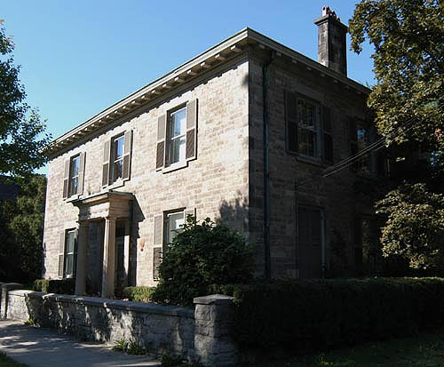
5
Four over Four 1600’s-1850
Basic two story with four rooms on each floor. A vernacular house (made from whatever materials were available in area.)

Slide 9
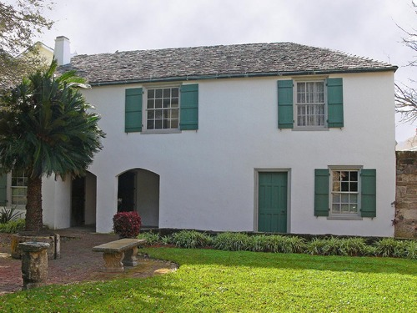
6
Spanish Colonial1600-1900
Florida, California, Southwest
Flat Roof. Rock or adobe covered with stucco walls. Interior Courtyard

Slide 10
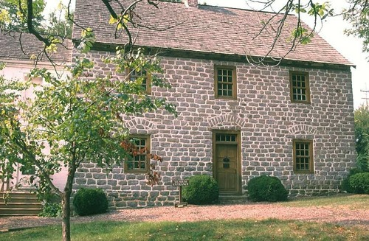
7
German Colonial 1600-1850s
New York Pennsylvania, Ohio Maryland
Think walls made of stone
Stone arches above first floor windows and doors.

Slide 11
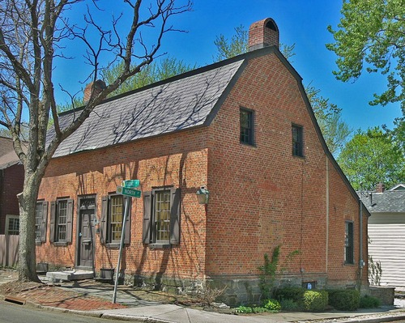
Dutch Colonial 1625-1850’s
New York. Brick and stone. Dutch Doors. Chimney on each side. Roof looks like a barn.
8

Slide 12
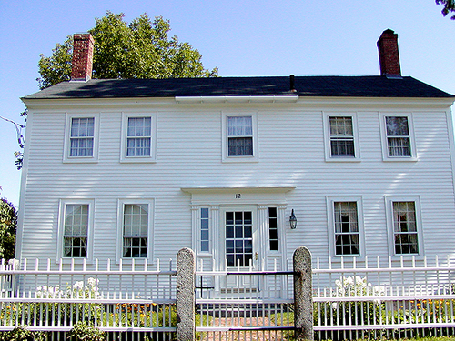
9
Georgian Colonial 1690-1830
Named after King George. Square and symmetrical…but more elaborate. 2 chimneys with 5 windows across front. Medium pitch roof but minimal overhang.

Slide 13
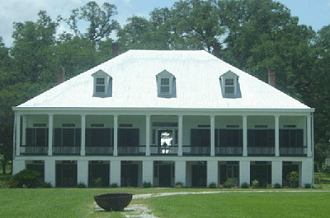
10
French Colonial 1700-1860
Mississippi Valley = Hot and Wet
Wide porches, raised above ground, French doors

Slide 14
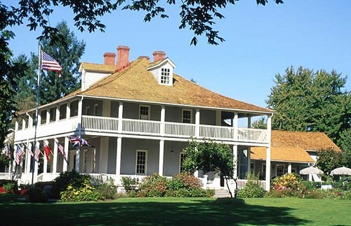
11
Tidewater 1800’s
Coastal American South – Hot and Wet.
Extensive porches. Roof extends over porches

Slide 15
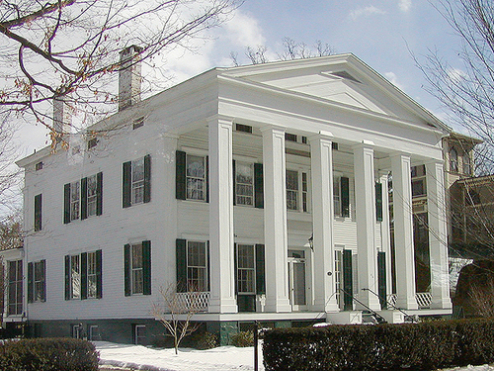
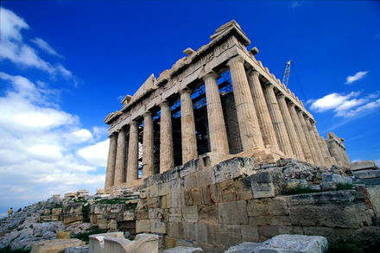
12
Greek Revival – Classical 1825-1860
Columns. Think of the Parthenon

Slide 16
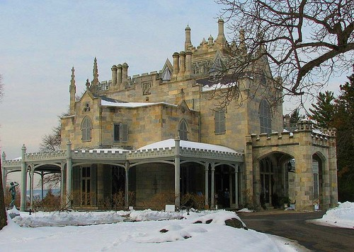
13
Gothic 1840-1880
Think of a Medieval Cathedral. Pointed windows, grouped chimneys. Stone and brick.

Slide 17
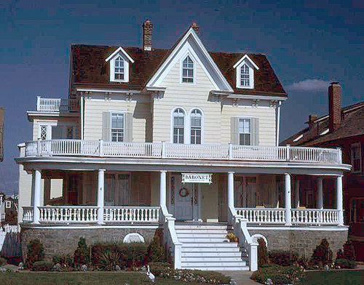
14
Gothic Revival (Wood) 1840-1880
Gothic but in wood. Steeply pitched roof, one story porch, heavily decorated wood trim.

Slide 18
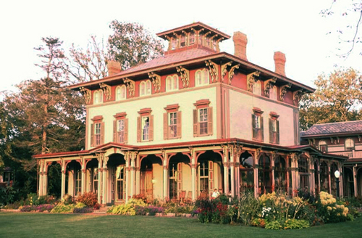
15
Italianate 1840-1885
Low pitched roof, symmetrical rectangular shape, square cupola.

Slide 19
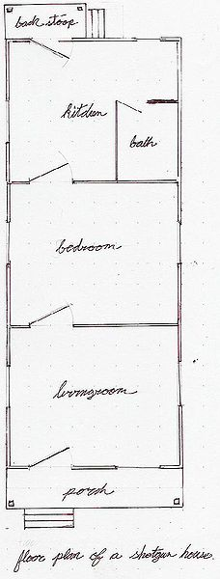
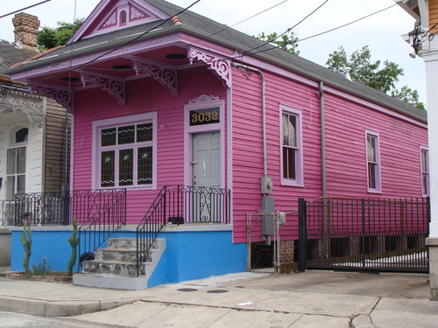
Shotgun House 1861-1930
Long and narrow so they fit in small city lots. On stilts to prevent flood damage. No hallways. Fire a gun through the front door, it will make it all the way to the back door.
16

Slide 20
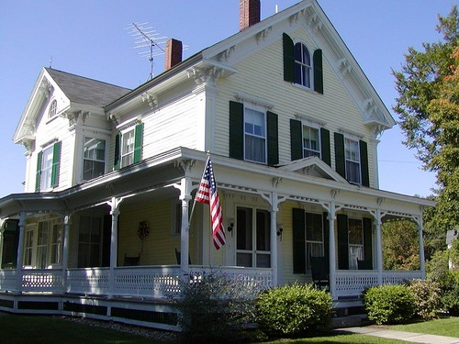
17
Folk Victorian 1870-1910
Square and symmetrical with a porch.
Anyone could afford these-think country home. Some fancy trim work.

Slide 21
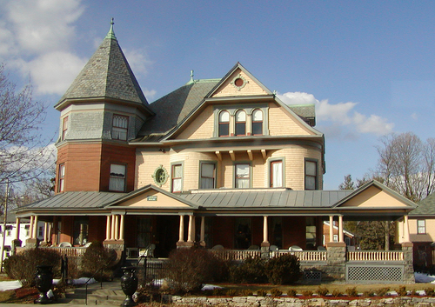
18
Queen Anne 1880-1910
Steep roof. Asymmetrical. One-story porch. Round or square towers. Bay windows. Ornamental decorations.
Possible due to mass-produced pre-cut trim.

Slide 22
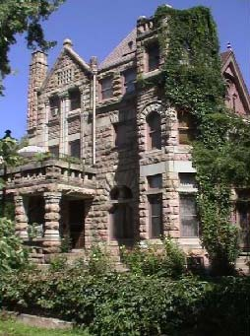
Romanesque 1880-1900
Rough square stones. Roman arches –Think Ancient Rome. Very expensive with all that stone!
19

Slide 23
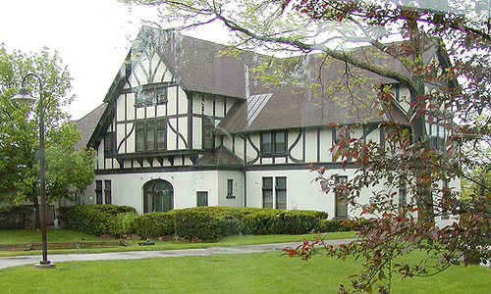
20
Tudor 1890-Present
Tudor Dynasty in England. Gables, parapets, and stonework.
Think of a Medieval cottage.

Slide 24
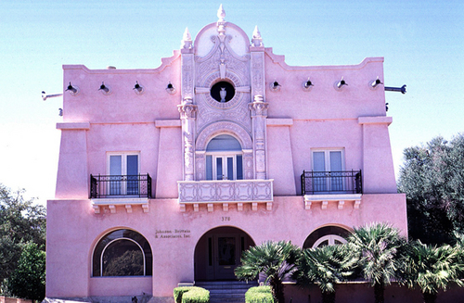
21
Mission Revival 1890-1920
Spanish style. Stucco, arches, red tile roof.

Slide 25
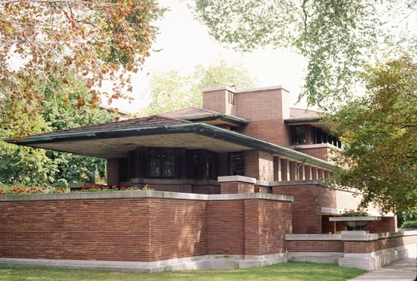
22
Prairie Style 1893-1920
Frank Lloyd Wright
Low horizontal lines and open interior. Central chimney. Blend in with the prairie landscape.

Slide 26
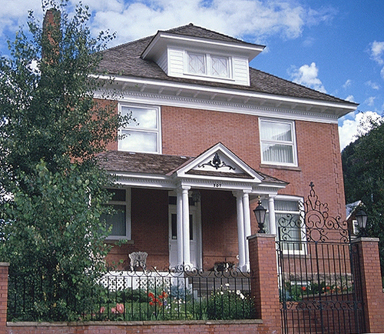
American Foursquare 1895-1930
a.k.a the Prairie Box. 2.5 stories high with porch. Designed to maximize interior space on small city lots. Some of these were mail order house kits from Sears and Montgomery Wards.
23

Slide 27
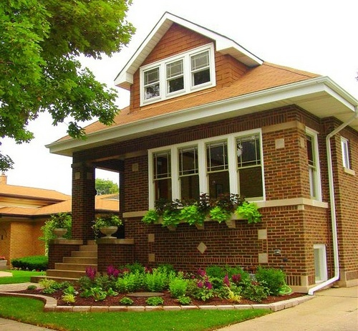
Bungalow 1905-1930
1.5 story efficient floor plan – no hallways.
Living room at center.
24

Slide 28
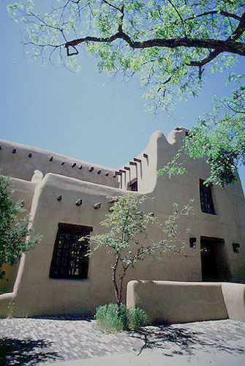
Pueblo Revival 1912-present
Rounded walls with adobe. Flat roofs. Deep window and door openings.
25

Slide 29
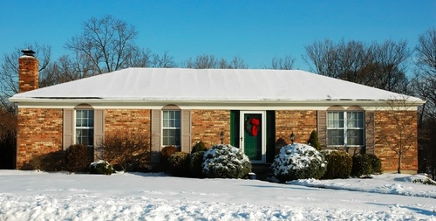
26
Ranch Style 1945-1980
Single story. Horizontal layout. Plain, simple, cheap, mass produced for suburban growth.

Slide 30
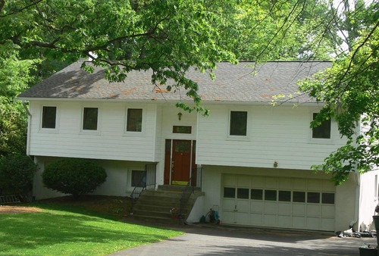
27
Raised Ranch 1945-1980
A two-story ranch. Partially submerged basement. Sliding glass door to back yard patio.

Slide 31
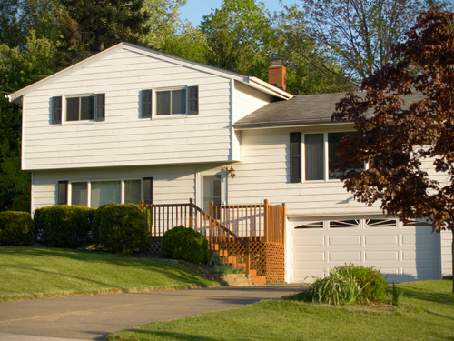
28
Split Level Ranch 1945-1980
Ranch but one section lowered and one raised.
Main entrance on center level.

Slide 32
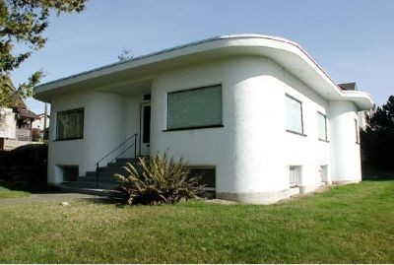
29
Art Moderne 1930-1945
Asymmetrical. Flat roof. Smooth white walls. Glass block windows. Suggestion of speed, movement, and technology. (1933 Chicago World Fair)

Slide 33
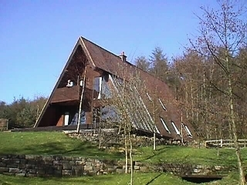
30
A Frame 1957-Present
Dramatic sloping roof great for snowy areas.

Slide 34
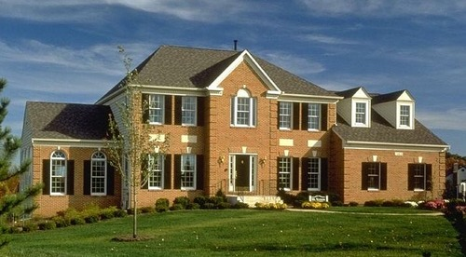
31
Neo-Colonial 1965-Present
Rectangular -2-3 story. Central entry hall floor plan

Slide 35
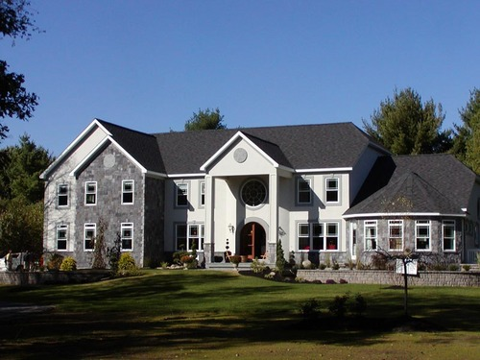
32
Neoeclectic (PostModern) 1965-Present
Rebel against modernism. Desire for traditional styles, but combine all of them. Large and also called McMansions.

Slide 36
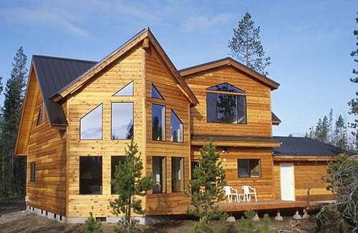
33
Contemporary 1965-Present
Huge windows. Large open spaces. Odd, irregular shape.

Slide 37
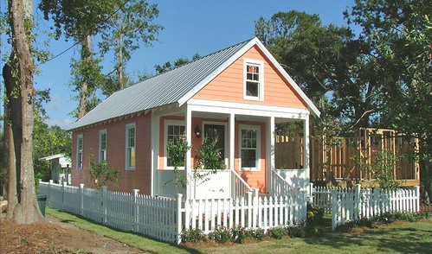
34
Katrina Cottage 2006-Present
Low cost emergency shelter. Prefab but designed to survive a hurricane. Can be small, some are 308 sq feet.

Slide 38
Are US Homes influenced by Local / Folk Culture or Popular Culture?
Are the houses we have today products of diffusion from an American Hearth?

Slide 39
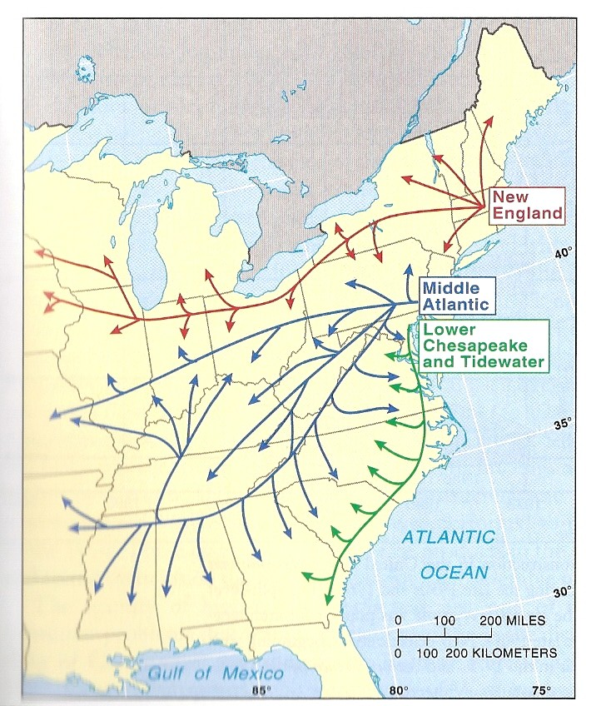
F. Kniffen

