Slide 1
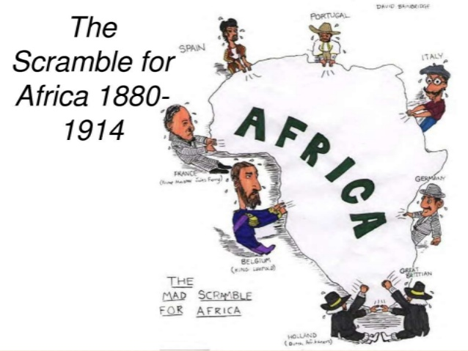
What does this political cartoon tell you about European countries, Africa and colonialism?

Slide 2
Why study the Age of Exploration
1.Desire to obtain more and different goods at better prices influences our relations with other nations, just as it did back then. (World –wide economy)
2. People of many nations continue to act to preserve their culture from outsiders.
3. Languages and cultures carried by explorers still influence those places today. (Spanish in Latin America and English in India for ex.)
4. Advances in technology allow present-day explorers to visit new places, just as it did back then.

Slide 3


What was it?
God- people thought that it was their duty to god to expand and find new lands, spread of Christianity
Gold- wanted the riches that went with exploring (spices, new land, etc.)- not just gold!
Glory-wanted recognition for themselves and their country

Slide 4
Why did European Exploration happen
1. Crusades → by-pass “middle-men” to get to Asia.
2. Renaissance → curiosity about other lands and peoples.
3. Reformation → refugees & missionaries.
4. Monarchs seeking new sources of revenue.
5. Technological advances.
6. Fame and fortune.

Slide 8
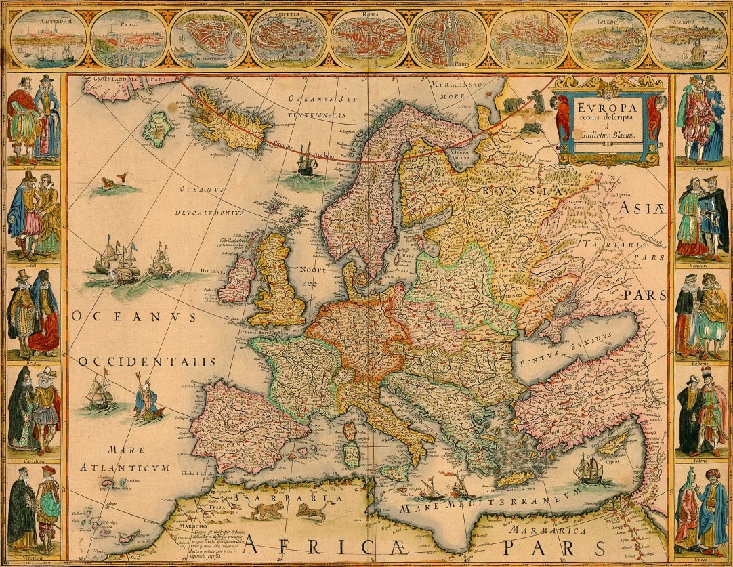
What countries are involved?
Portugal
Spain
France
England
Netherlands

Slide 9
European Colonialism Recap
Colony – territory that is tied to a sovereign state rather than being completely independent
Extent of sovereign state’s control can vary
European states established colonies because of God, glory and gold
European states first colonized North and South America (independent by the mid 1800s)
Then turned to Africa and Asia
United Kingdom and France had the most colonies of any European country
After WWII, most African and Asian colonies gained independence
Boundaries of new states frequently coincide with former colonial provinces

Slide 10
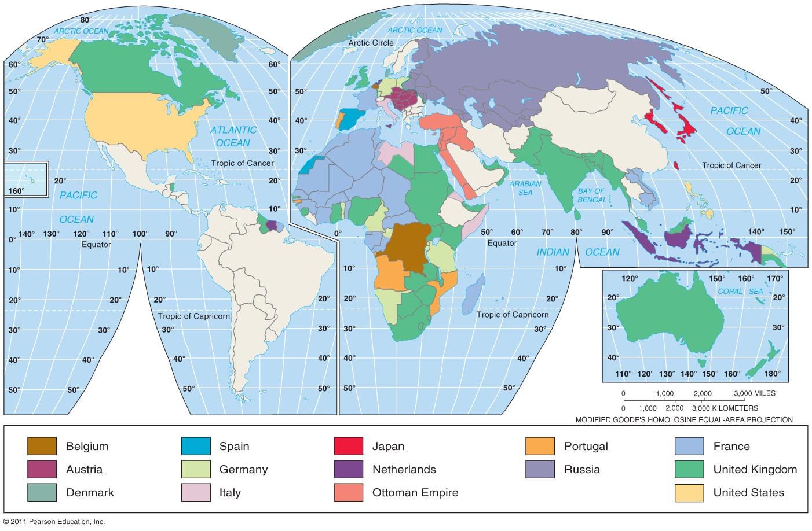
Colonial Possessions, 1914
By the outbreak of World War I, European states held colonies throughout the world, especially throughout Africa and in much of Asia.

Slide 11
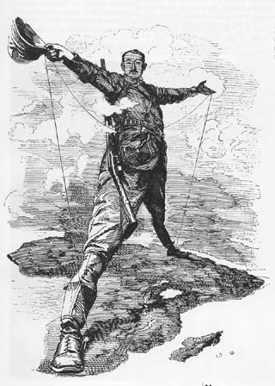

Slide 12
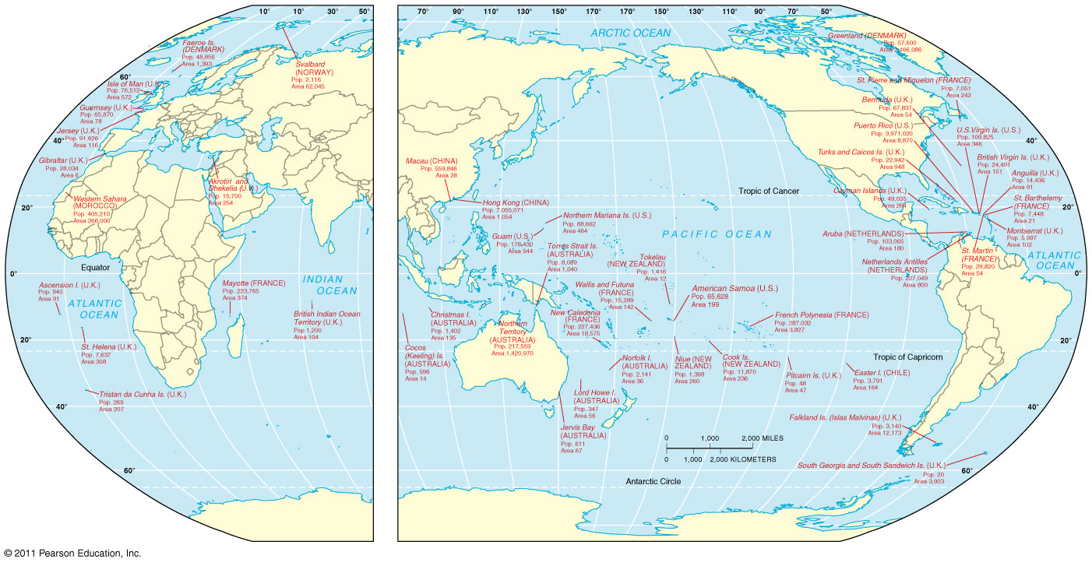
Colonial Possessions, 2006
Most of the remaining colonies are small islands in the Pacific or Caribbean

Slide 13

What is the difference between colonialism and imperialism?

