Slide 1
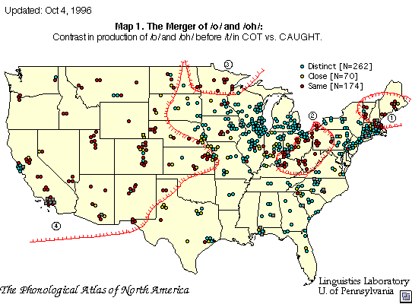
Isogloss
What is an isogloss?
How would a dialect be an example of an isogloss?

Slide 2
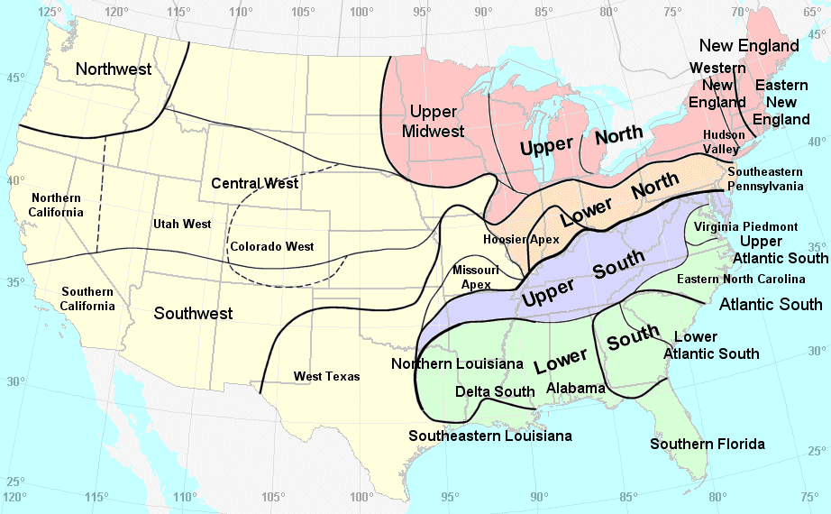

Slide 3
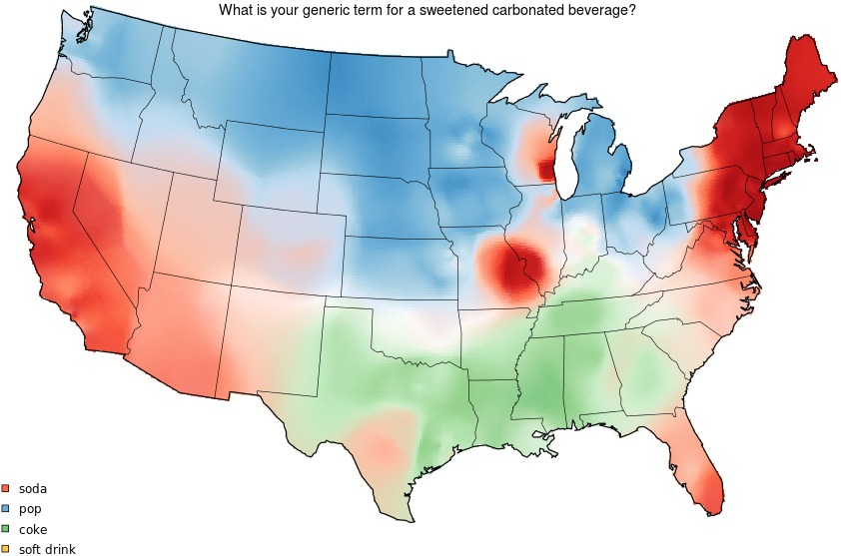

Slide 4
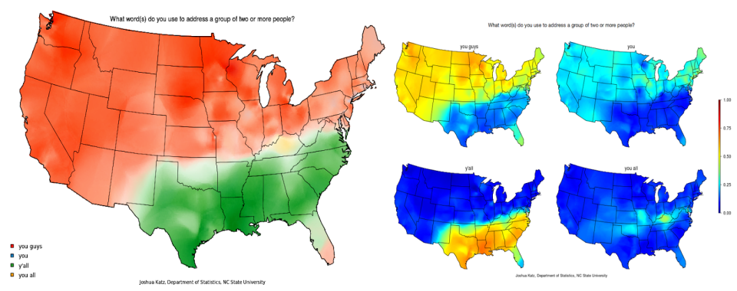

Slide 5
