Slide 1
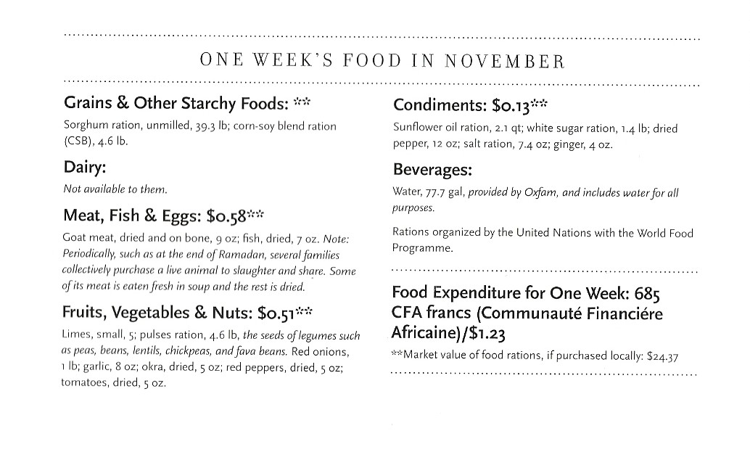
Chad: The Aboubakars of Breidjing Camp

Slide 2
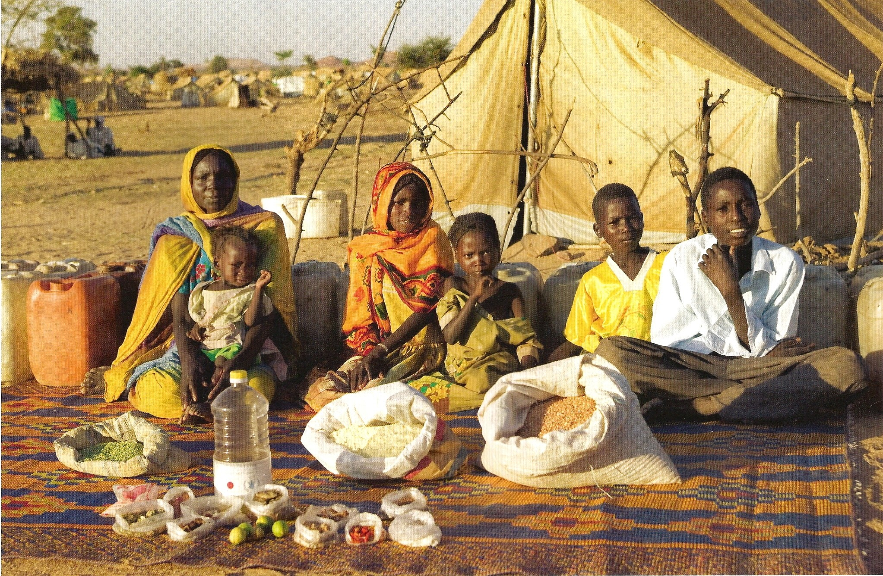
Chad : The Aboubakars of Breidjing Camp
The Aboubakar family of Darfur province, Sudan, in front of their tent in the Breidjing Refugee Camp, in eastern Chad, with a week's worth of food. D'jimia Ishakh Souleymane, 40, holds her daughter Hawa, 2; the other children are (left to right) Acha, 12, Mariam, 5, Youssouf, 8, and Abdel Kerim, 16. Cooking method: wood fire. Food preservation: natural drying. Favorite food - D'jimia: soup with fresh sheep meat.

Slide 3
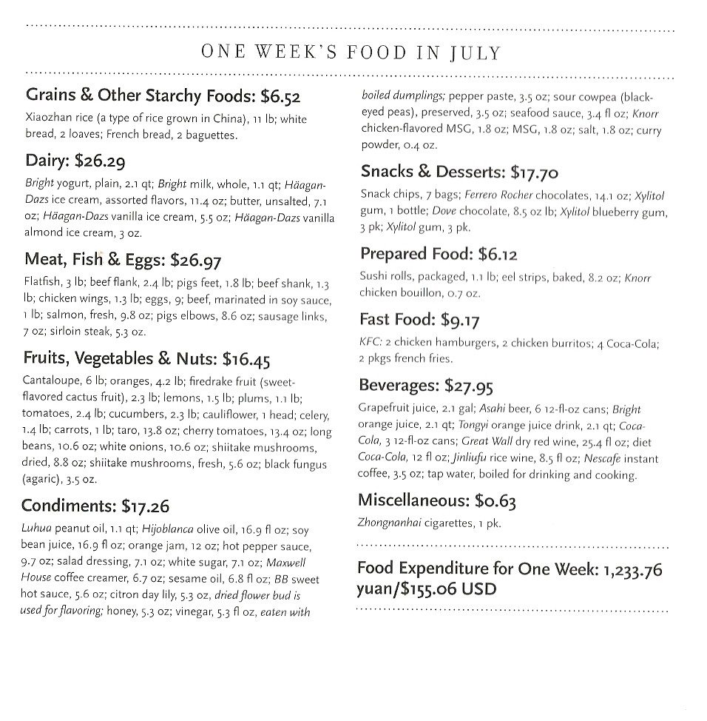
China: The Dongs of Beijing

Slide 4
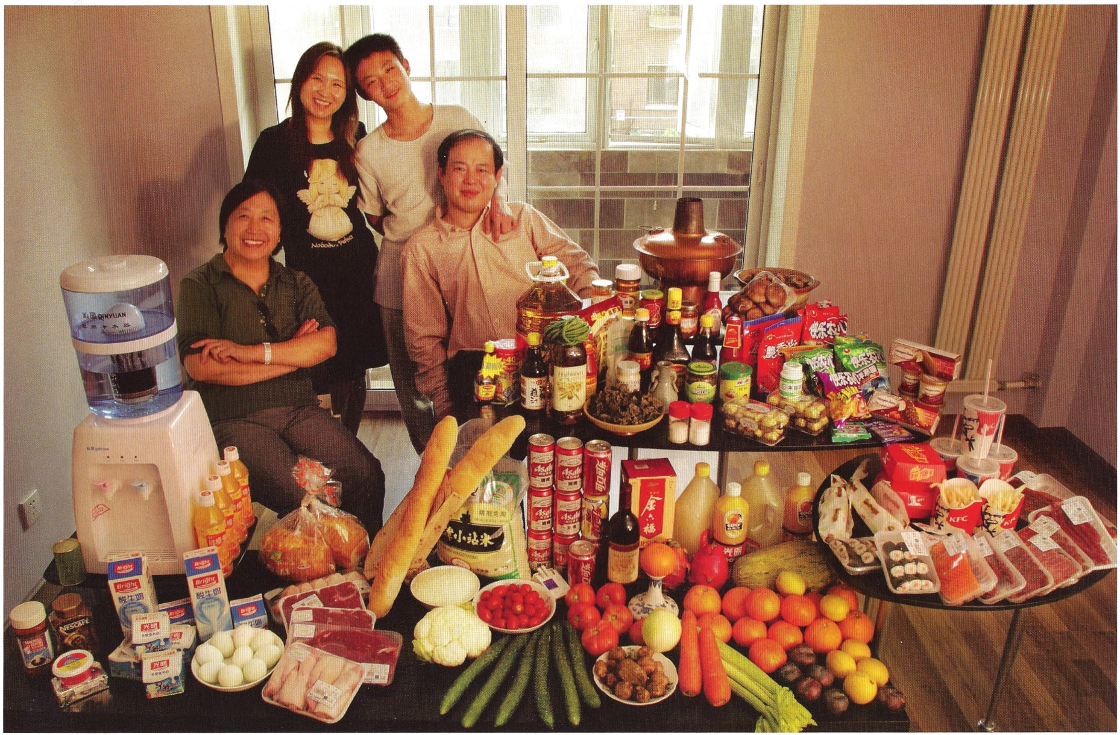
China : The Dongs of Beijing
The Dong family in the living room of their one-bedroom apartment in Beijing, China, with a week's worth of food. Seated by the table are Dong Li, 39, and his mother, Zhang Liying, 58, who eats with them a few times a week. Behind them stand Li's wife, Guo Yongmei, 38, and their son, Dong Van, 13. Cooking method: gas stove. Food preservation: refrigerator-freezer. Favorite food - Dong Yan: yuxiang rousi - fried shredded pork with sweet and sour sauce.

Slide 5
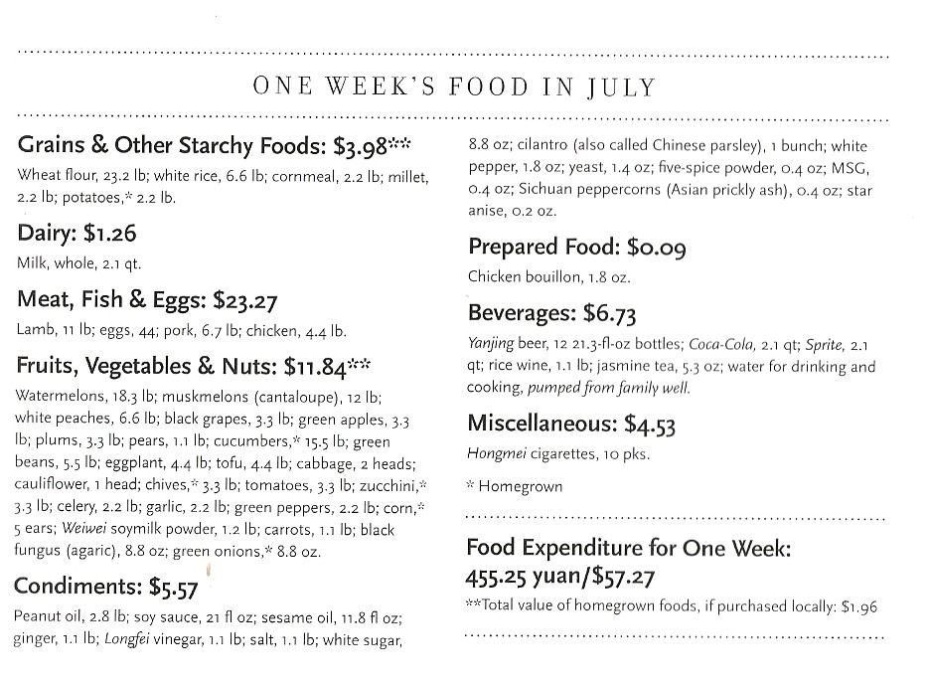
China: The Cuis of Weitaiwu Village

Slide 6
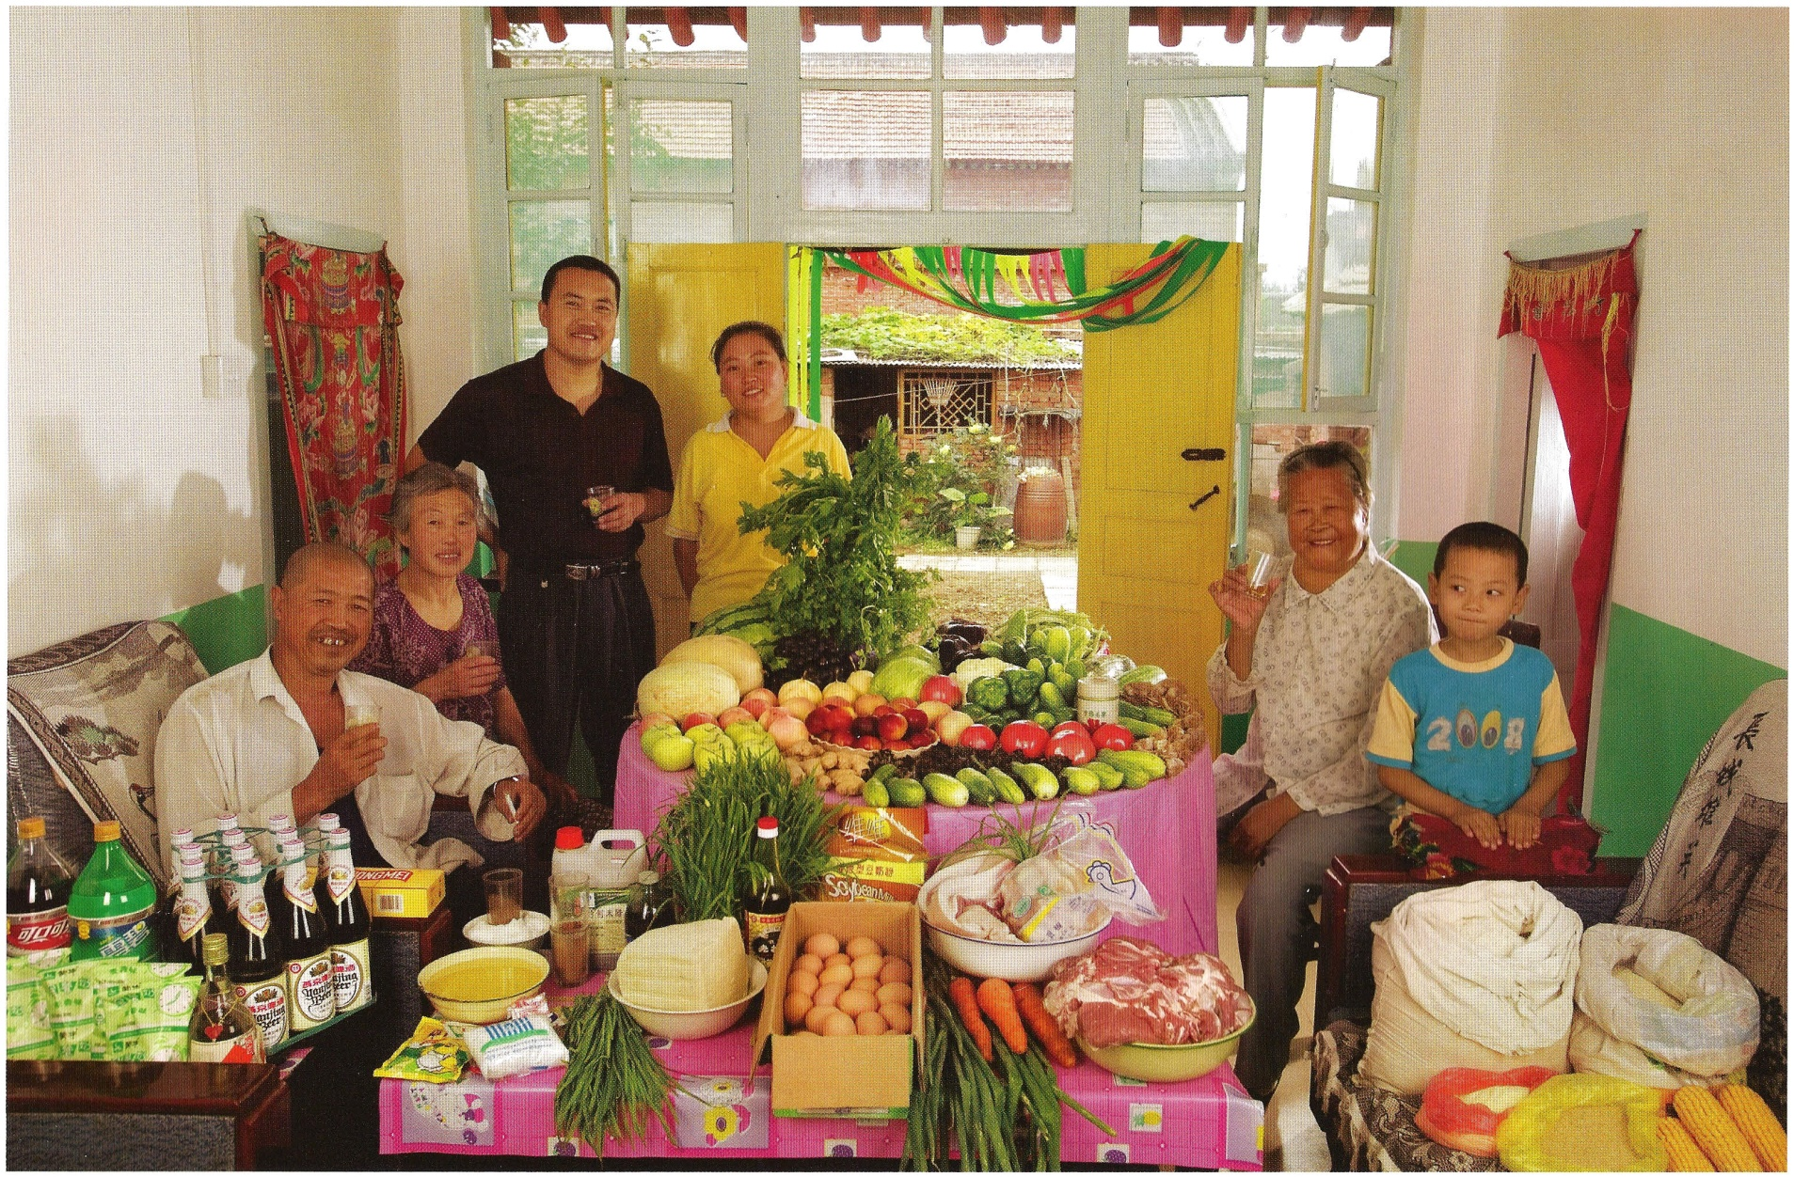
China: The Cuis of Weitaiwu Village
The Cui family ofWeitaiwu village, Beijing Province, in their living room with a week's worth of food. Cui Haiwang, 33, and Li Jinxian, 31, stand with their son, Cui Yuqi, 6, Haiwang's mother, Wu Xianglian, 61, and father, Cui Lianyou, 59, and Haiwang's grandmother, Cui Wu, 79. Cooking methods: gas burner, coal stove. Food preservation: refrigerator-freezer. Favorite foods - Cui Yuqi: fish. Li Jinxian: vegetables. Wu Xianglian: "anything." Cui Wu: "everything."

Slide 7
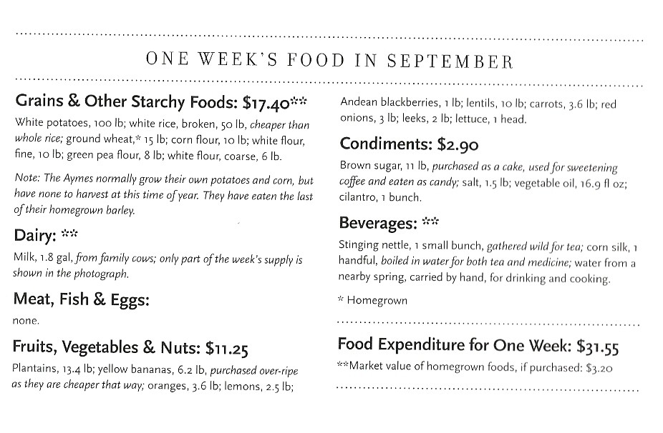
Ecuador : The Aymes of Tingo

Slide 8
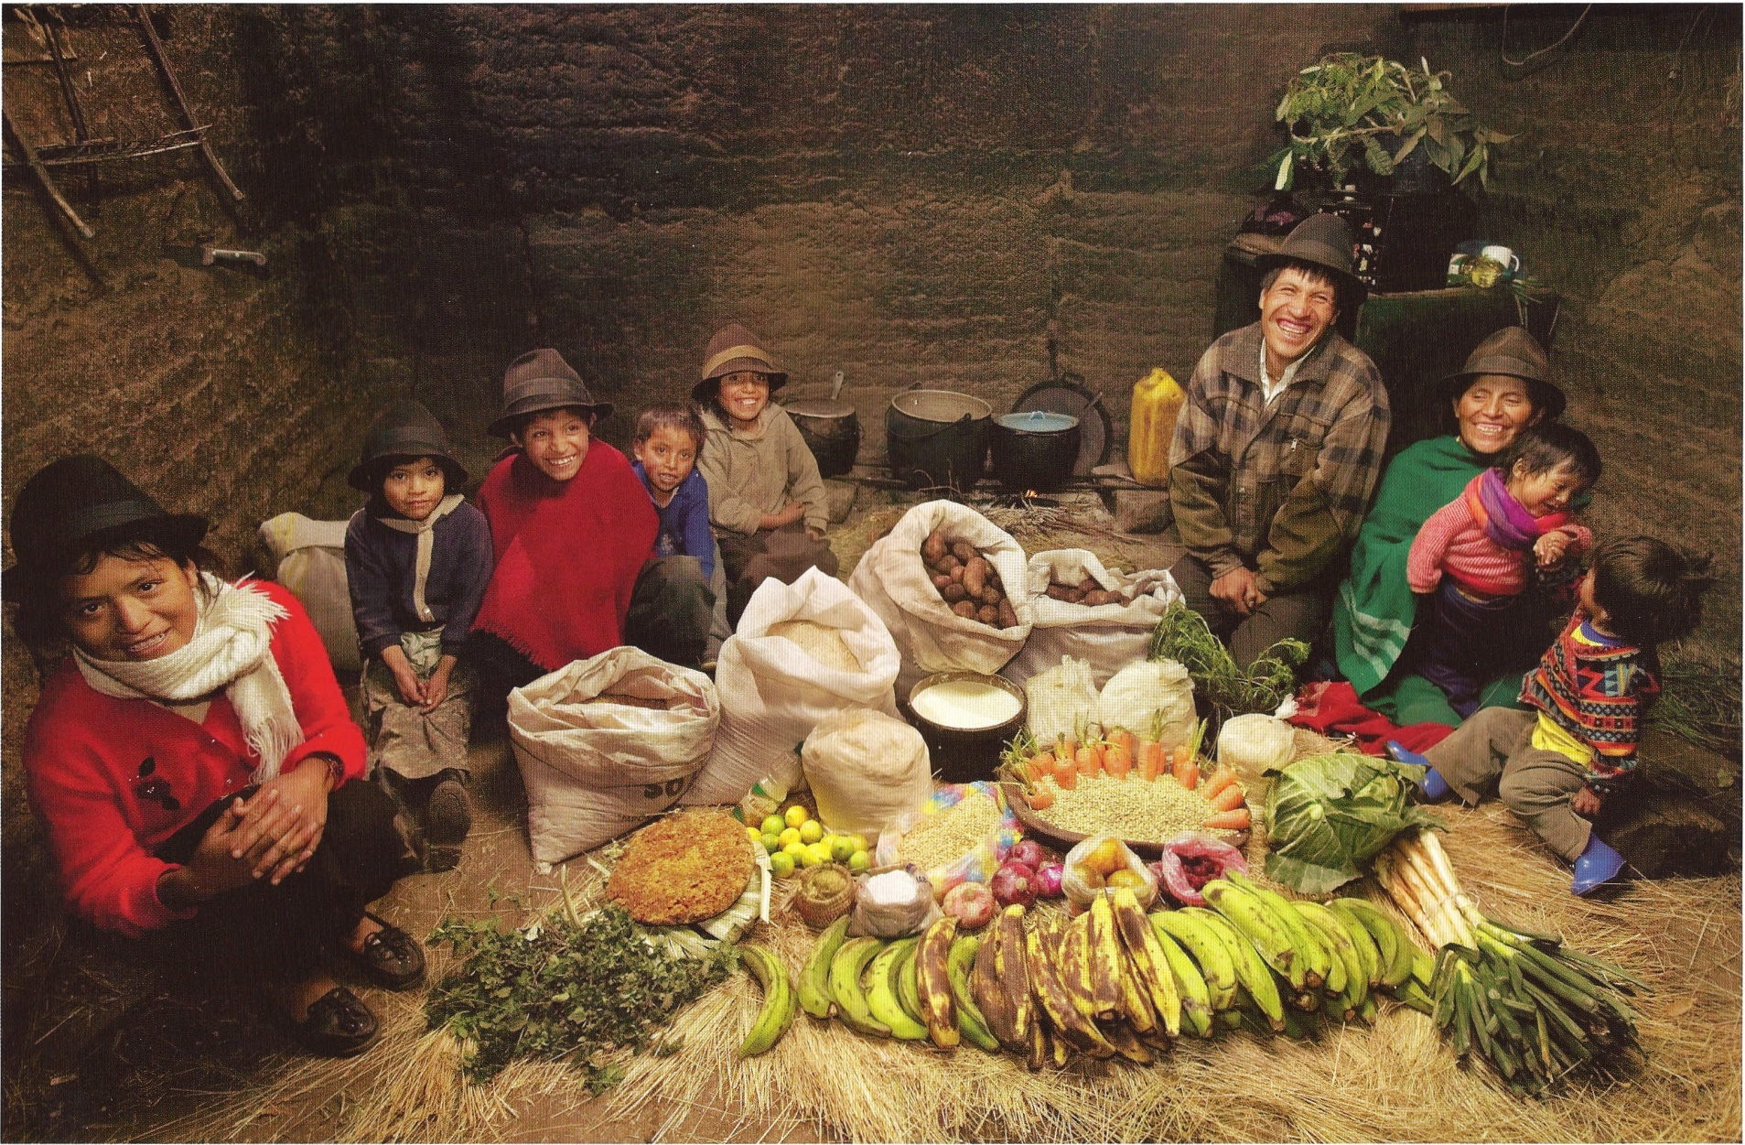
Ecuador : The Aymes of Tingo
The Ayme family in their kitchen house in Tingo, Ecuador, a village in the central Andes, with one week's worth of food. Ermelinda Ayme Sichigalo, 37, and Orlando Ayme, 35, sit flanked by their children (left to right): Livia, 15, Natalie, 8, Moises, 11, Alvarito, 4, Jessica, 10, Orlando hijo (Junior, held by Ermelinda), 9 months, and Mauricio, 30 months. Not in photograph: Lucia, 5, who lives with her grandparents to help them out. Cooking method: wood fire. Food preservation: natural drying.

Slide 9
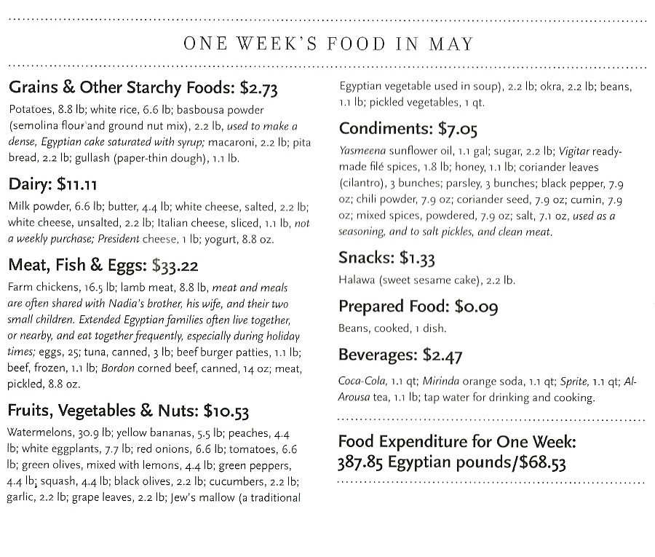
Egypt : The Ahmeds of Cairo

Slide 10
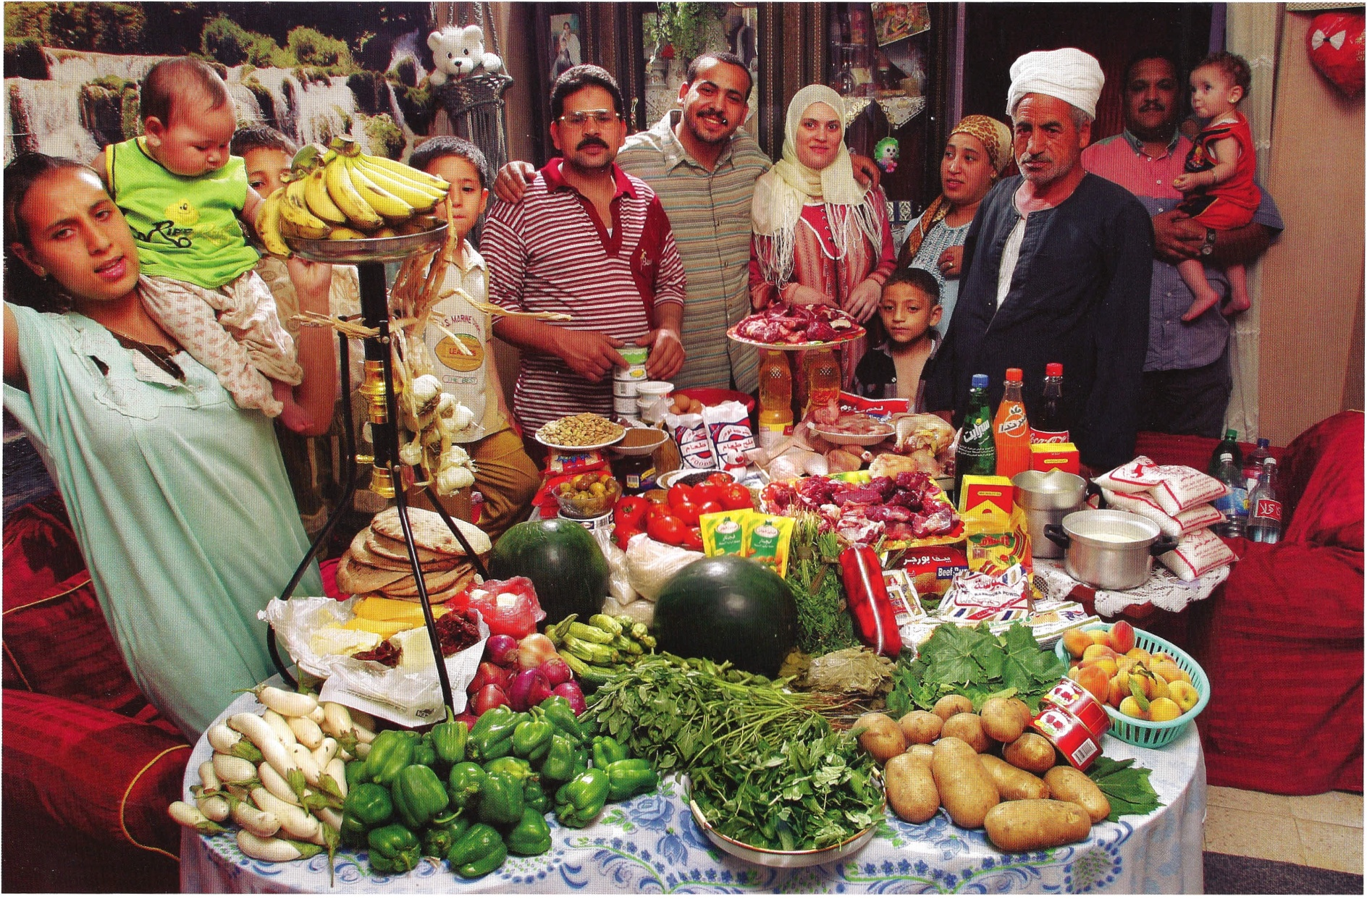
Egypt : The Ahmeds of Cairo
The Ahmeds' extended family in the Cairo apartment of Mamdouh Ahmed, 35 (glasses), and Nadia Mohamed Ahmed, 36 (brown headscarf), with a week's worth of food. With them are their children, Donya, 14 (far left, holding baby Nancy, 8 months), and Karim, 9 (behind bananas), Nadia's father (turban), Nadia's nephew Islaam, 8 (football shirt), Nadia's brother Rabie, 34 (gray-blue shirt), his wife, Abadeer, 25, and their children, Hussein, 4, and lsraa, 18 months (held by family friend).

Slide 11
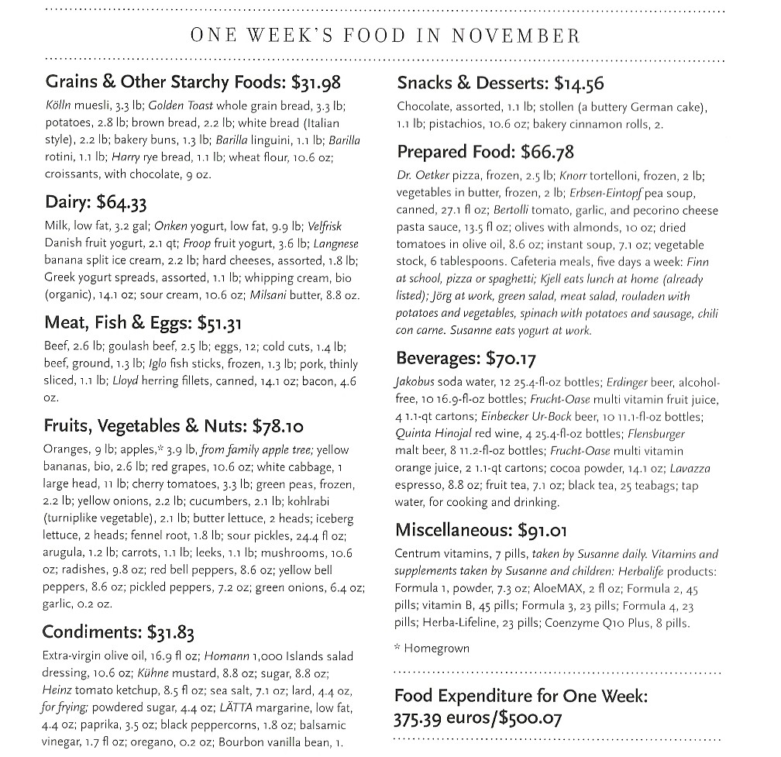
Germany: The Melanders of Bargteheide

Slide 12
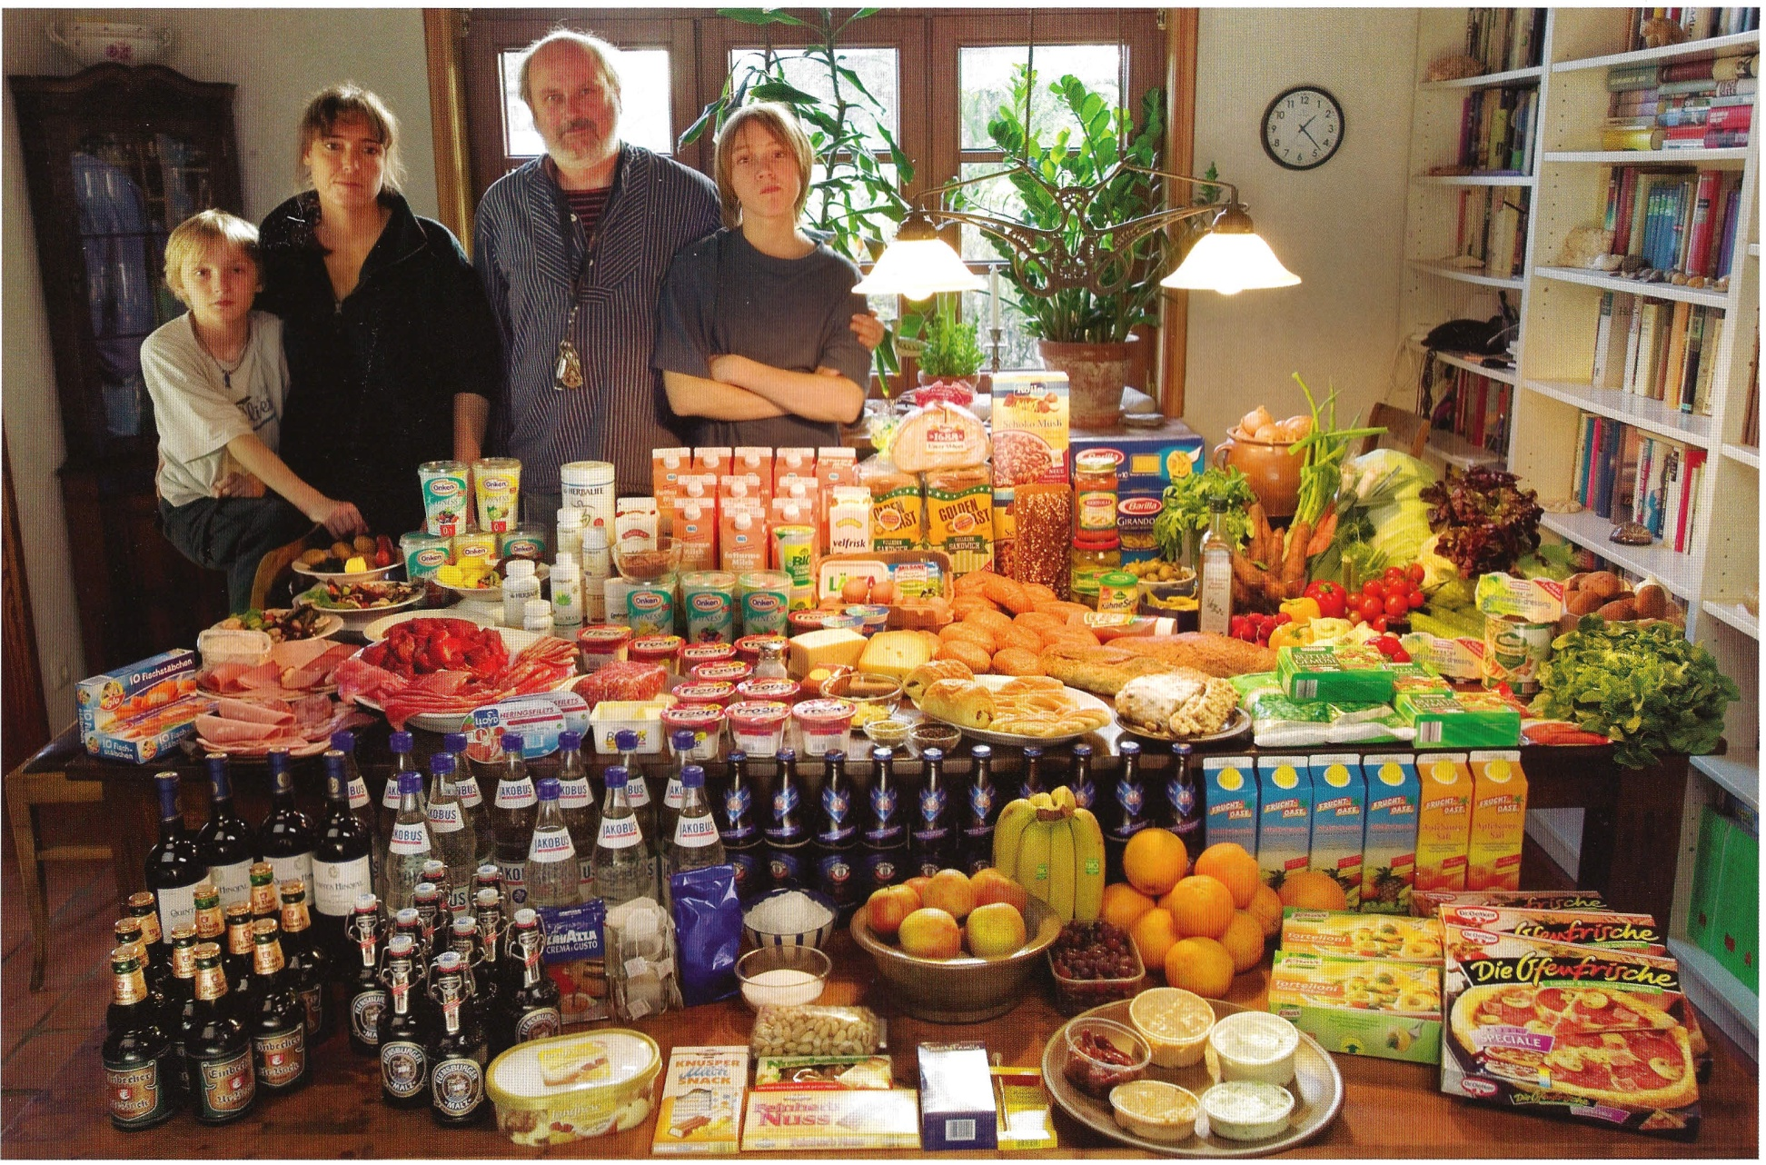
Germany: The Melanders of Bargteheide
The Melander family- Jorg, 45, and Susanne, 43, with sons Kjell, 10, and Finn, 14 -in the dining room of their home in Bargteheide, Germany, with a week's worth of food. Cooking methods: electric stove, microwave, and outdoor BBQ grill. Food preservation: refrigerator-freezer, freezer chest. Favorite foods -- Jorg: fried potatoes with onions, bacon, herring. Finn: fried noodles with eggs, cheese. Kjell: pizza, vanilla pudding. Susanne: "anything that's fresh and good".

Slide 13
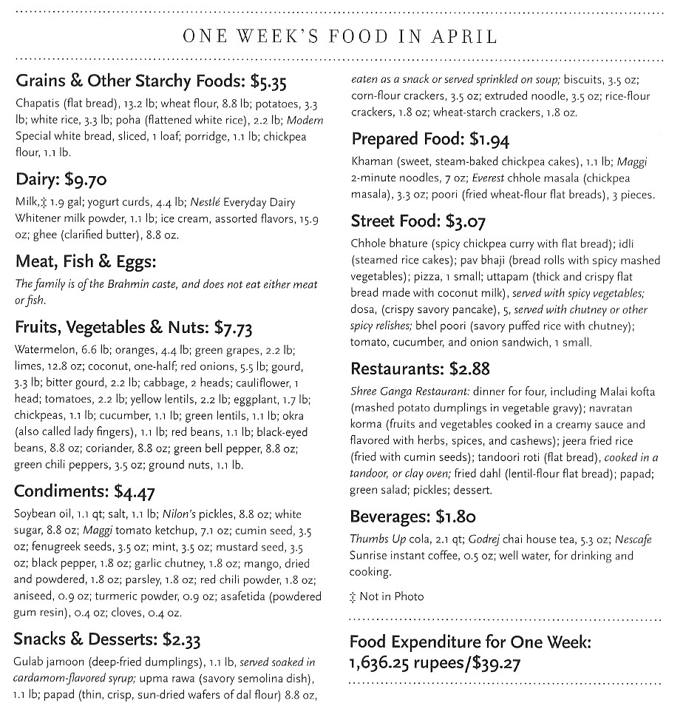
India : Patkars of Ujjain

Slide 14
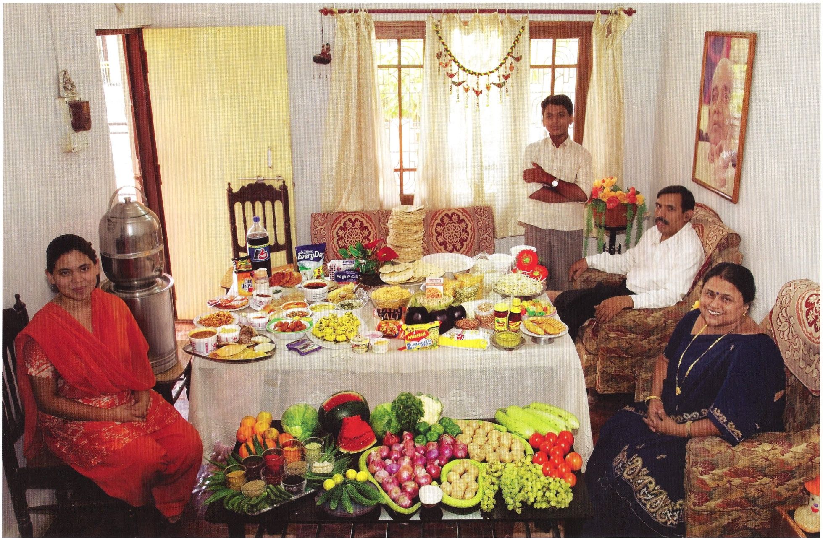
India : Patkars of Ujjain
The Patkar family - Jayant, 48, Sangeeta, 42, daughter Neha, 19, and son Akshay, 15 - in the living room of their home in Ujjain, Madhya Pradesh, India, with one week's worth of food. Cooking method: gas stove. Food preservation: refrigerator-freezer.

Slide 15
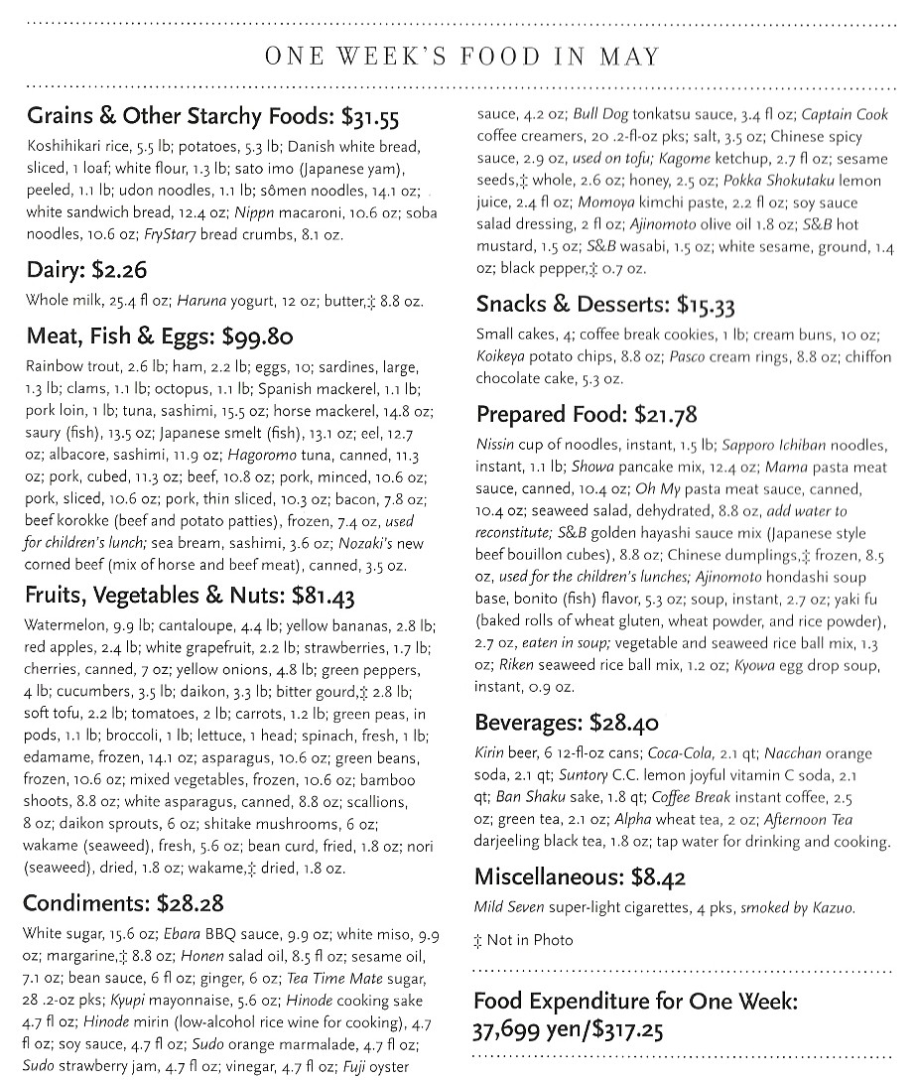
Japan : The Ukitas of Kodaira City

Slide 16
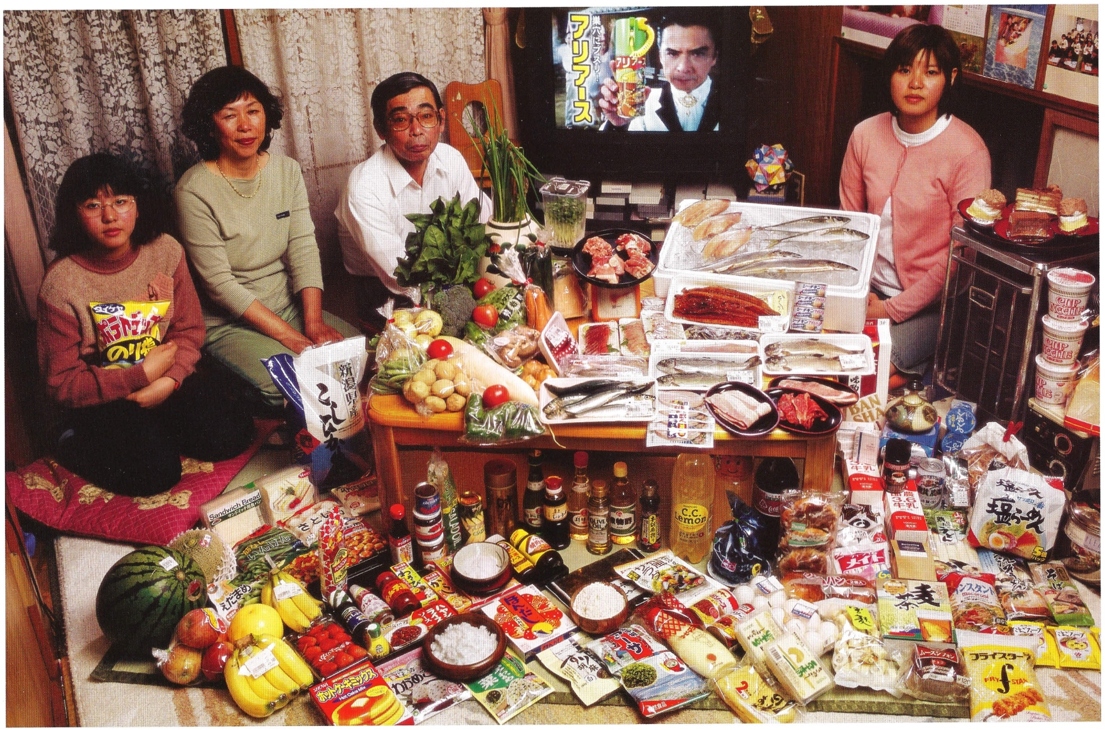
Japan : The Ukitas of Kodaira City
The Ukita family - Sayo Ukita, 51, and her husband, Kazuo Ukita, 53, with children Maya, 14 (holding chips) and Mio,17 - in their dining room in Kodaira city, Japan, with one week's worth of food. Cooking methods: gas stove, rice cooker. Food preservation: small refrigerator-freezer. Favorite foods - Kazuo: sashimi. Sayo: fruit. Mio: cake. Maya: potato chips.

Slide 17
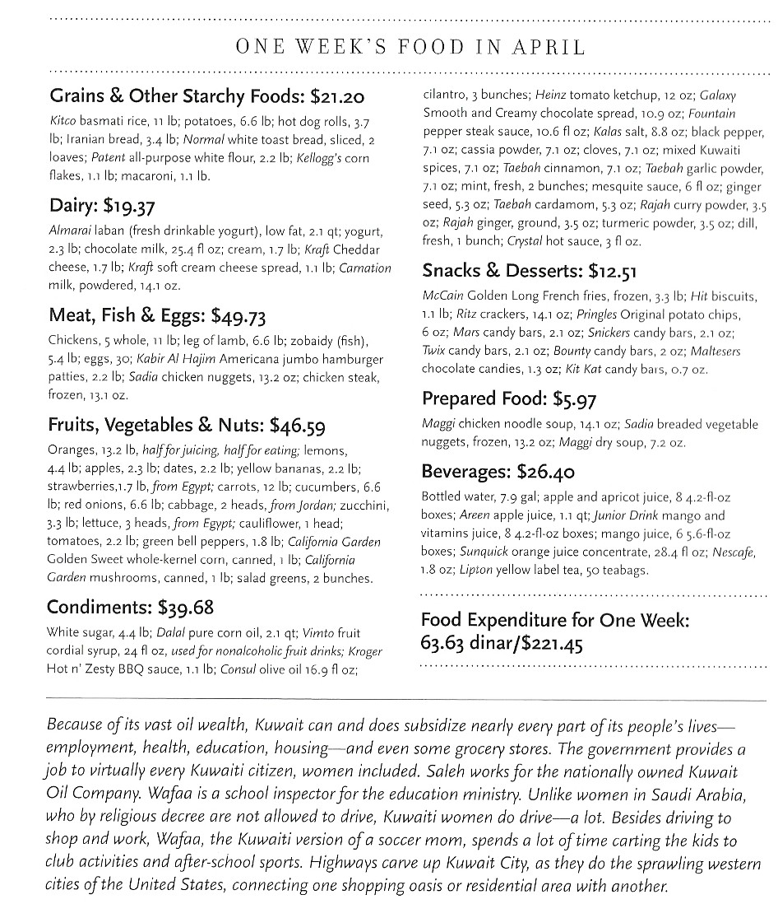
Kuwait : The Al Haggans of Kuwait City

Slide 18
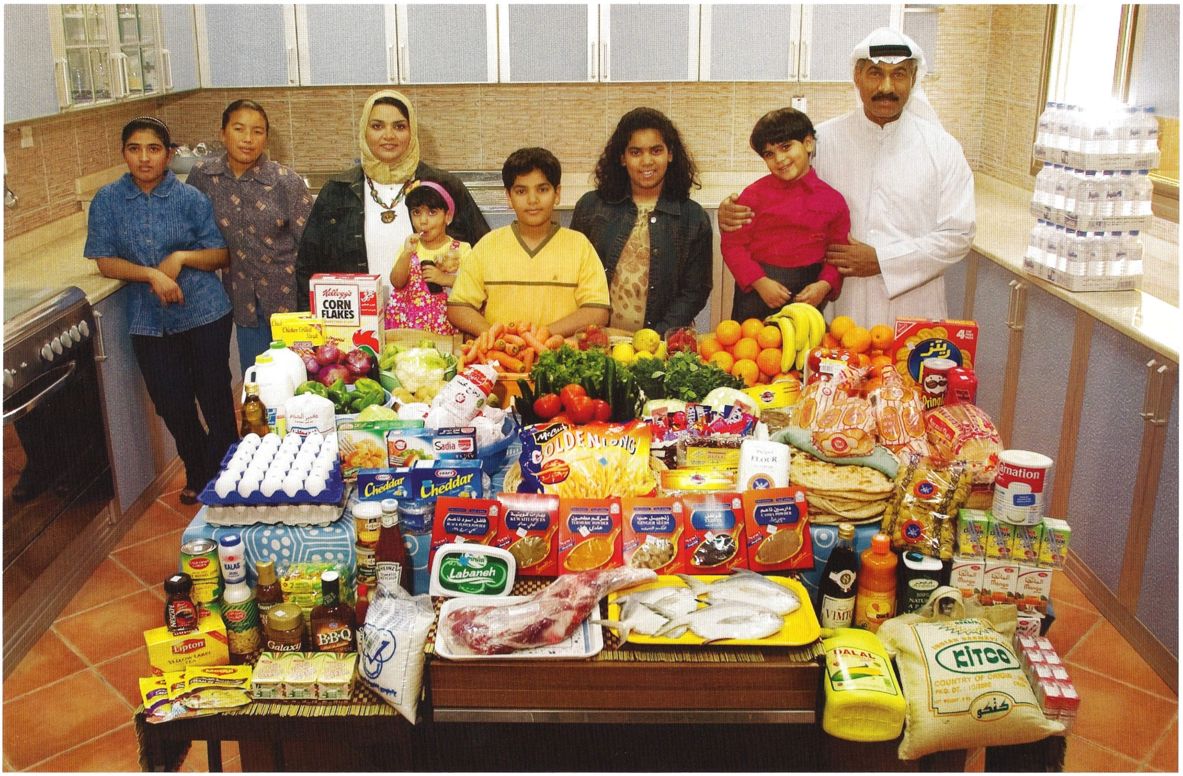
Kuwait : The Al Haggans of Kuwait City
The AI Haggan family and their two Nepali servants in the kitchen of their home in Kuwait City, Kuwait, with one week's worth of food. Standing between Wafaa Abdul Aziz AI Qadini, 37 (beige scarf), and Saleh Hamad AI Haggan, 42, are their children, Rayyan, 2, Hamad, 10, Fatema, 13, and Dana, 4. In the corner are the servants, Andera Bhattrai, 23 (left), and Daki Serba, 27. Cooking methods: gas stoves (2), microwave. Food preservation: refrigerator-freezer.

Slide 19
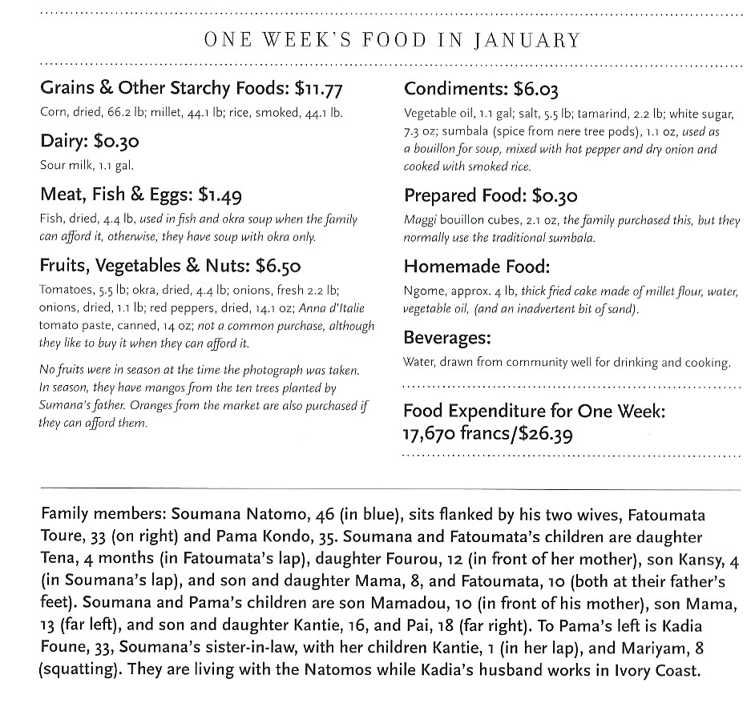
Mali : The Natomos of Kouakourou

Slide 20
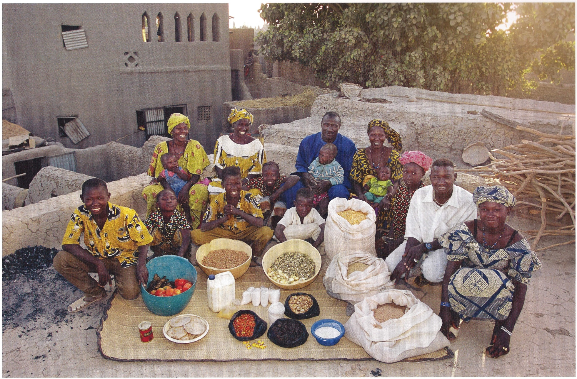
Mali : The Natomos of Kouakourou
The Natomo family on the roof of their mud-brick home in Kouakourou, Mali, with a week's worth of food. Cooking method: wood fire. Food preservation: natural drying. Favorite foods - the Natomo family doesn't think in terms of "favorites."
(See opposite page for list of family members.)

Slide 21
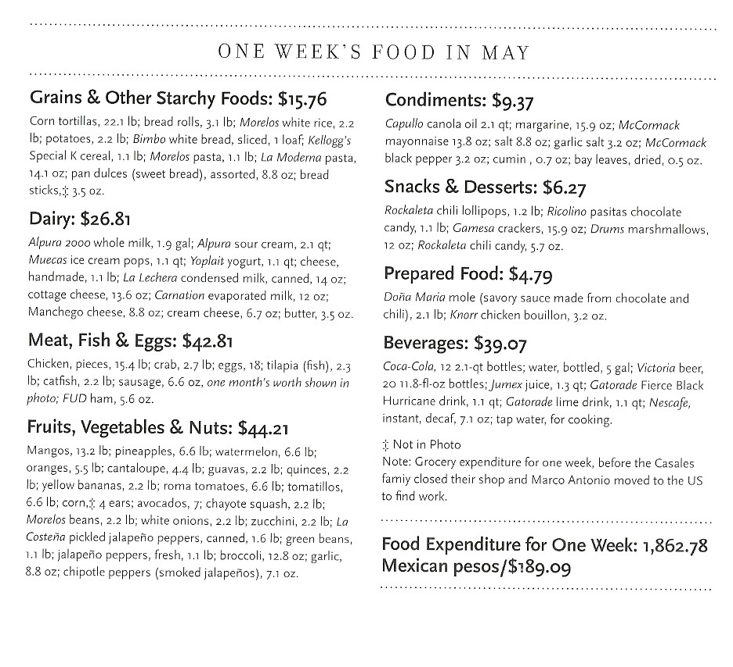
Mexico : The Casaleses of Cuernavaca

Slide 22
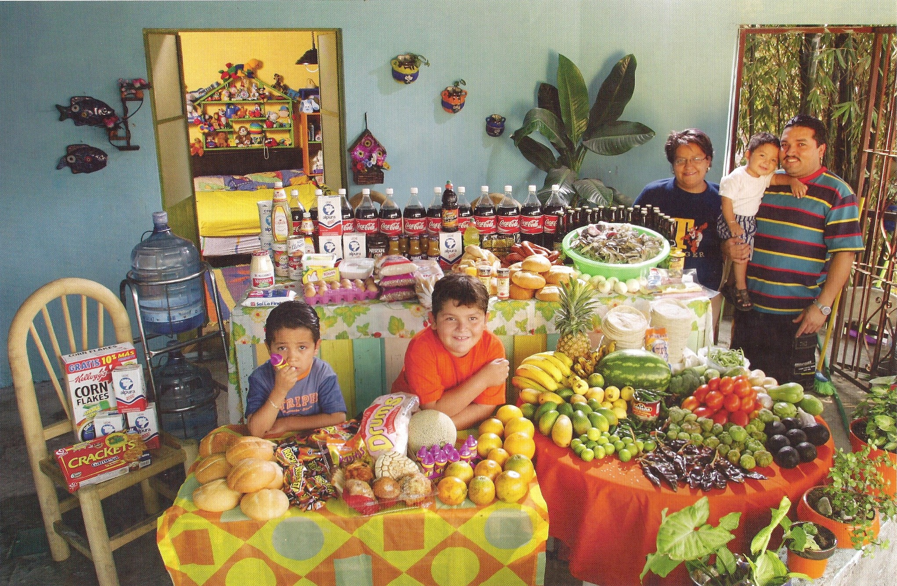
Mexico : The Casaleses of Cuernavaca
The Casales family in the open-air living room of their home in Cuernavaca, Mexico, with a week's worth of food. Marco Antonio, 29, and Alma Casales Gutierrez, 30, stand with baby Arath, 1, between them. At the table are their older children, Emmanuel, 7, and Bryan, 5. Cooking method: gas stove. Food preservation: refrigerator-freezer. Favorite foods - Marco Antonio: pizza. Alma: crab. Emmanuel: pasta. Bryan: crab and candy. Arath: chicken.

Slide 23
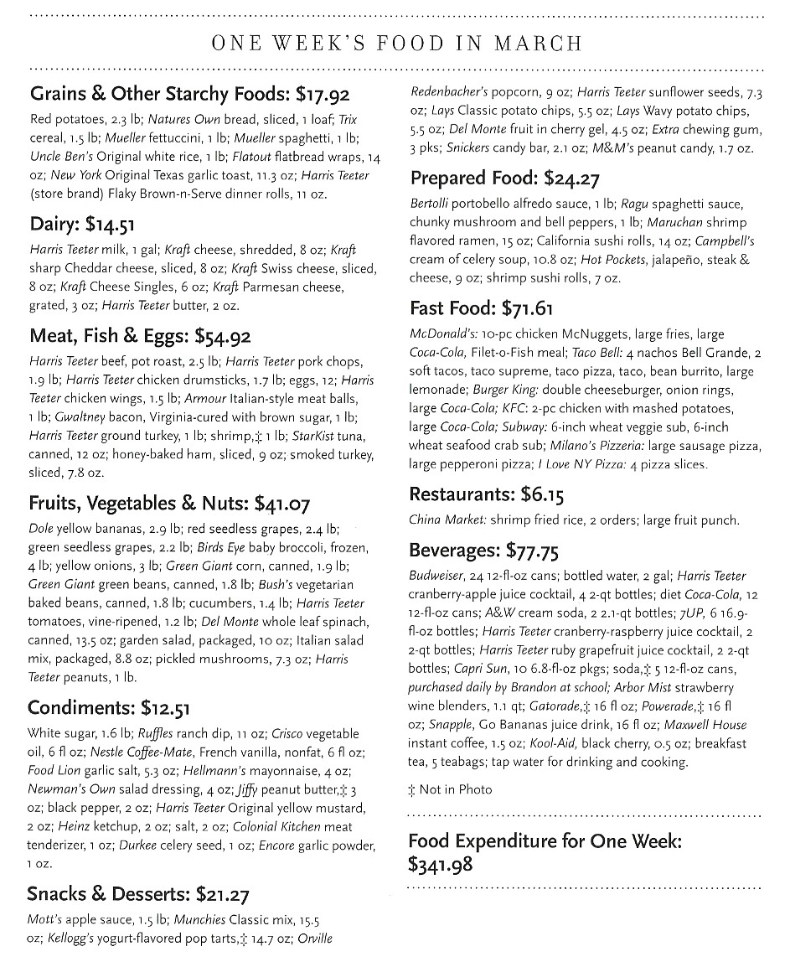
USA : The Revises of North Carolina

Slide 24
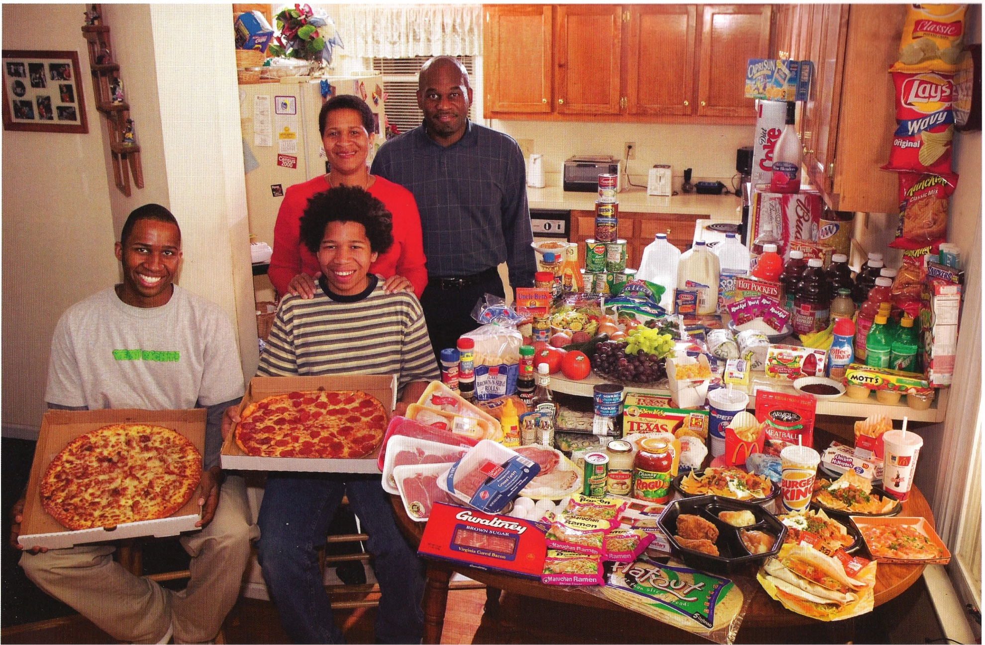
USA : The Revises of North Carolina
The Revis family in the kitchen of their home in suburban Raleigh, North Carolina, with a week's worth of food. Ronald Revis, 39, and Rosemary Revis, 40, stand behind Rosemary's sons from her first marriage, Brandon Demery, 16 (left), and Tyrone Demery, 14. Cooking methods: electric stove, toaster oven, microwave, outdoor BBQ. Food preservation: refrigerator-freezer. Favorite foods - Ronald and Brandon: spaghetti. Rosemary: "potatoes of any kind." Tyrone: sesame chicken.

