Slide 1
Intro to Agriculture
Chapter 10

Slide 2
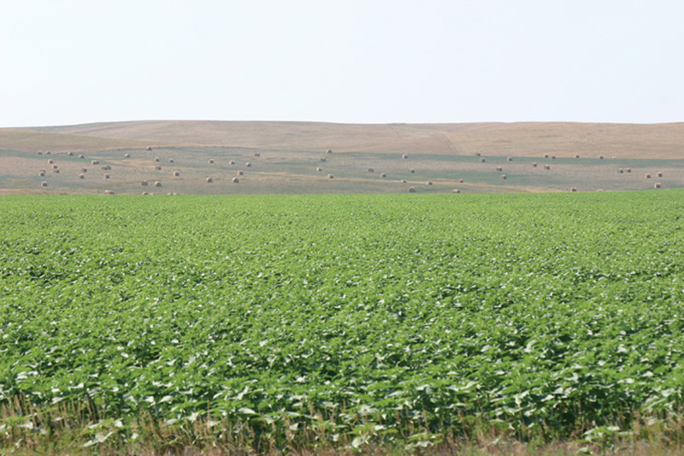
What is agriculture?
Deliberate modification of Earth’s surface through the cultivation of plants and rearing of animals to obtain sustenance or economic gain
What are many of the crops grown or animals raised used for?
Which sector of the economy?
Approximately ½ of people in LDCs are farmers and grow enough food only to feed themselves
Very few farmers in MDCs (2 million or 2% of Americans are farmers)
  Mechanization & farm consolidation have forced out many small scale farmers.
  Yet U.S. farm production is at an all time high.
Remember what the number of farmers per unit of arable land is called?
The number of people per unit of arable land?

Slide 3
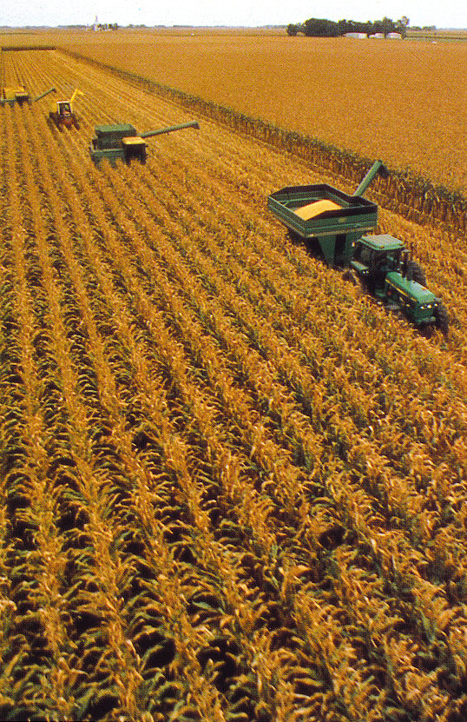
Importance of Agriculture
  Urban-industrial societies depend on the base of food surplus generated by farmers and herders
  Without agriculture there could be no cities, universities, factories, or offices
  Today agriculture remains the most important economic activity in the world
  Agriculture employs 45 percent of the working population
  In some parts of Asia and Africa, over 80 percent of the labor force is engaged in agriculture
Notes:
Very few of us depend on agriculture for our livelihood -- only 2% of the labor force in the US/Canada is engaged in agriculture -- but we all depend on agriculture for food.
Agricultural surplus was a necessary foundation upon which cities and ultimately our urban-industrial society were built
Agriculture continues to be important, occupying a larger proportion of Earth’s land area than any other economic activity
Agriculture accounts for 45% of the world’s labor force over all, and as much as 80% in some less developed areas
While some historical context is necessary and important, the main focus should be on modern agriculture and food production

Slide 4
Invention of agriculture
How did people get their food before the invention of agriculture?
Hunting and gathering or fishing
  specific jobs for men and women, traveled frequently to follow animals or seasonal growth of plants
Today, less a quarter of a million people are hunter gatherers (.005% of world’s population)
Spinifex in Australia’s Great Victorian Desert
Sentinelese in India’s Andaman Islands
Bushmen in Namibia and Botswana

Slide 5
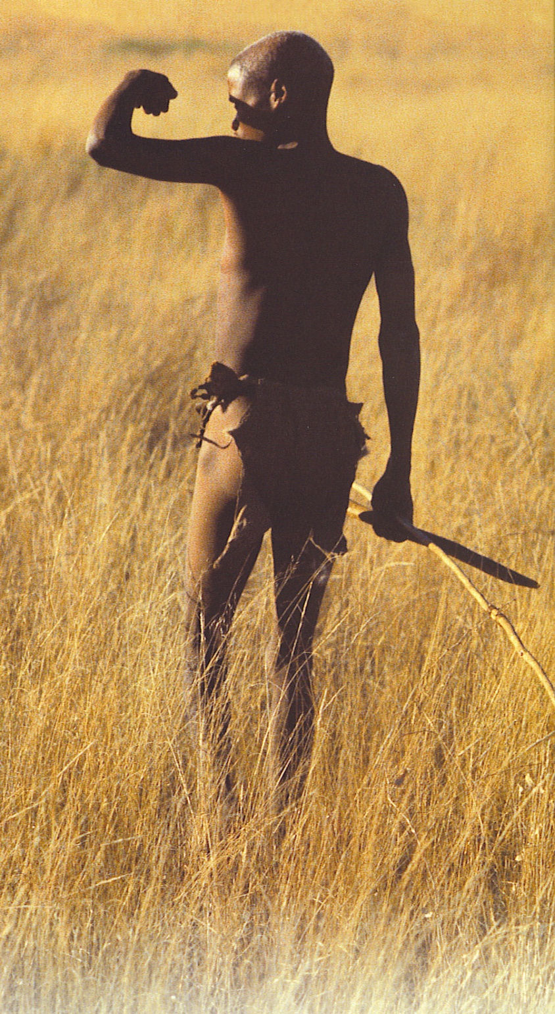
Hunting & Gathering Societies
Settlements are NOT PERMANENT
Populations remain small
Early hunter-gatherers lived in wetter & better environments and had an easier life than those of the modern day.
  Eastern North America-forests, wildlife & nuts
  Pacific Coast Americas-salmon fishing
  Aleuts of tundra caribou herds
  Interior North America-buffalo herds

Slide 6
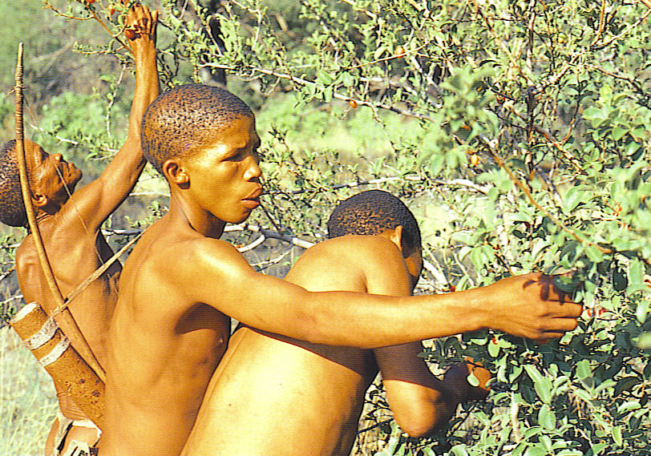
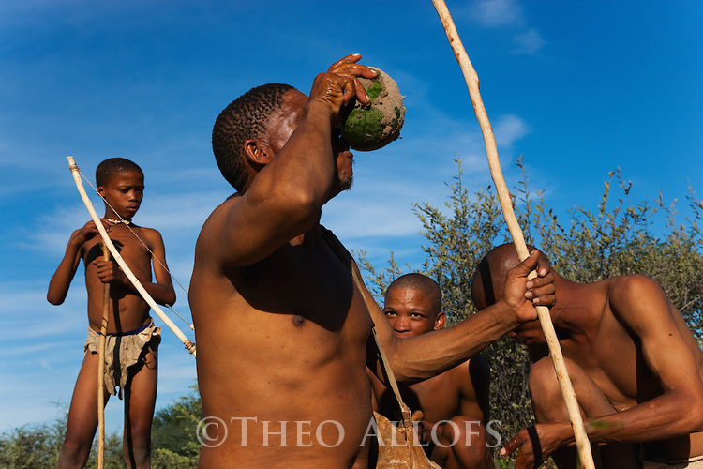
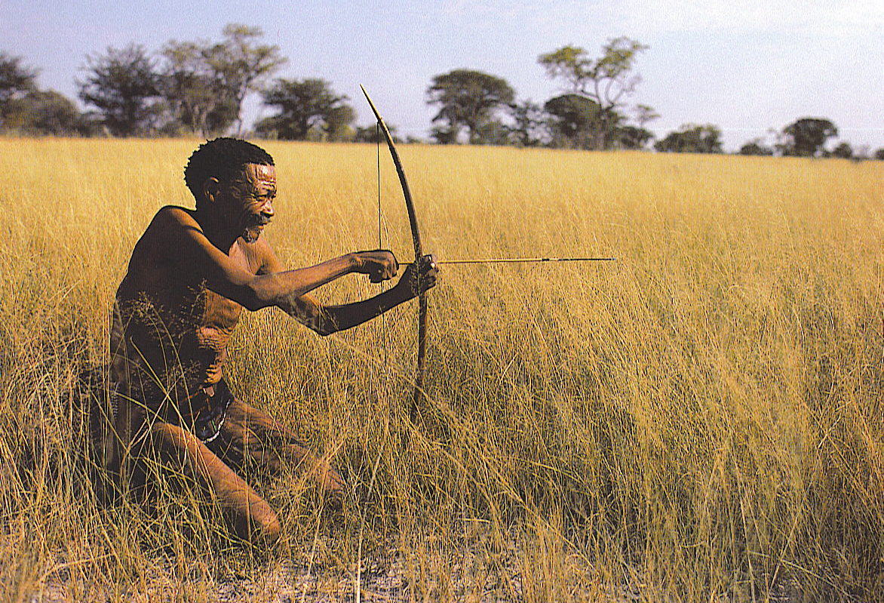
Bushmen of the
Kalahari still live
by hunting and
gathering
Notes:
Top Left-Bushmen of the Kalahari gather berries
Bottom Right-a Bushman aims his poisoned tipped, bone arrow at an animal in the dry grass plains of the Kalahari Desert. Also called the San-the live in small, scattered mobile bands. Most common prey are antelopes, wildebeest and other smaller game.

Slide 7
Agricultural Revolutions
Agriculture has passed through a series of revolutionary changes
  Not everywhere at the same time
  Transition from predominantly subsistence activity to predominantly capital-intensive, market-oriented commercial agriculture
Three distinct revolutions
Notes:
Since its discovery some 10,000 years ago, agriculture has passed through a series of revolutionary changes
We have moved from predominantly subsistence practices to predominantly capital-intensive, market-oriented practices
Three distinct revolutions

Slide 8
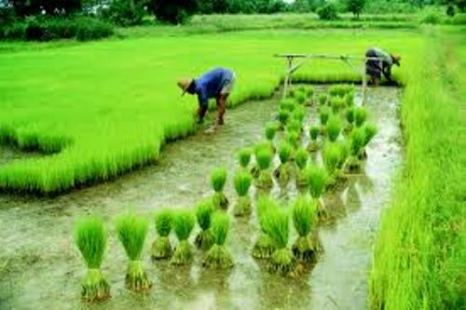
Invention of agriculture
1st Agricultural Revolution
  Humans domesticated plants and animals; no longer relied on hunting/gathering
Emergence of seed agriculture (wheat, rice)
    Use of the plow and draft animals
  8000 BC – population starts growing at a more rapid rate, some emigration begins to happen (move from stage 1 to 2 of DTM)
  People were able to create larger and more stable sources of food and more people survived
  Job Specialization / Settled lifestyle

Slide 9
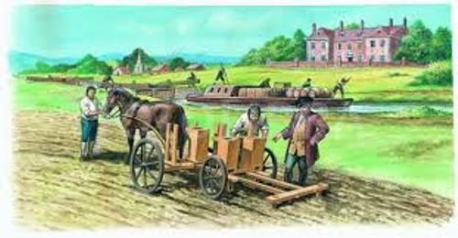
Second Agricultural Revolution
Late Middle Ages
Occurred in tandem with Industrial Revolution
    End of feudal landholding system
    Enclosure of individually owned fields
    Emergence of urban industrial markets
Modification of subsistence farming practices
    Crop rotation
    Use of natural and semi-processed fertilizers
    New tools and equipment
Dramatic increase in crop and livestock yields
Population Explodes
Railroad began linking farm & urban commercial food market

Slide 10
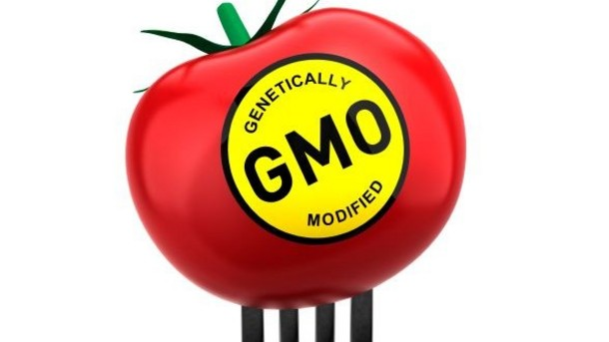
Third Agricultural Revolution
Origins in North America
Industrialization of agriculture
  Mechanization
    Replacement of human labor with machines
  Chemical farming
    Use of synthetic fertilizers, herbicides, pesticides
  Food manufacturing
    Addition of economic value through processing, canning, refining, packaging
Green Revolution
  Plant breeding
Biotechnology
  Genetic manipulation
Notes:
Unlike the first two agricultural revolutions – which originated in the Eastern Hemisphere, the third had its origins in the Western Hemisphere – North America, to be specific
The Third Agricultural Revolution involves the industrialization of agriculture
Mechanization
Chemical farming
Food manufacturing
In other words, that fourth bullet in the unit description in the course outline: “modern commercial agriculture”
And this is where the challenge of teaching comes into play.
Most textbooks cover traditional agriculture well, but many fall short in addressing contemporary agro-industry.
Most textbooks cover the Green Revolution, but give only passing reference to biotechnology – two important and quite different movements in modern agriculture

