Slide 1
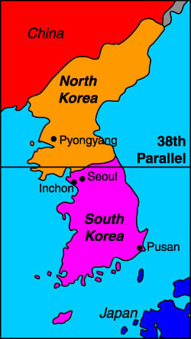
War in Korea
After WWII, North of 38th surrenders to USSR, South surrenders to US
Soviets supply North with tanks and planes in hopes of taking over peninsula
Did not believe the US would defend S. Korea

Slide 2
Standoff at the 38th Parallel
N. Korea swept over 38th Parallel in surprise attack on S. Korea
S. Korea asks UN for help – 15 nations participate under command of General MacArthur
N. Koreans continue to advance
  Control entire peninsula by 1950
MacArthur launches surprise attack in same month
  N. Koreans pushed back north
  Half surrender, half retreat

Slide 3
The Fighting Continues
UN troops push N. Koreans across 38th into N. Korea
  Keep pushing north towards Chinese border
Which side would China support?
China sends troops into N. Korea
Chinese push south back over 38th and capture S. Korean capital Seoul

Slide 4
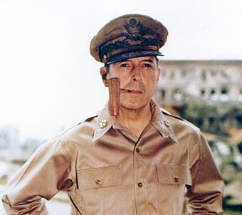
General MacArthur
Calls for a nuclear attack on China
Truman says, “We are trying to prevent a world war, not start one.”
MacArthur fired after he tried to go over Truman’s head to Congress

Slide 5
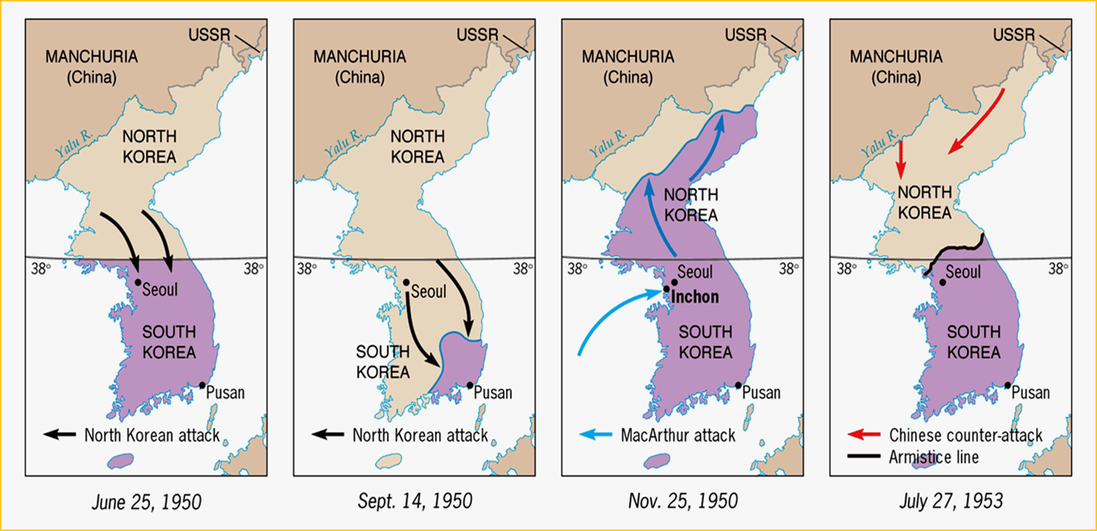
The War Nears the End
UN forces drive Chinese and N. Koreans out of S. Korea and regain control
July 1953 – cease-fire agreement signed
  Border set near the 38th Parallel

Slide 6
Aftermath of the War
Korea remains divided
Demilitarized zone separates the two countries
N. Korea
  Dictator Kim Il Sung established collective farms, developed heavy industry, built of military
  1994 – developed nuclear weapons but major economic problems
S. Korea
  Prospered with help from US and other countries
  Highly developed, democratic country

Slide 7
Secret State of North Korea
Google: Frontline Secret State of North Korea
Watch video and take notes:
  What are the defining aspects of the North Korean state?
  What is life like for North Koreans?

