Slide 1
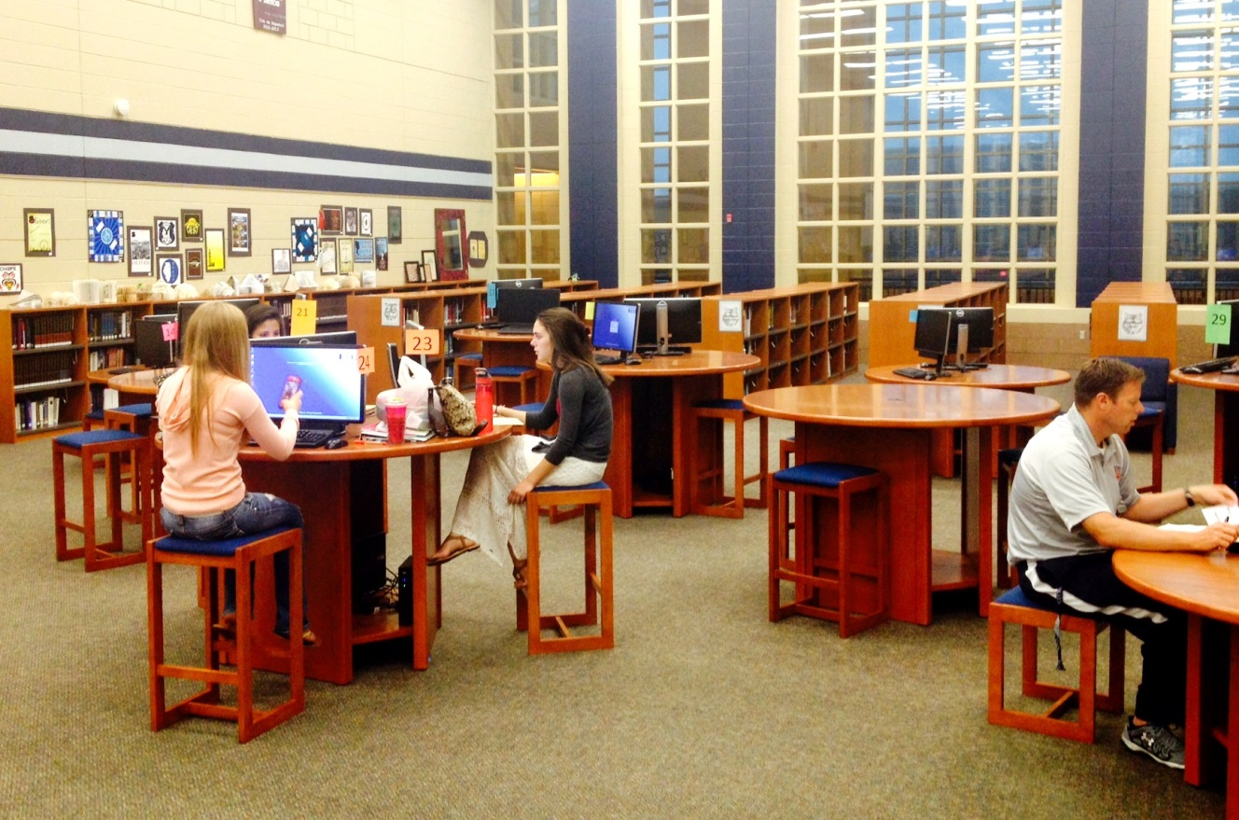
Oswego East High school
LRC

Slide 2
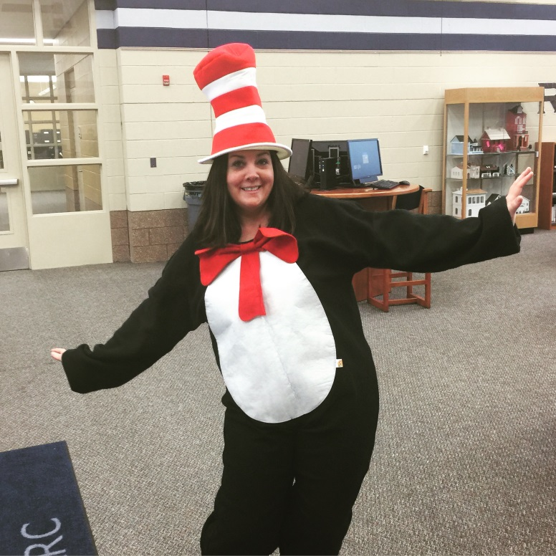
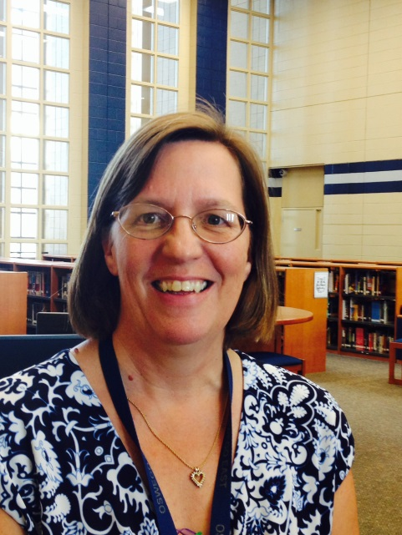
Smiling Faces in the LRC
Mrs. Fairless
LRC Director
Mrs. Kline
LRC/AV Assistant

Slide 3
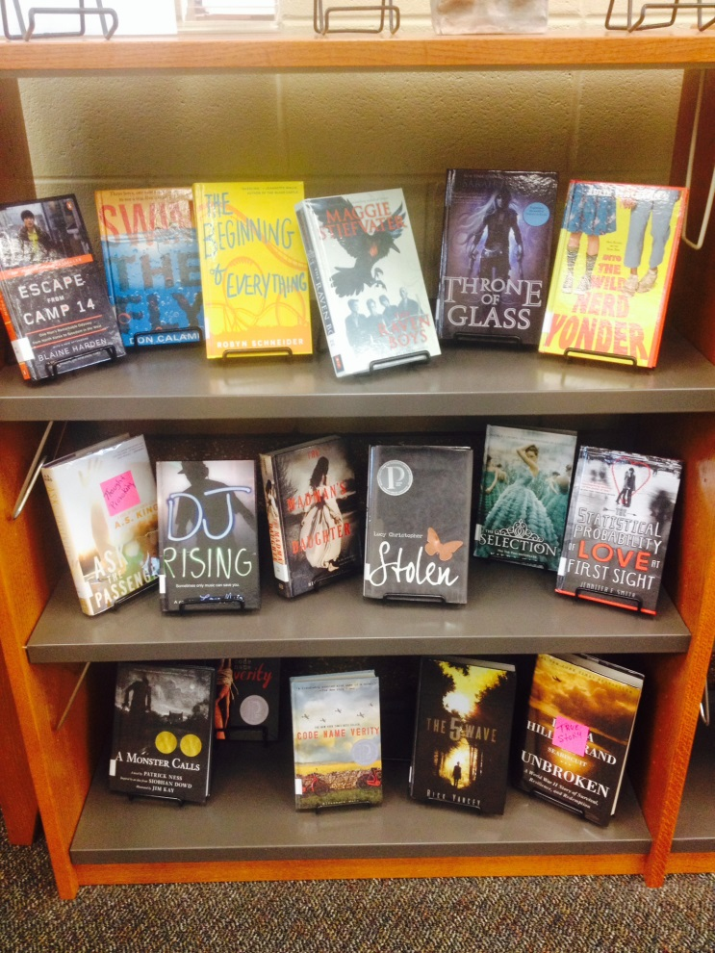
Something for everyone!
10,000+ UNIQUE titles
30+ Computer workstations
Online databases

Slide 4
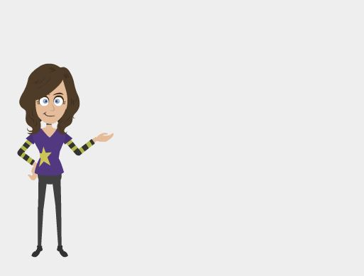
OEHS Reading Programs
Abraham Lincoln Reader’s Choice Award
Read for a Lifetime
Read 4 books on one list - receive an invitation to the voting party

Slide 5
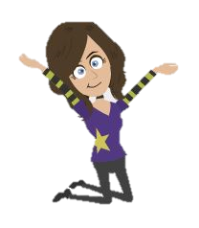
Oswego East Book Club
Read books, talk about books, watch movies that were books
Meets the 1st & 3rd Thursday of the month
First meeting/Open house September 5@ 2:30 in the LRC
More information visit www.sd308.org/oehs and click on the LRC tab and find the OE Book Club link

Slide 6
Library need-to-knows
Mon–Thurs 7:00am - 3:30pm
Friday 7:00am - 2:30pm
Passes needed during the day
Swipe card at attendance cart

Slide 7
Library need-to-knows
  LRC use during Lunch/Freshman Seminar
  Pass from teacher
  Sign in for attendance
  Computer work/quiet read/book check-out/group work

Slide 8
Library need-to-knows
Book check out is 3 weeks
Check out 10 items at a time
10 cent/day late fee
Half price fines if you pay when you return

Slide 9
Library need-to-knows
Purchase pencils, pens, paper…
Food??
Print – Don’t forget to bring your School ID
Really great books!!

Slide 10
Browsing the LRC
  Fiction
  Nonfiction
  Reference

Slide 11
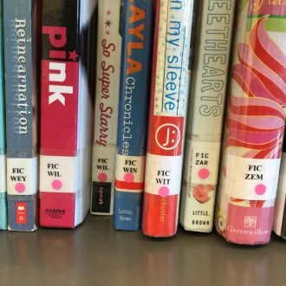
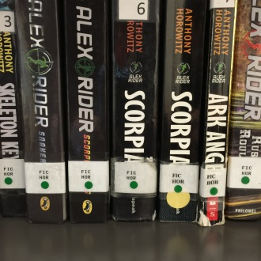
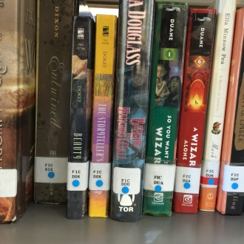
Browsing the LRC
13 Different Genres
Adventure
Romance
Classic
Fantasy
Historical
Humor
Mystery
Paranormal
Realistic
Sci fi
Sports
Urban Lit
War

Slide 12

Oswego East LRC Online
Log on to your desktop
www.sd308.org
Locate your school
Locate the OE LRC
Locate the Online Databases
No password needed at school
Password needed to access from home
User ID: oehs Password: wolves

Slide 13
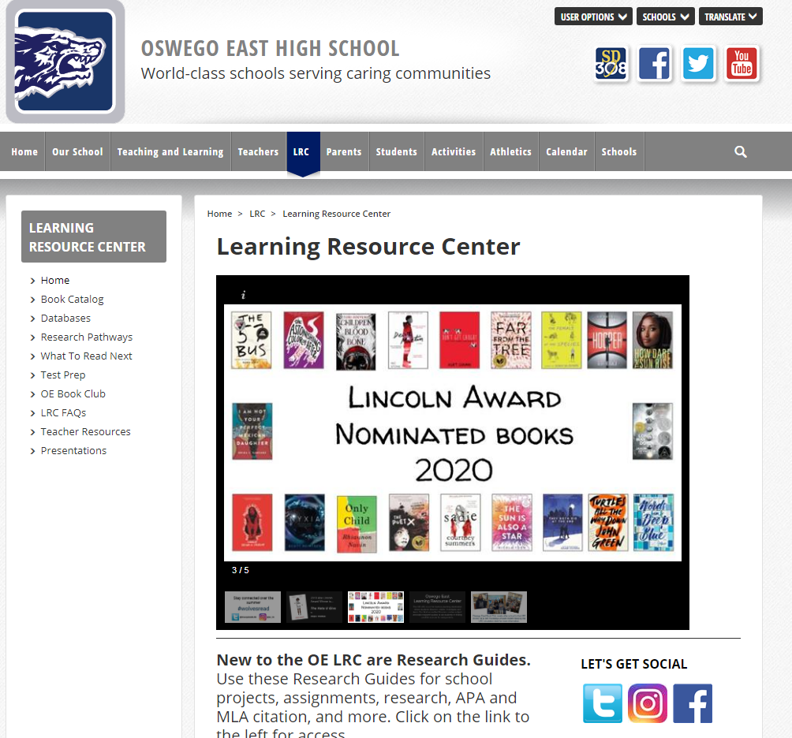
www.sd308.org/oehs

Slide 14
www.sd308.org/oehs

Slide 15
www.sd308.org/oehs

Slide 16
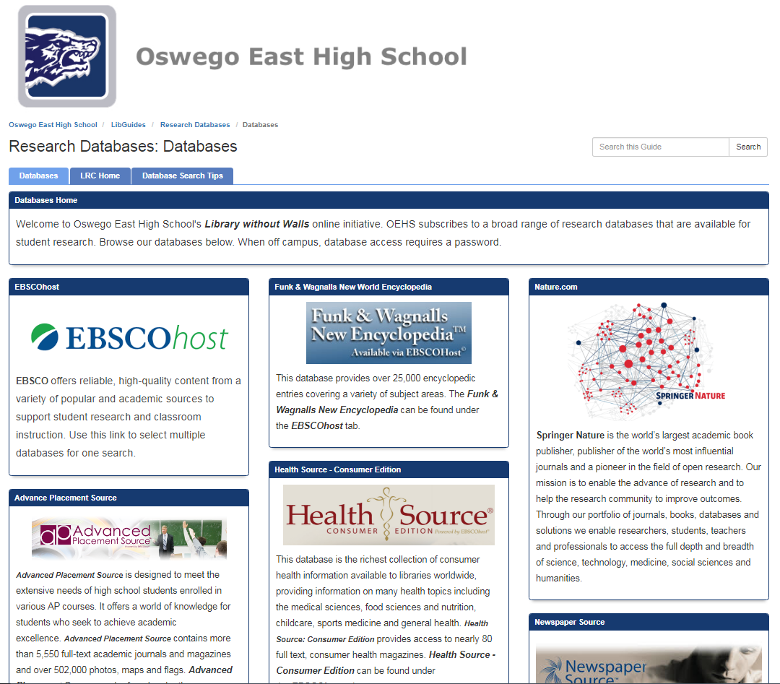
Research Databases

Slide 17
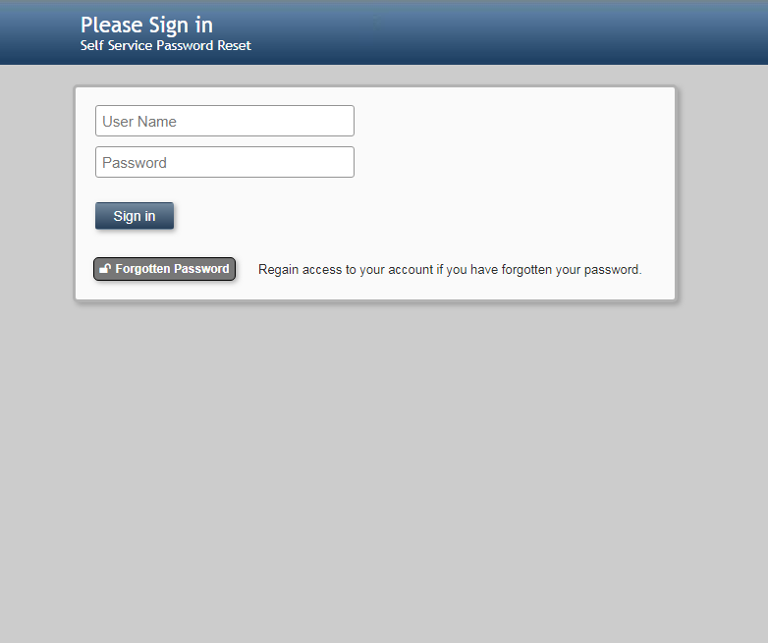
Mypassword.sd308.org

Slide 18
Thanks for your attention…
Now, let’s go find some great books!!

Slide 19
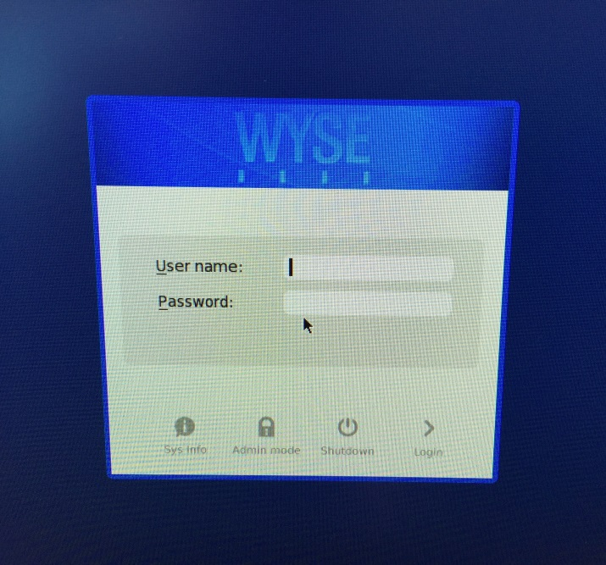
Oswego East Online
Log on to your desktop
User Name : Your student ID
Password: previous password or birthdate or locker combo – no dashes
We can change it

Slide 20
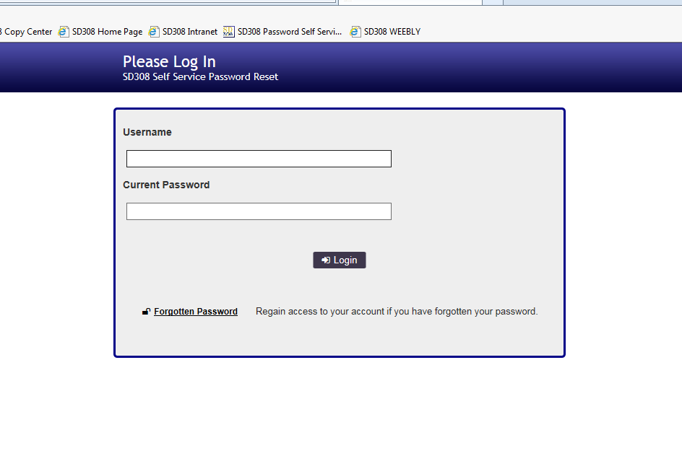
My Password Portal
mypassword.sd308.org
User Name : Your student ID
Password: current password or birthdate or locker combo – no dashes
We can change it

