Slide 1
Models of
Spatial relationships
Between Nations and States

Slide 2
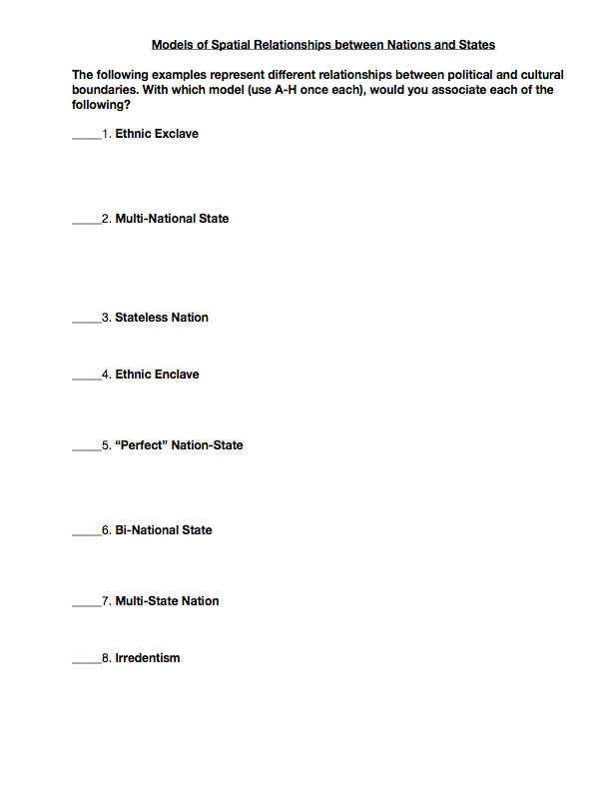
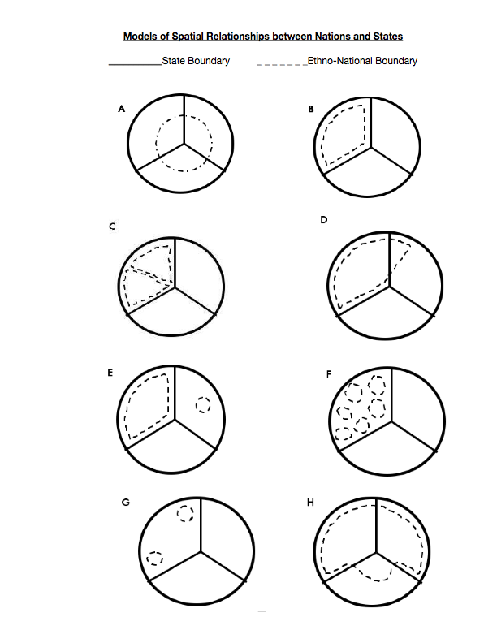
STUDENT HANDOUT
FRONT
BACK

Slide 3
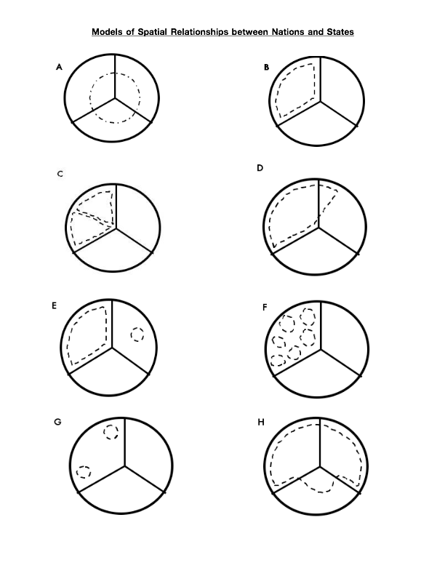

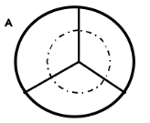
Match the locations with the correct graph..some will have more than one country.
Match the name with the graph on the opposite side.
Albanians
Austria
Basques in Spain
Belgium
Bretons in France
Canada
former U.S.S.R.
Germany
Hungarians in Romania
Iceland
Japan
Kurds
Palestinians
Country 1
Country 3
Country 2
Ethnic Exclave
Multi-National State
Stateless Nation
Ethnic Enclave
“Perfect” Nation-State
Bi-National State
Multi-State Nation
Irredentism

Slide 4

A
Match the locations with the correct graph. Some will have more than one country.
Albanians
Austria
Basques in Spain
Belgium
Bretons in France
Canada
former U.S.S.R.
Germany
Hungarians in Romania
Iceland
Japan
Kurds
Palestinians
Ethnic Enclave
Multi-National State
Stateless Nation
Ethnic Enclave
“Perfect” Nation-State
Bi-National State
Multi-State Nation
Irredentism
Stateless Nation
EXAMPLE COMPLETED WITH CLASS

Slide 5
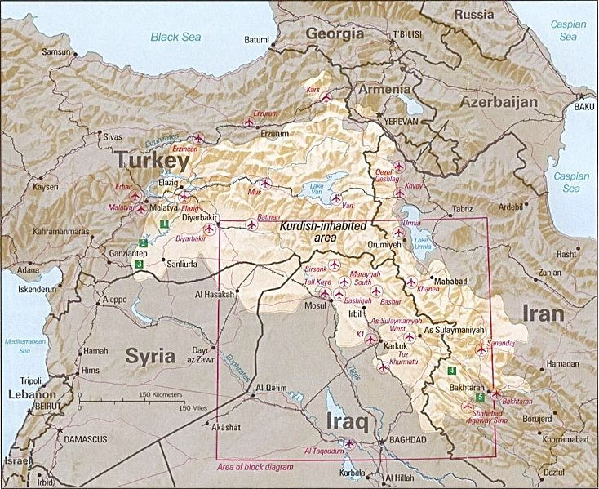

Slide 6
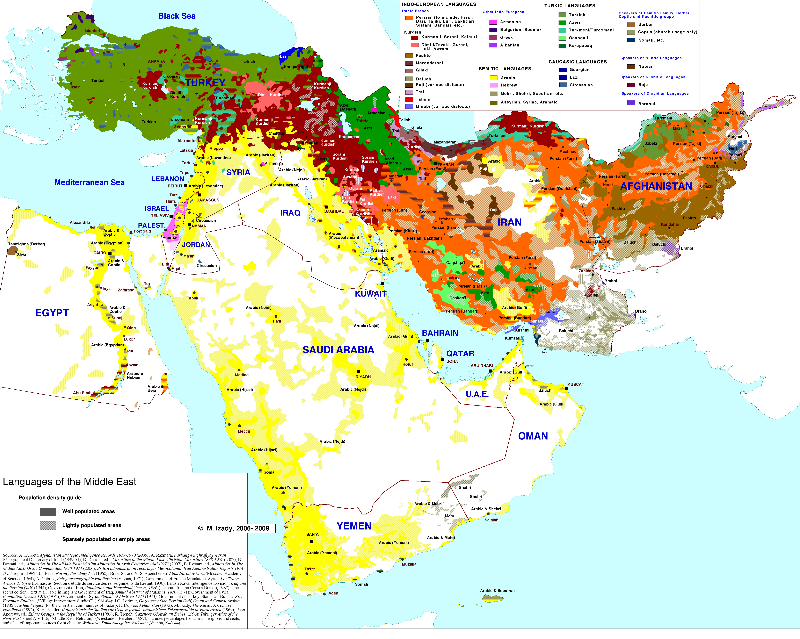

Slide 8
A
Stateless Nation - Kurds: An ancient group with a distinctive language and culture, and concentrate in Turkey, Iran, and Iraq. Smaller numbers live in Syria, Armenia, and Azerbaijan.

Slide 9
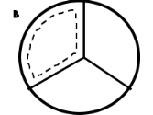
b
Albanians
Austria
Basques in Spain
Belgium
Bretons in France
Canada
former U.S.S.R.
Germany
Hungarians in Romania
Iceland
Japan
Kurds
Palestinians
Ethnic Exclave
Multi-National State
Stateless Nation
Ethnic Enclave
“Perfect” Nation-State
Bi-National State
Multi-State Nation
Irredentism
“Perfect” Nation-State

Slide 10
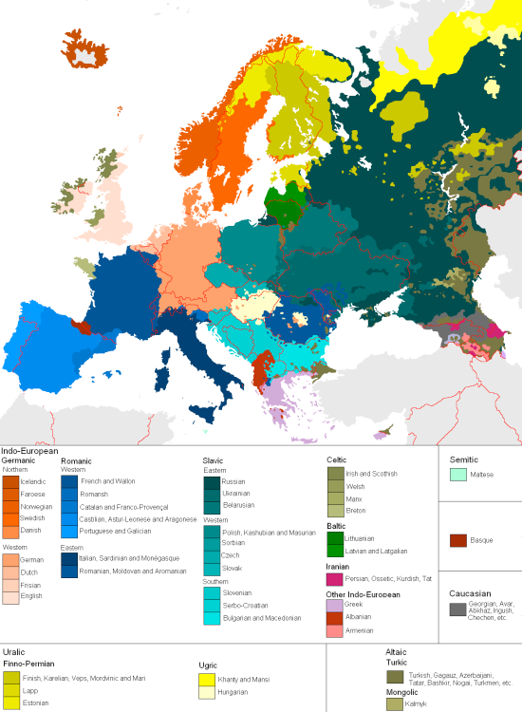

Slide 11
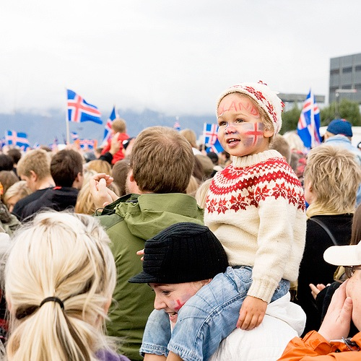

Slide 12
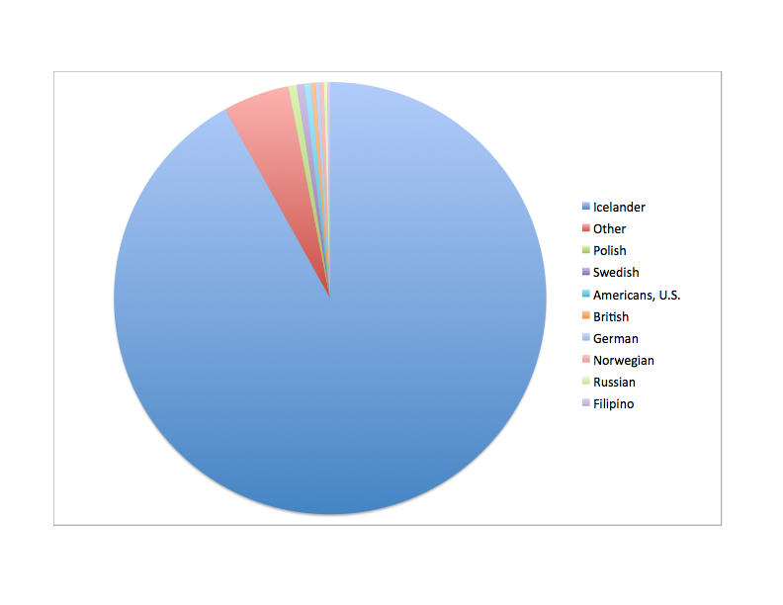
92% Icelander
Iceland’s Ethnic Groups

Slide 13
b
“Perfect” Nation-State - Icelanders: Although they are of Northern European origin, the people who live on the island of Iceland have evolved as a nation of their own. Virtually the entire population of Iceland is today comprised of Icelanders and few Icelanders live anywhere else in the world. Another example is Japan: Occupied by a distinct nation, or people.

Slide 14
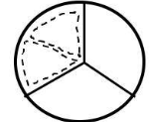
C
Albanians
Austria
Basques in Spain
Belgium
Bretons in France
Canada
former U.S.S.R.
Germany
Hungarians in Romania
Iceland
Japan
Kurds
Palestinians
Ethnic Exclave
Multi-National State
Stateless Nation
Ethnic Enclave
“Perfect” Nation-State
Bi-National State
Multi-State Nation
Irredentism
Bi-National State

Slide 15
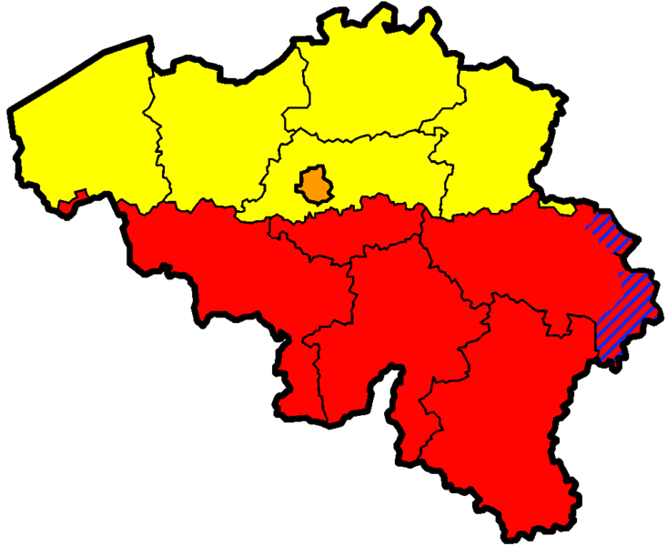

Belgium’s languages

Slide 16
C
Bi-National State - Flemings and Walloons in Belgium: Although the map would encourage us to think that the people who live in Belgium are Belgians, this is not necessarily true. Instead, the people of northern Belgium identify themselves as Flemings, and the people of southern Belgium identify themselves as Walloons.

Slide 17
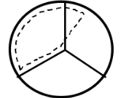
D
Albanians
Austria
Basques in Spain
Belgium
Bretons in France
Canada
former U.S.S.R.
Germany
Hungarians in Romania
Iceland
Japan
Kurds
Palestinians
Ethnic Exclave
Multi-National State
Stateless Nation
Ethnic Enclave
“Perfect” Nation-State
Bi-National State
Multi-State Nation
Irredentism
Irredentism

Slide 18
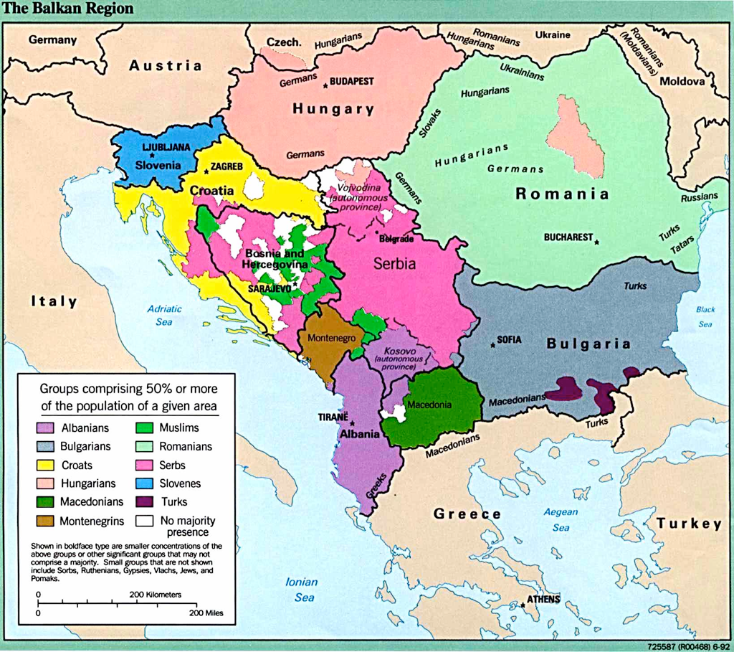

Slide 20
D
Irredentism - Albanians: Most of the people who identify themselves as Albanians live in the Republic of Albania. However, the southernmost part of Yugoslavia, an area bordering Albania known as Kosovo, is about 90 percent Albanian.

Slide 21
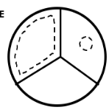
E
Albanians
Austria
Basques in Spain
Belgium
Bretons in France
Canada
former U.S.S.R.
Germany
Hungarians in Romania
Iceland
Japan
Kurds
Palestinians
Ethnic Exclave
Multi-National State
Stateless Nation
Ethnic Enclave
“Perfect” Nation-State
Bi-National State
Multi-State Nation
Irredentism
Ethnic Exclave

Slide 23
E
Ethnic Exclave (outside bits of one country inside another country) - Hungarians: The state of Hungary emerged out of the Austro-Hungarian Empire after World War I, but with a very restrictive set of boundaries. Although most of the people who live in Hungary are Hungarians, there are minorities in surrounding countries, including a pocket of Hungarians in the middle of Romania.

Slide 24
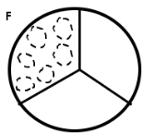

F
Albanians
Austria
Basques in Spain
Belgium
Bretons in France
Canada
former U.S.S.R.
Germany
Hungarians in Romania
Iceland
Japan
Kurds
Palestinians
Ethnic Exclave
Multi-National State
Stateless Nation
Ethnic Enclave
“Perfect” Nation-State
Bi-National State
Multi-State Nation
Irredentism
Multi-National State

Slide 25
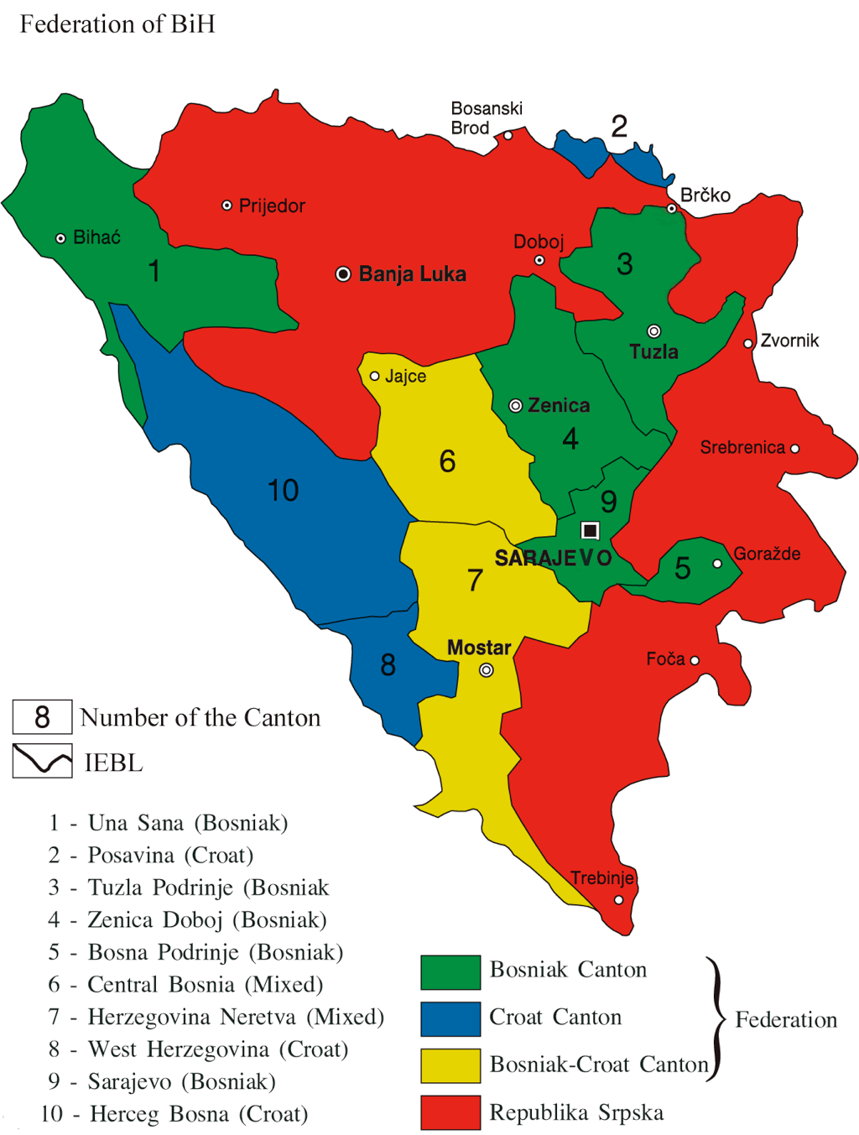
Bosnia

Slide 26
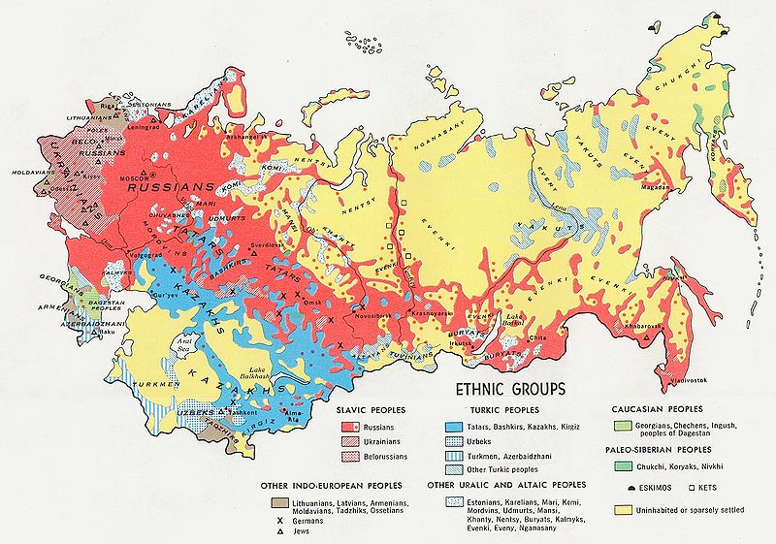

Slide 27
F
Multi-National State - Former U.S.S.R.: The Union of Soviet Socialist Republics was born of the Russian Empire in 1917. It encompassed over 100 different nationalities, fifteen of which were assigned Union Republic status. The Soviet Union ceased to exist on December 26, 1991, in part because of the “nationalities problem.” Another example is Canada: It contains three distinct nations (native Canadians and British and French origins) and has two official languages, English and French.

Slide 28
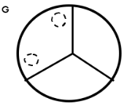
G
Albanians
Austria
Basques in Spain
Belgium
Bretons in France
Canada
former U.S.S.R.
Germany
Hungarians in Romania
Iceland
Japan
Kurds
Palestinians
Ethnic Exclave
Multi-National State
Stateless Nation
Ethnic Enclave
“Perfect” Nation-State
Bi-National State
Multi-State Nation
Irredentism
Ethnic Enclave

Slide 29
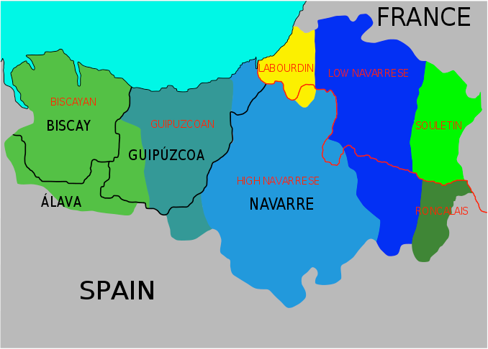
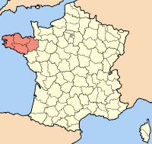
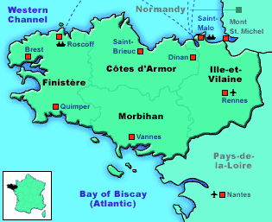
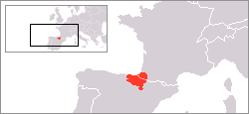

Slide 30
G
Ethnic Enclave (completely surrounded by another state but not controlling it) - Bretons and Basques in France: In France, the concept of being French permeates virtually everyone who lives there. Nevertheless, two minorities on the mainland are distinctly non-French, the Basques of the southwest, and the Bretons of the peninsula known as Brittany.

Slide 31
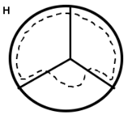

H
Albanians
Austria
Basques in Spain
Belgium
Bretons in France
Canada
former U.S.S.R.
Germany
Hungarians in Romania
Iceland
Japan
Kurds
Palestinians
Ethnic Exclave
Multi-National State
Stateless Nation
Ethnic Enclave
“Perfect” Nation-State
Bi-National State
Multi-State Nation
Irredentism
Multi-State Nation

Slide 33
H
Multi-State Nation - Germans: There are two German states in Europe, Germany and Austria. In addition, about 70 percent of Switzerland’s population is German-speaking, most of who live on the German and Austrian sides of Switzerland.

Slide 34
Match the locations with the correct graph..some will have more than one country.
Match the name with the graph on the opposite side.
Albanians
Austria
Basques in Spain
Belgium
Bretons in France
Canada
former U.S.S.R.
Germany
Hungarians in Romania
Iceland
Japan
Kurds
Palestinians
3
5
6
8
1
2
4
7

Slide 35
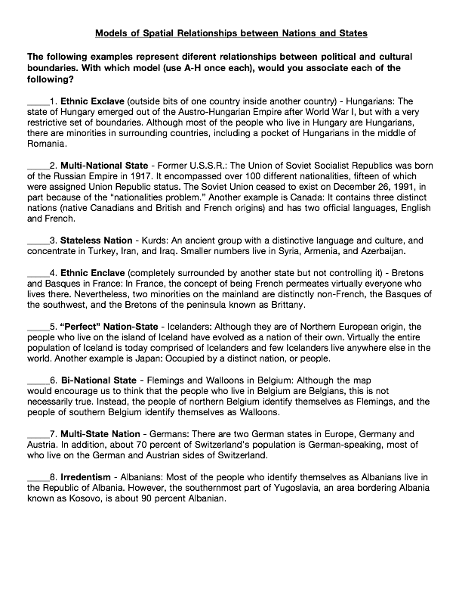
E
F
A
G
B
C
H
D

Slide 36
REVIEW
Which would the following be an example of:
1. Aborigines
2. United States
3. Russians in Kazakhstan
4. South Korea
5. Chinatown in NYC
6. Icelanders in Canada
7. Argentina and Uruguay
8. Potential Solution to Israel-Palestine Issue
Stateless Nation
Multi-National State
Irredentism
“Perfect” Nation-State
Ethnic Enclave or Exclave
Ethnic Exclave or Enclave
Multi-State Nation
Bi-National State

