Slide 1
Renaissance

Slide 2
Opening Q’s
Who has authority over your life?
Have you ever went against this authority?
Have you ever went against what was popular?
Who was the authority in medieval times?
What were the problems within the church?

Slide 3
What was going on before the Renaissance?
War and Plague in Europe
Strong belief in Christianity
The Crusades and the Plague cause doubt in existing institutions (the Church)
Survivors wanted to celebrate life and the human spirit

Slide 4

Transition from Medieval
Whole worldview is shattered
  No longer living in a bubble
Done with the church
Loss of faith = focus on individual
Concentrate on the here and now
Medieval – suffer to get to God
  Renaissance – enjoy life
Wars and fighting decreased
Trade brought the redevelopment of $$$ and the end of the _____________system.

Slide 5
What was the Renaissance?
Started in Italy and lasted from about 1300 to 1600
Explosion of creativity in art, writing architecture – “rebirth”

Slide 6
Why Important?
Renaissance ideas still influence modern thought
Led to the Reformation & creation of new religions

Slide 7
Pear deck map

Slide 8
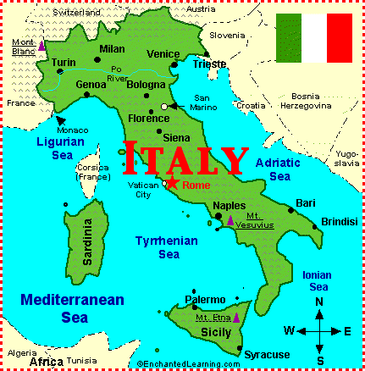

Why Italy?
City States
  Urban unlike the rest of Europe
  Then it spreads around the Mediterranean
Merchants ($$$)
  Merchants dominated politics
  Belief in individual achievement
The Medici family of Florence
  Had bank branches in Italy and throughout major cities in Europe
Greek and Roman Influence
  Inspiration from ruins
  Studied & preserved ancient Latin / Greek writings

Slide 9
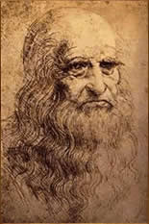
What is a Renaissance Man / Woman
Renaissance Man – excelled in many areas of study
  Charming, witty, well-educated in the classics, dances, sings, plays music, writes poetry, skilled rider, wrestler, swordsman, has self-control
  Da Vinci – artist, scientist, writer, botanist, musician, architect, engineer
Renaissance Woman – upper class, knows the classics, charming, inspires art but does not create it

Slide 10
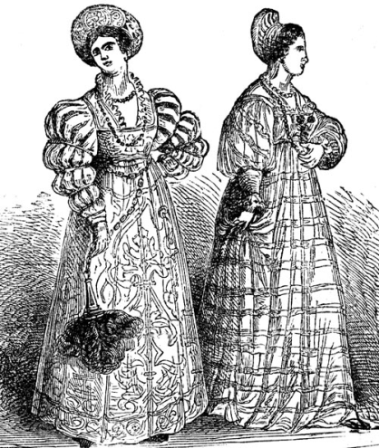

Classical Ideas Influence Renaissance
Humanism
  Human potential & achievements, use the wisdom of the ancients to increase the understanding of life
  History, literature, philosophy
Worldly Pleasures (Secularism)
  Middle Ages – plain clothing and food
  Renaissance – luxuries, music, fine food
Individualism – focus on individual interests & achievements
Scholarship – learning and questioning everything
Humanities-Greek, Latin, History, and Philosophy
People began to write more…Thinking!
Patrons of the Art (Supported the Arts)
  Church leaders (Pope Julius II), merchants, wealthy

Slide 11
Artists
Decorate homes, towns, and churches
Artists were well rewarded in Renaissance society.
  Leonardo da Vinci – Mona Lisa
  Michelangelo – David – follows Greek tradition
    Sistine Chapel
  Raphael – School of Athens – imaginary gathering of Greek thinkers
  Donatello – Statue of David slaying Goliath

Slide 12
Art - techniques
Perspective – make distant objects look smaller than closer ones, appears 3-D
Portraits of well-known figures – reflects individualism
More Realistic than Medieval Art
Accuracy – studied human anatomy & drew from live models
Frescoes-
Marble and Bronze Statues

Slide 13
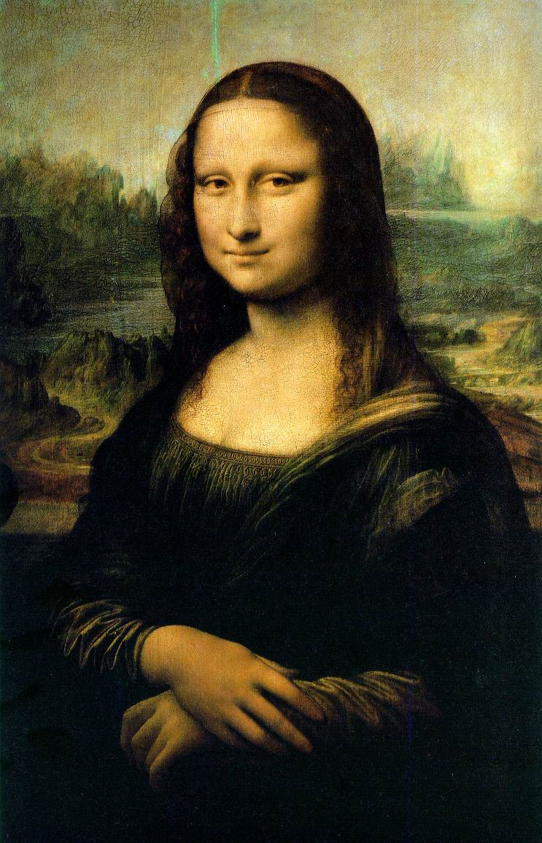
Renaissance Art
Life-like
Captivating
Combination of religious, secular, humanist, and classical thought
Mostly frescoes
Mona Lisa
Leonardo da Vinci
1503-1506

Slide 14
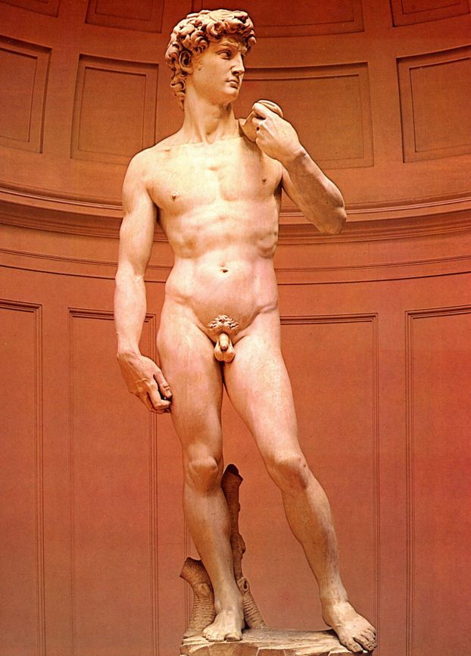
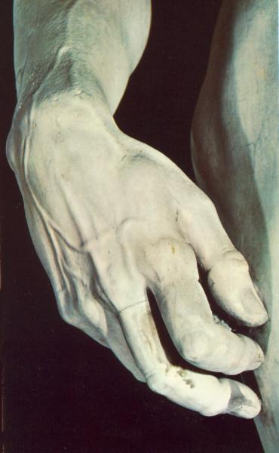
Renaissance artists studied anatomy
Showed signs of gesture and expression
Michelangelo’s David
  1501-1504

Slide 15
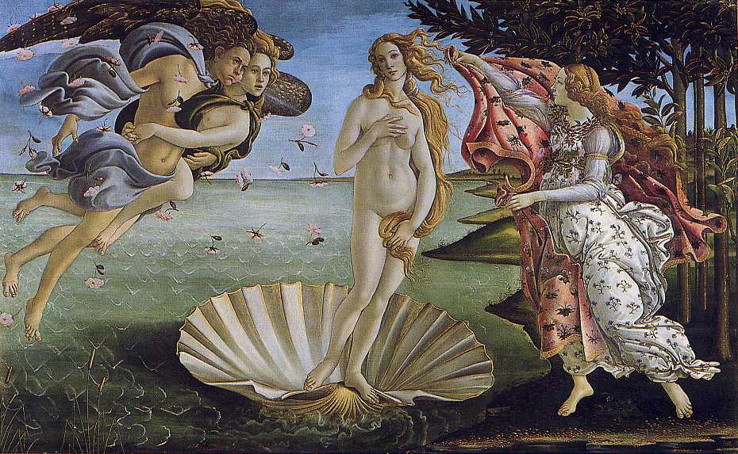
Renaissance Frescoes
Use of perspective
Sandro Botticelli
Birth of Venus
  1482

Slide 16
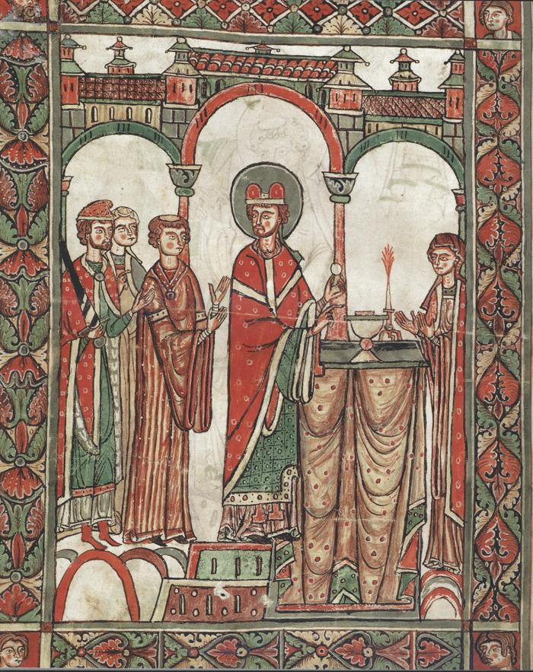
Medieval Artwork… what do you see?
What is the theme?
What is this style?
How can you tell this is Medieval?

Slide 17
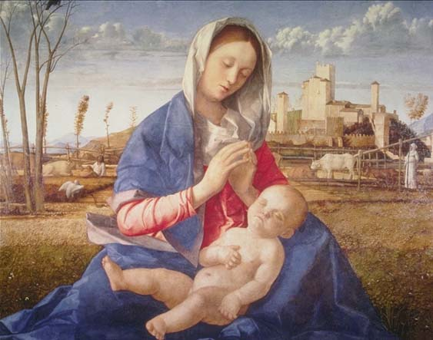
Renaissance Artwork… what is different?
Giovanni Bellini, The Madonna of the Meadow
Evidence of Humanism?

Slide 18


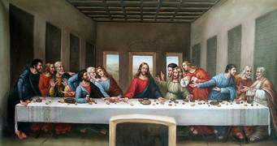

Leonardo da Vinci
“True Renaissance Man”

Slide 19
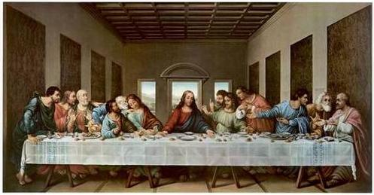
Da Vinci’s Tricks
Leonardo da Vinci
The Last Supper
  1497
Played a major role in Da Vinci Code by Dan Brown

Slide 20
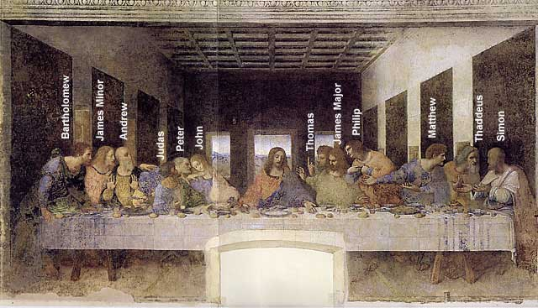
A Da Vinci “Code”:
St. John or Mary Magdalene?

Slide 21
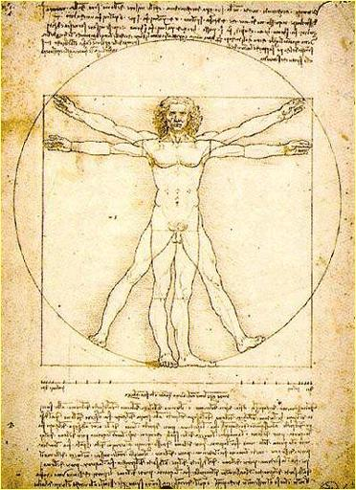

Slide 22
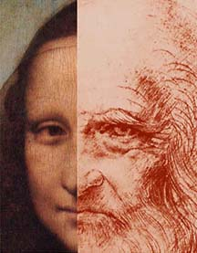

Mona Lisa OR da Vinci??

Slide 23
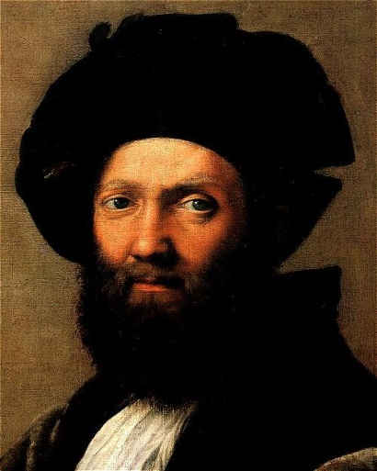
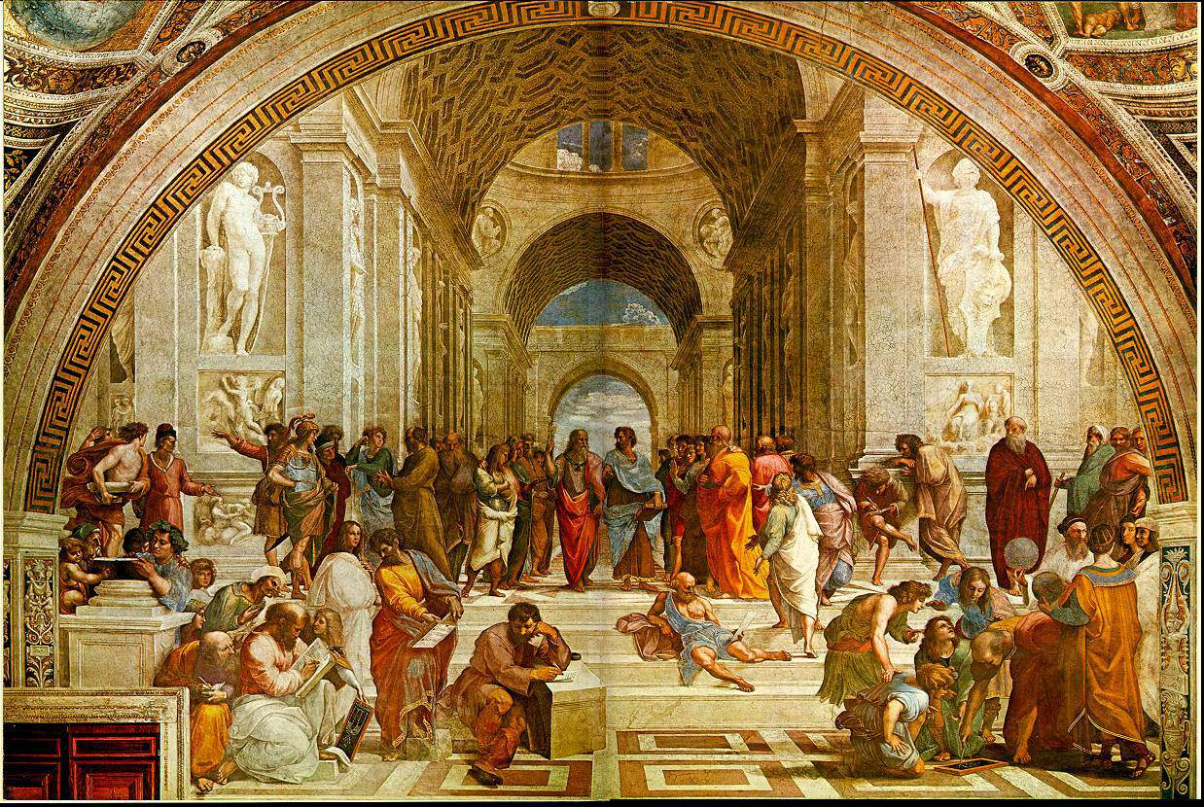
Raphael
School of Athens

Slide 24
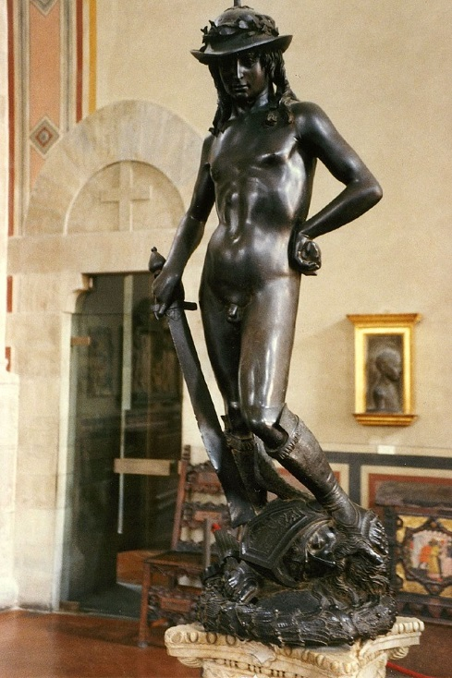
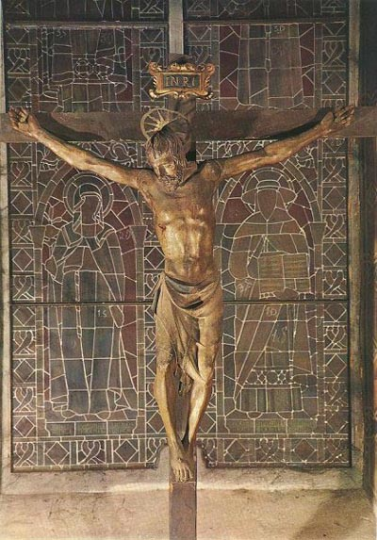
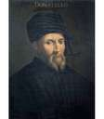
Donatello
David slaying Goliath
&
Jesus on the Cross

Slide 25
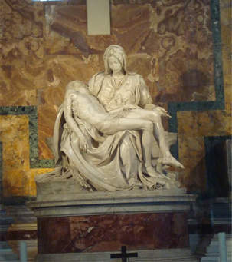
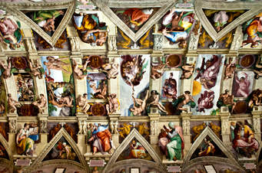
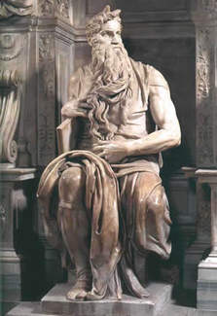
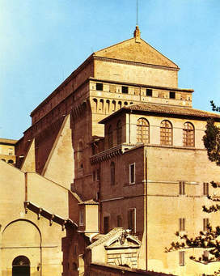
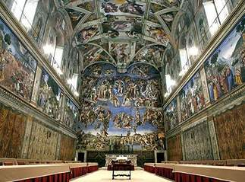
Michelangelo

Slide 26
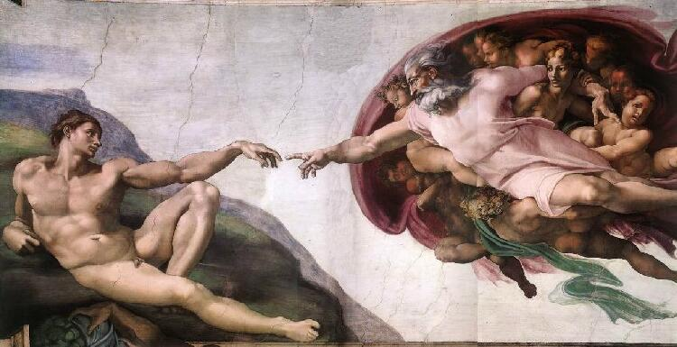
Sistine Chapel
Michelangelo Buonarroti
- Creation of Adam
- 1510

Slide 27
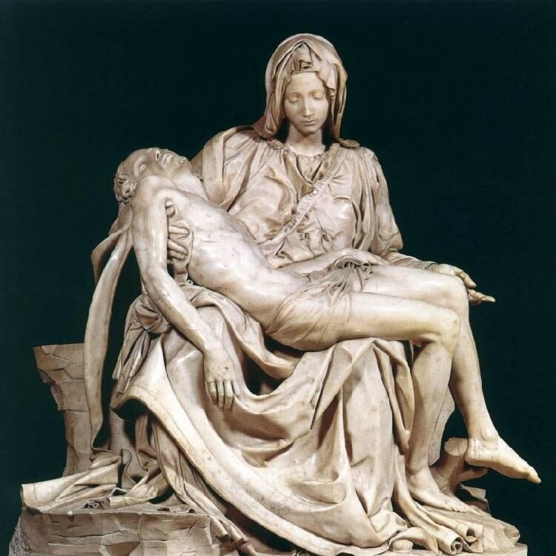
Religious Influence in art
La Pieta
Michelangelo
  1498-1499

Slide 28
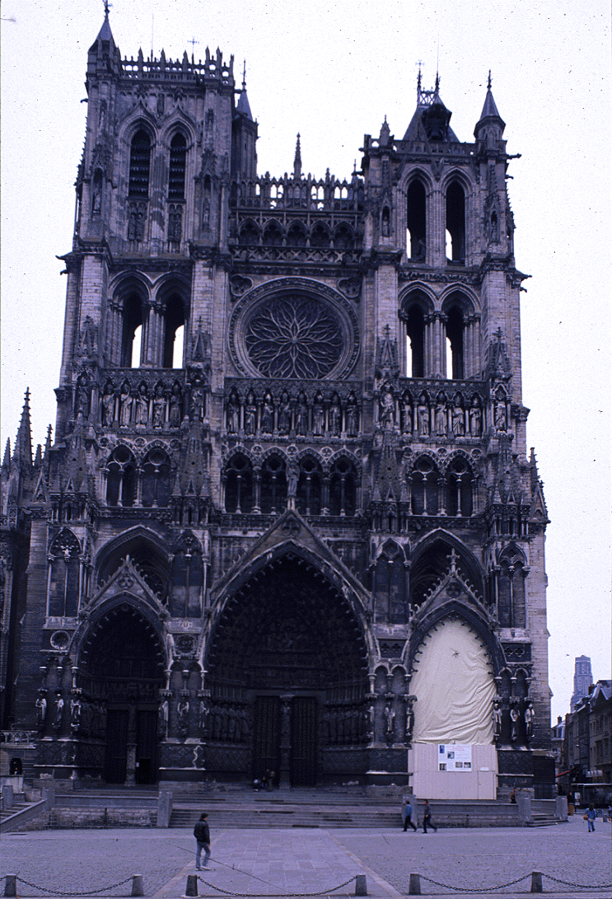
Renaissance Architecture
Rejected the Gothic Style
Adopted columns, arches, domes that the Greeks and Romans favored
During Middle Ages, cathedral architects had pointed, soaring arches and spires
Renaissance was a return to classical style

Slide 29
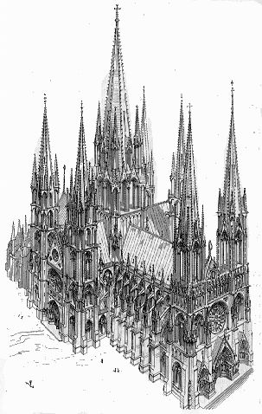
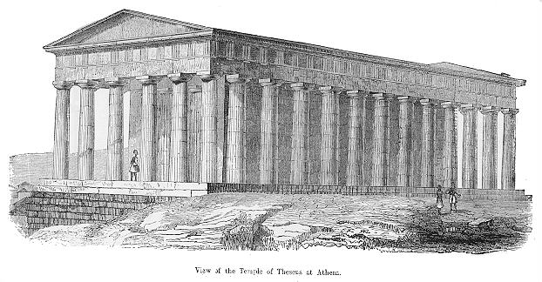

Slide 30
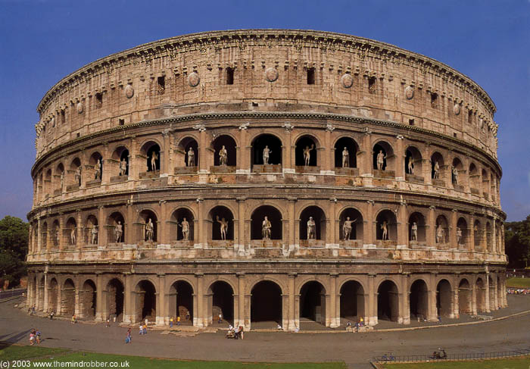

Slide 31
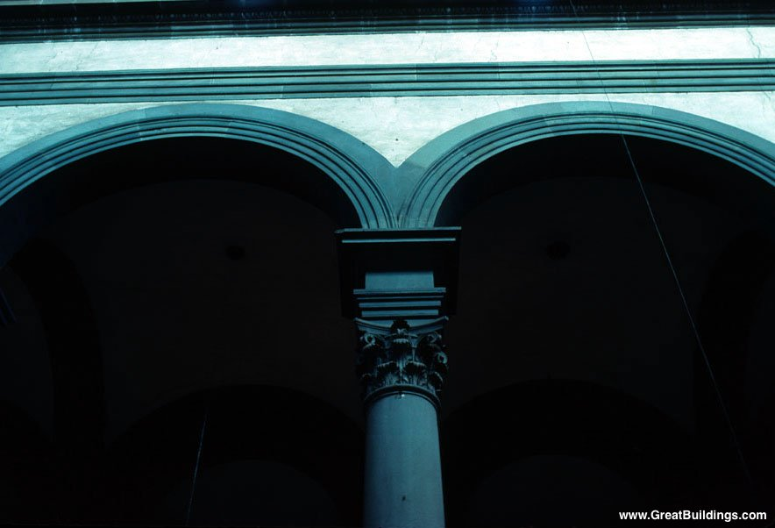
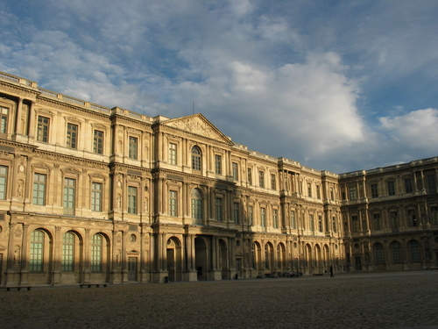

Slide 32
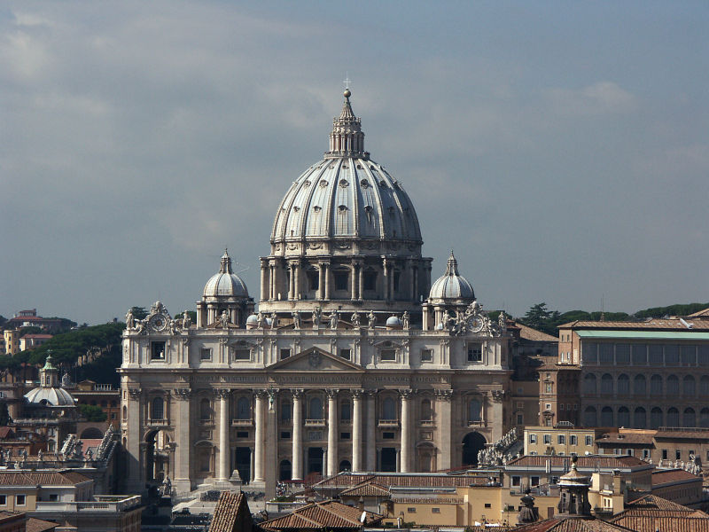
St. Peter’s of Rome
Greatest creation of the Renaissance, construction started in 1506 and completed in 1615

Slide 33
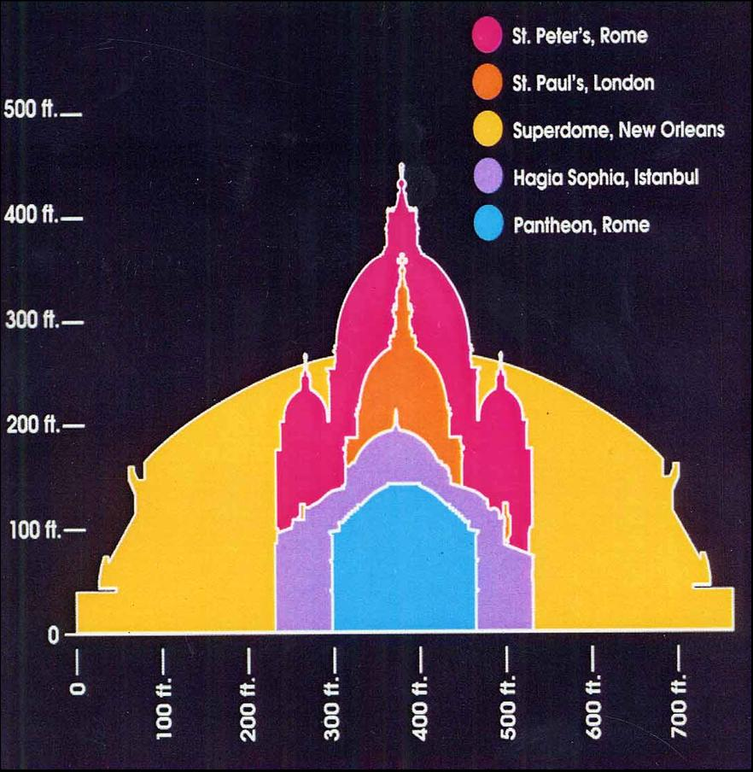
Comparing Domes

Slide 34
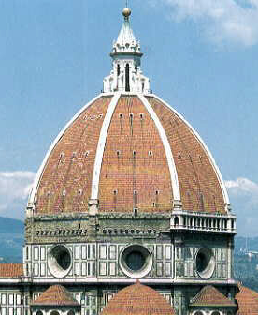
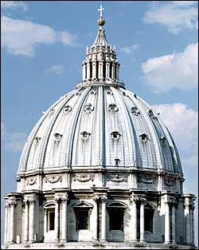
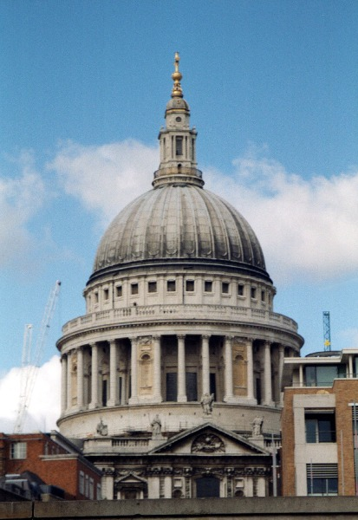
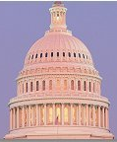
Other Famous Domes
Il Duomo St. Peter’s St. Paul’s US capital
(Florence) (Rome) (London) (Washington)

Slide 35
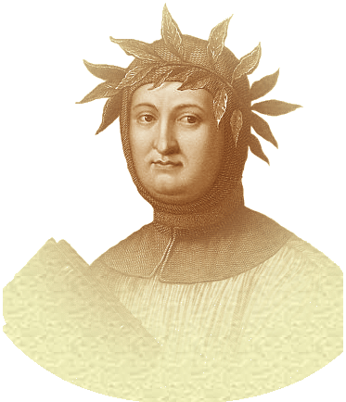
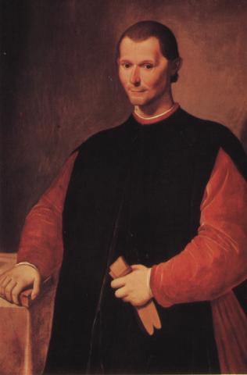
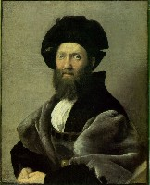
3 Examples of Humanism in Literature
PETRARCH
MACHIAVELLI
CASTIGLIONE

Slide 36
Changes in Literature
Humanism inspired news forms of writing
Produced works that reflected their time
Written in native language (vernacular) instead of Latin
Writers wrote for self-expression or to portray the personality of their subjects

Slide 37
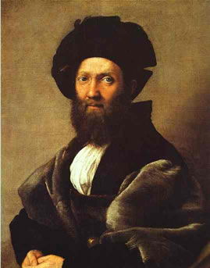
How-to Books
  Baldassare Castiglione – ideal man and woman
  A diplomat, observed court life
  Wrote The Courtier – how-to-book on manners and polite behaviors
  How to be the ideal man and ideal woman (Renaissance man/woman)
Niccolo Machiavelli – guide to rulers on how to gain and maintain power
Franceso Petrarch – wrote 317 Humanist sonnets (short poems)

Slide 38
Niccolò Machiavelli
A government official
Observed leading political figures of his time
Grew to respect those who knew how to gain & use power
Wrote The Prince – how to obtain and maintain power (Political Guide book)
Revolutionized the study of government and politics

Slide 39
The Prince – Key Ideas
Trickery is better than honesty
World is wicked- a successful prince must be “strong as a lion & shrewd as a fox”
Getting & maintaining power is more important than being a “good” leader
Argued that in the real world of power & politics a prince must sometimes mislead the people & lie to his opponents.
Better to be feared than loved
Ready to use force & deceit to hold power
Not morally right, but politically effective
Approved any activity deemed necessary to maintain control
Individuals can suffer as long as it is for the good of the state
Break agreements, tell lies, kill opponents, fight wars – to keep & expand power

