Slide 1
What imprint does agriculture make on the cultural landscape?
If you’ve even flown over large portions of the US, what did you notice about the organization of rural land?

Slide 2
Rural Life
It didn’t just happen that way, someone planned it out
It depended on what was important to you:
  French: Water = Long-lot system
  English: Use old system = Metes and Bounds
  Americans: Need consistent and large scale = Public Land Survey System (PLSS): Township and Ranges (rectangular survey system)

Slide 3
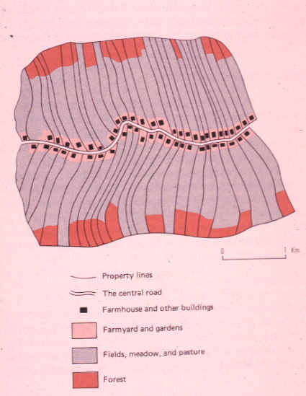
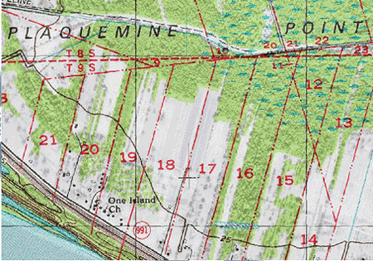
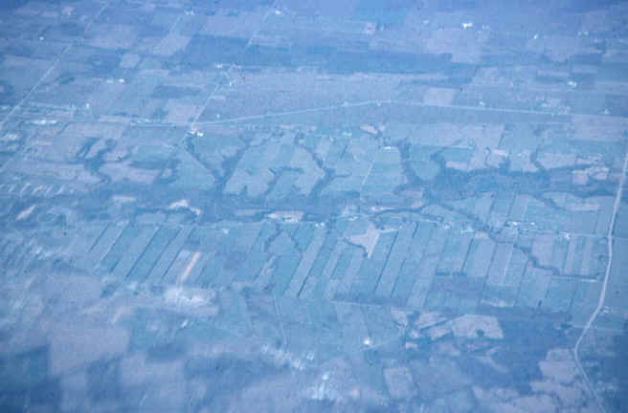
Long-lot system
Divided land into narrow parcels stretching back from rivers, roads or canals

Slide 4
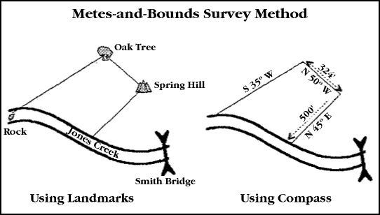
Metes and bounds survey
Natural features used to demarcate irregular parcels of land
Beginning with the Large White Oak 13 poles above the Sinking Spring, or Rock Spring, Running thence North 9 1/2 degrees East, 310 poles to a stake in John Taylor's field, thence South 89 1/2 degrees East, 310 poles to two Blackjacks, then North 89 1/2 degrees East, 155 poles to the beginning.

Slide 5
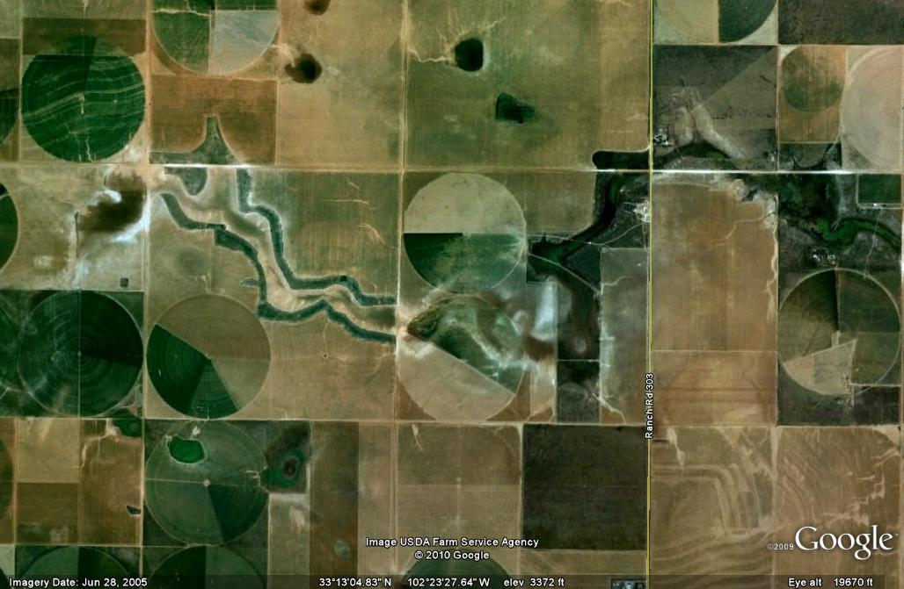
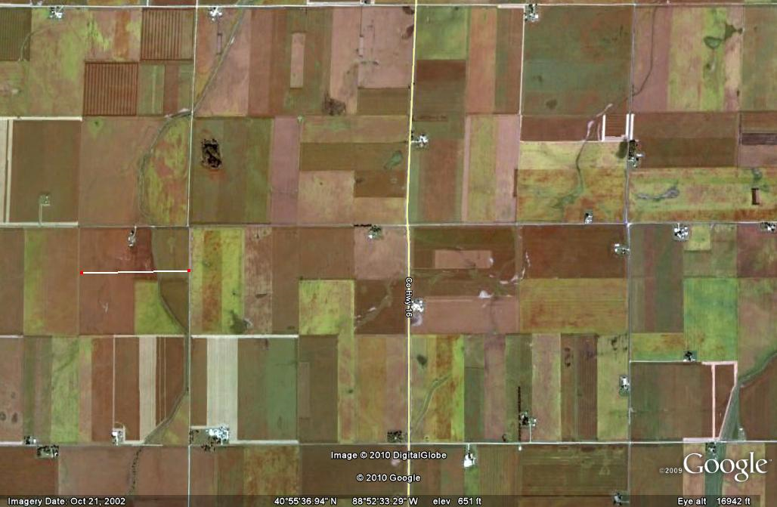
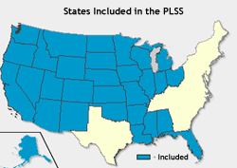
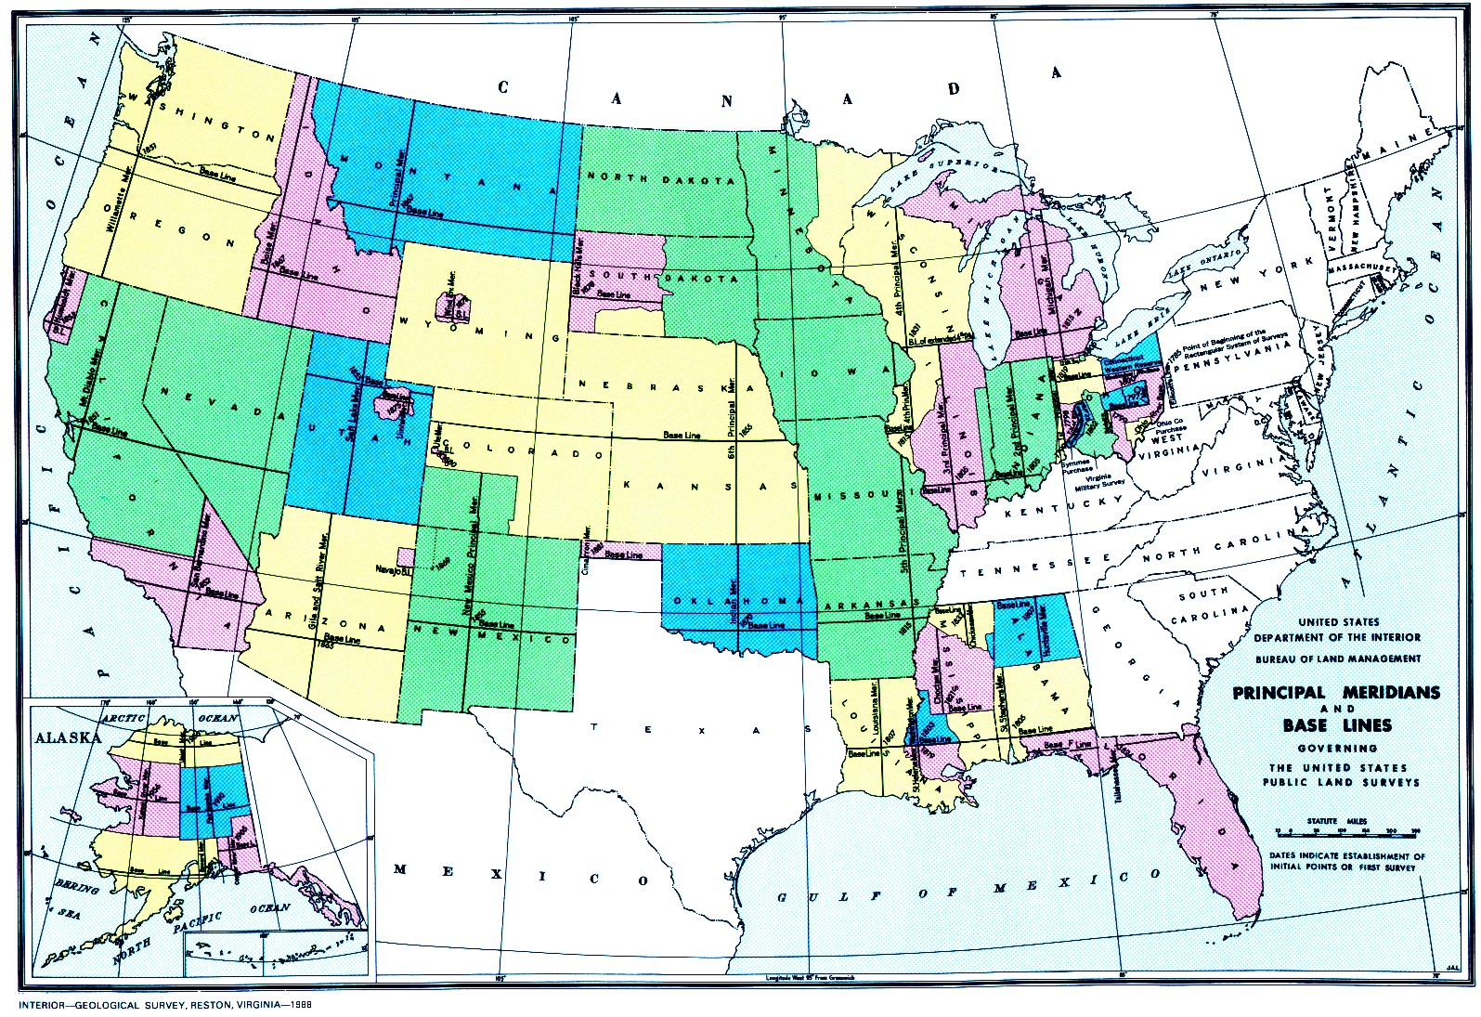
Public Land Survey System (PLSS): Township and Ranges (rectangular survey system)
Settlement could be regulated by law
Rigid gridlike pattern
Basic unit = 1 square mile section
Lines drawn without reference to terrain

