Slide 1
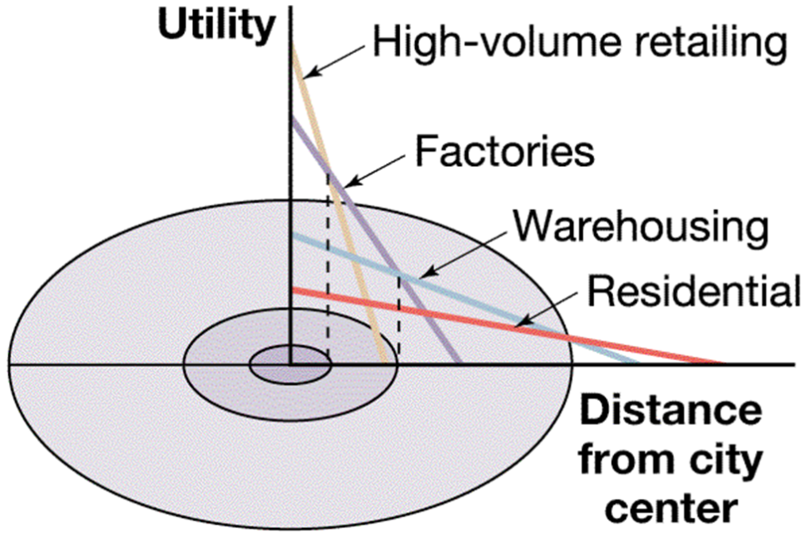
Bid-Rent Theory
The price and demand for real estate changes as the distance from the CBD increases
Price of land closer to CBD is higher
Different land uses will compete for desirable pieces of property in order to maximize profits
Accessibility increases the potential for more customers
Trade-off between accessibility and cost of land
Where have we seen a similar idea before?
How does this relate to Concentric Zone Model?

Slide 2
If you were a city planner, what would you rather add to your city?
A farmers market
A library
A Walgreens
An auto manufacturing plant
Multiplier Effect: the 'snowballing' of economic activity.
Industry locates in an area
This provides jobs
Workers have money to spend (taxes)
More shops open (taxes)
Services improve (paid for by taxes)
More jobs created

Slide 3
Can you have a Negative Multiplier?
Negative Multiplier Effect - A phenomenon in which the loss of jobs in one economic sector leads to further job loss in other economic sectors
So which would hurt more if it closed?
A farmers market
A library
A Walgreens
An auto manufacturing plant
Fermi Lab

Slide 4
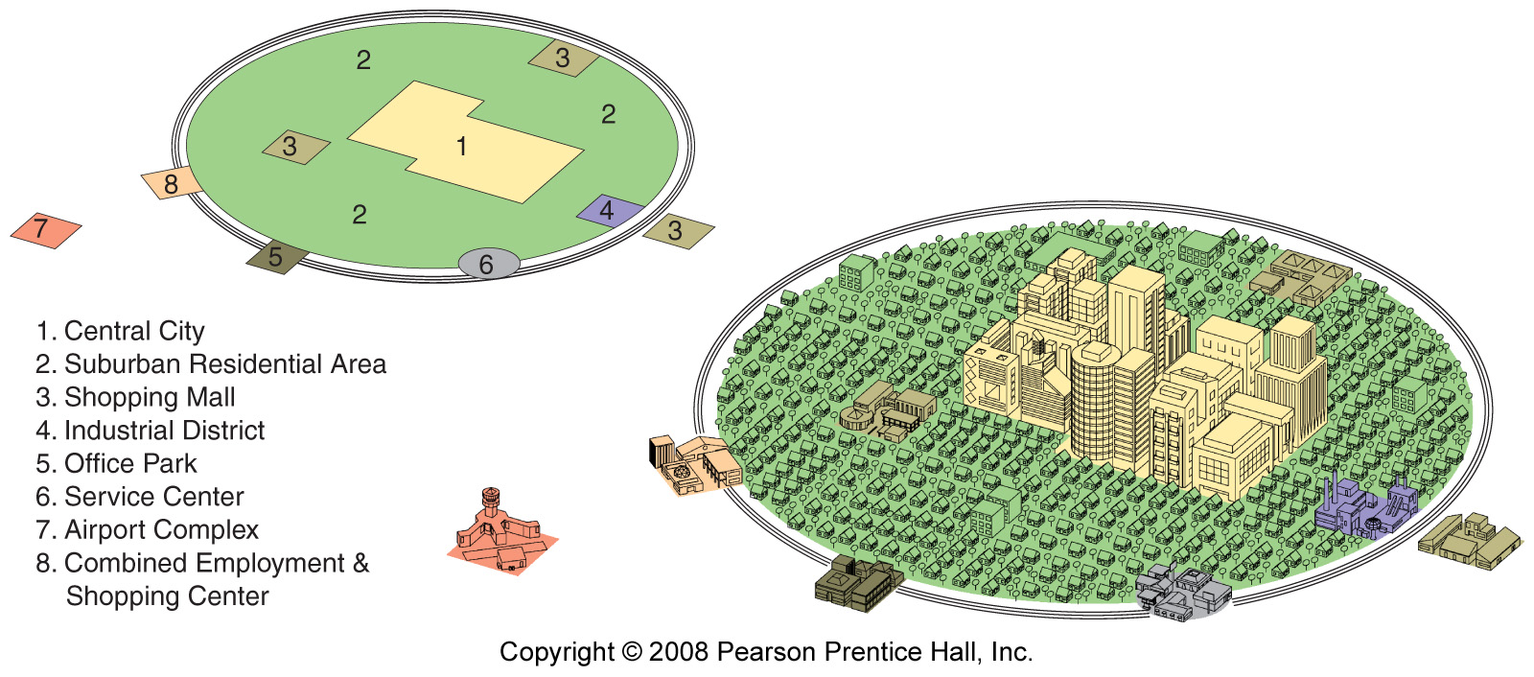
Peripheral Model / Urban Realm
Chauncey Harris (Multiple Nuclei)
Urban area consists of an inner city surrounded by large suburban residential and business areas tied together by a beltway

Slide 5
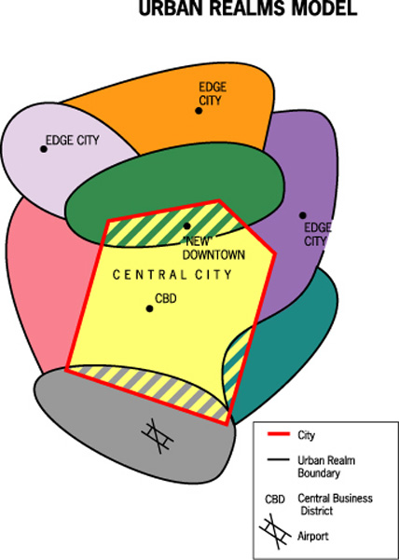
Urban Realms Model
Term used to describe the spatial components of the modern metropolis where each realm is a separate economic, social and political entity that is linked together to form the large metropolitan framework
Today’s outer cities (edge cities) are not satellites of the central city; they are shaping the metropolis
CBD is losing dominance
Ties loosened to central city but other suburbs as well

Slide 6
What is connected to what?
City
Urbanized Area
Metropolitan Area
A functional area
A continuously built up area
A legal entity
Pop Density > 1000/sq mile)
Area with at least 50,000 and adjacent counties with density of 25 people/ sq mile and 50% work in central city.

Slide 7
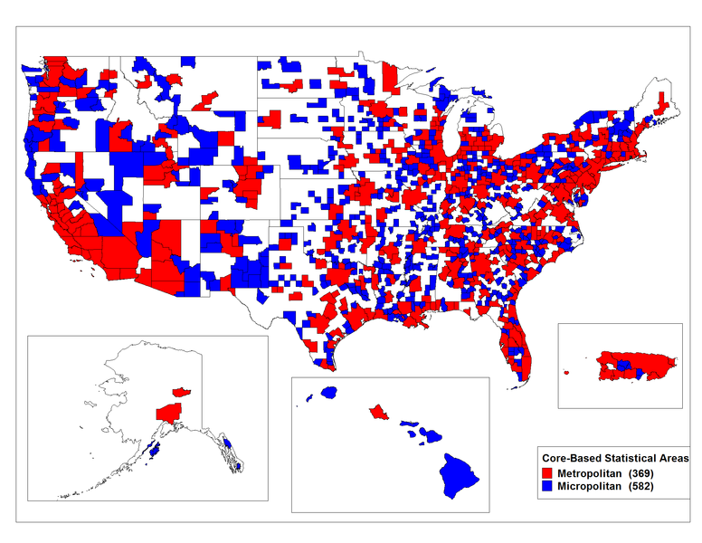

Slide 8
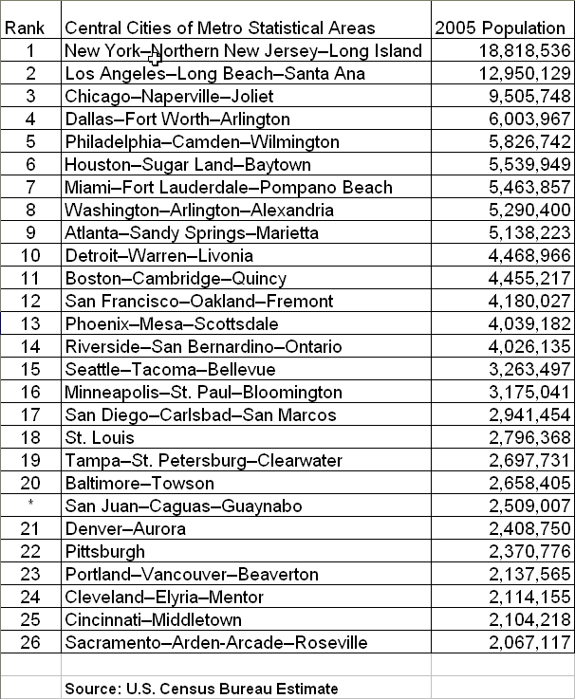
Examples?

Slide 9
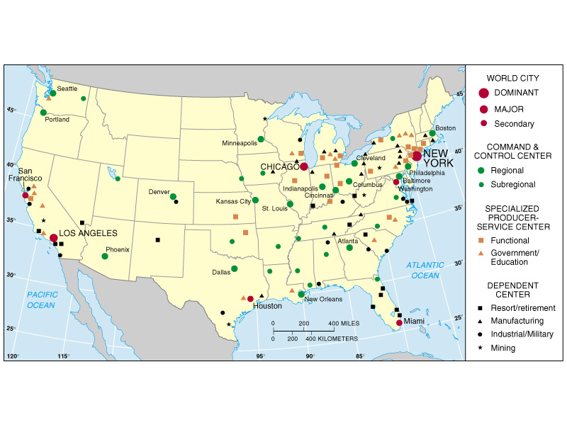
Urban Hierarchy and Megalopolis

Slide 10
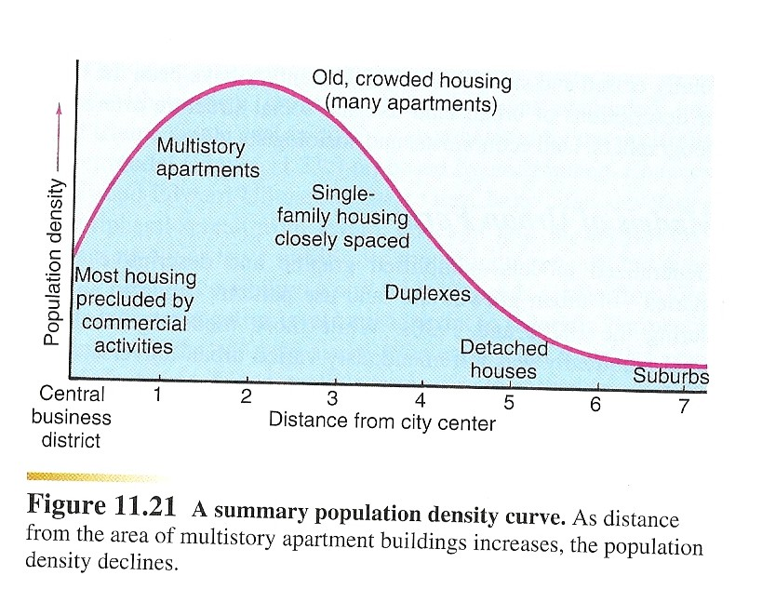
Density gradient

Slide 11
