Slide 1

What is Fair Trade?

Slide 2


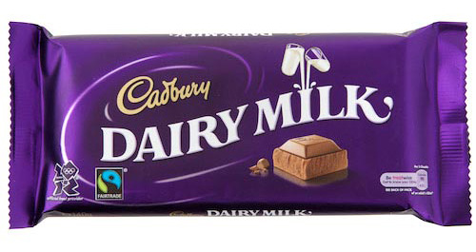
Fair trade is an organized international non-governmental, non-profit organization.
It is an approach to empower developing country producers and promoting sustainability.
It is an alternative approach to conventional trade based on a partnership between producers and consumers

Slide 3

It helps make sure that the people that produce the products in developing countries get fair pay for their work.

Slide 4
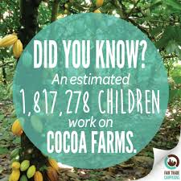
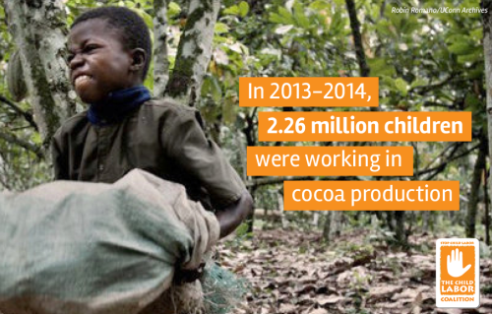
Fair Trade and Child Labor
Hundreds of children work in cocoa plantations in West Africa under terrible conditions. Many of them were taken away from their families by force and are treated as real slaves by the plantation owners. They cannot return to their families. They may have never tasted chocolate in their lives.
Fair Trade tries to secure a better future for farmers and workers in developing countries

Slide 5
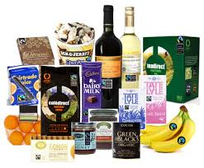
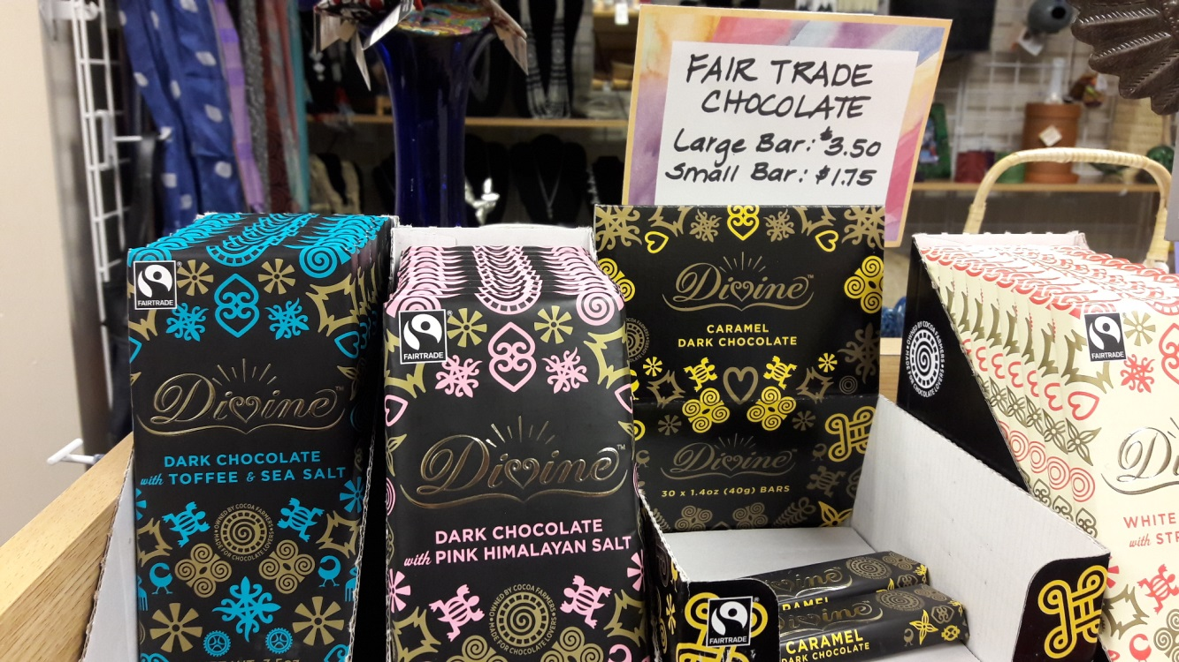
Fair – Trade Products
Coffee Sports Balls
Cocoa Handicrafts
Sugar Clothes
Tea Cotton
Bananas Wine
Honey Fresh Fruit

Slide 6
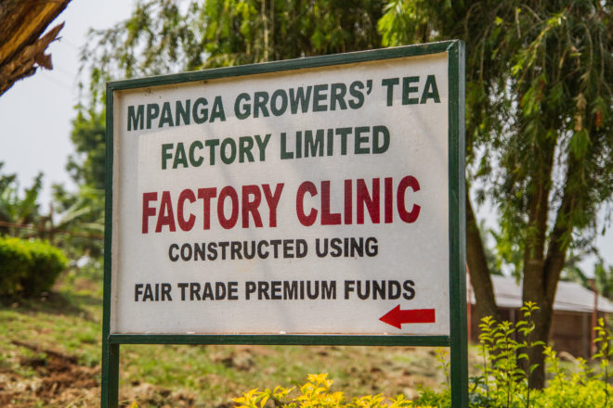
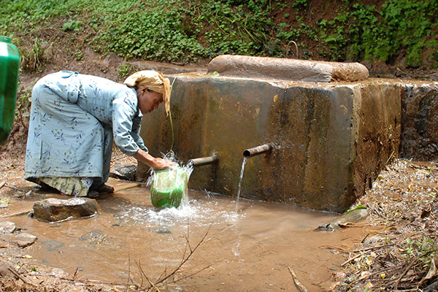
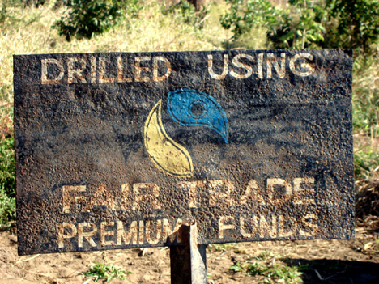
What is the Fair Trade Premium?
Better price for their products.
Guarantees a minimum price for the products of small producers.
Creates millions of jobs and improves their living conditions.
Extra money is paid on top of the minimum.
Farmers invest in social, environmental and development projects. They can help their community.

Slide 7
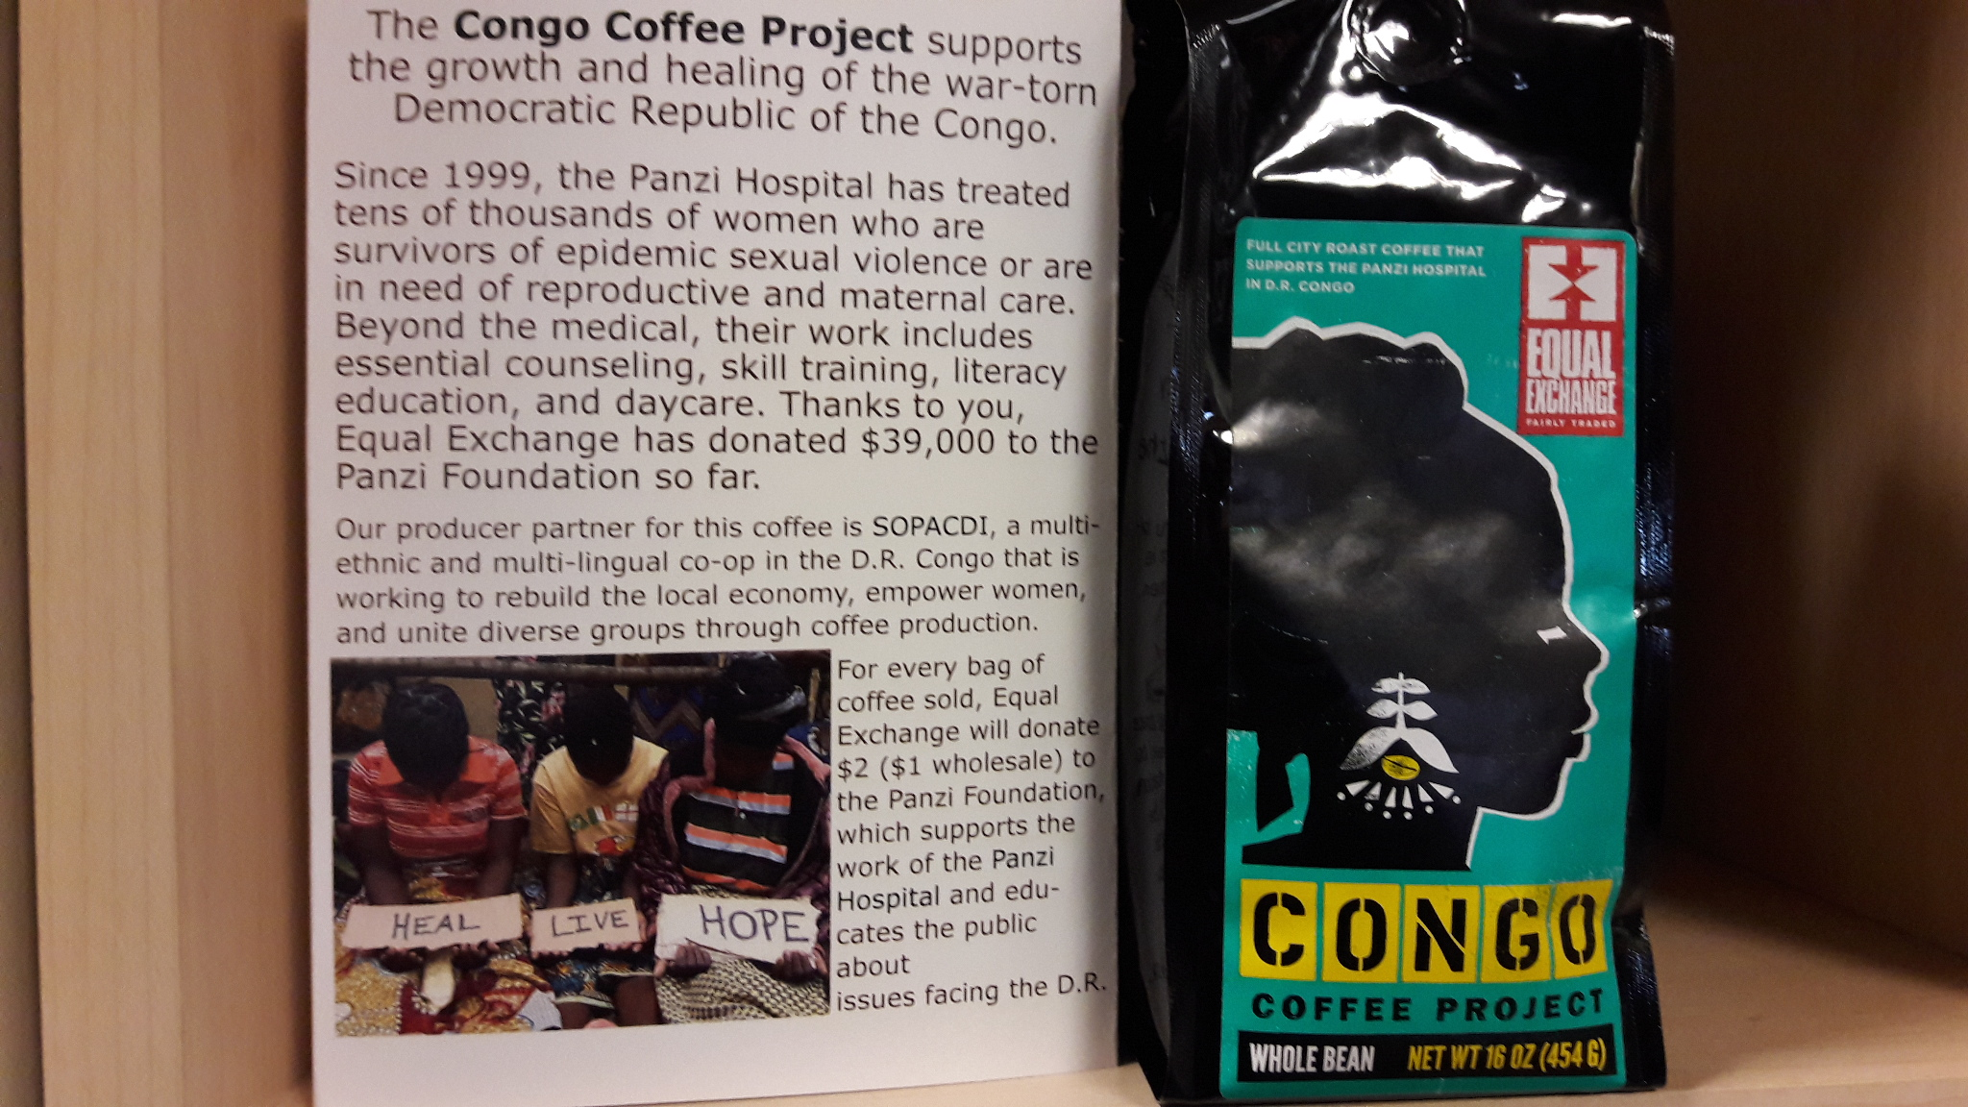
Example of where the money goes.

Slide 8
Fair Trade Video
https://www.youtube.com/watch?v=PLKTGWH398Q

