Slide 1
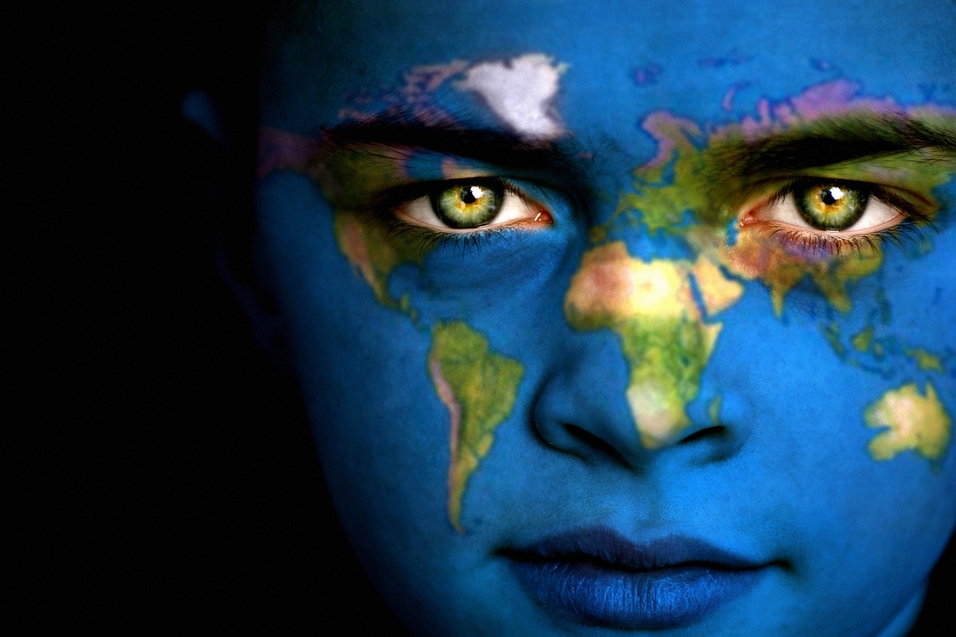
With your group…
Discuss:
  What is geography?
  What is HUMAN geography?
  Why is it important to study geography?

Slide 2
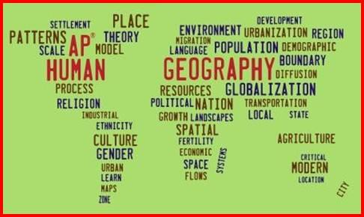
What is Human Geography?
Geo means “Earth”, graphy means “to write”
  Geography is the study of where things are found on the Earth’s surface and the reasons for the locations
  Geographers (you!) answer where? and why?
Human geography deals with how human activities affect or are influenced by the Earth’s surface
  Where are people and activities found on Earth?
  Why are they found there?

Slide 3
Why is it important to study geography?
Because I don’t want you to end up like these people!
  https://www.youtube.com/watch?v=7_pw8duzGUg

