Slide 1
Ecological Succession
Ecosystems change over time
  especially after disturbances, as some species die out and new species move in
A series of predictable changes that occur in a community over time
Over the course of succession, the number of different species present typically increases.

Slide 3
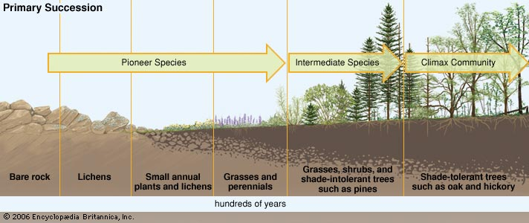
1. Primary Succession
Succession that begins in an area with no remnants of an older community
Lifeless beginning (such as rock)
Eventually becomes soil
VERY slow
Examples:
  retreating glaciers
  emerging islands
  formation of new lake

Slide 4
Primary Succession Stages
Pioneer species
  The first species to colonize barren areas
  Make soil from rock
  Example: lichens (algae/plant)
Intermediate species
  More species move in as soil is created by pioneer species
Climax community
  Stable “complete” ecosystem

Slide 5
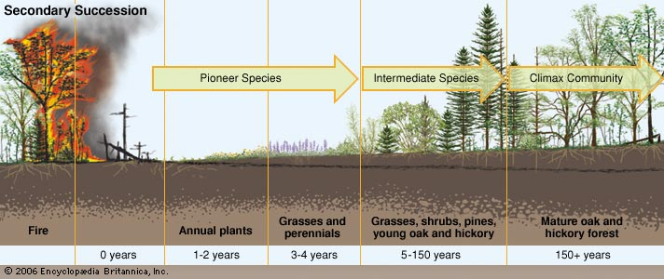
2. Secondary Succession
Re-colonization following disturbance
Faster than primary succession, because soil is already there.
  As a result, new and surviving vegetation can regrow rapidly, reach climax community faster
Examples:
  Fire
  Floods
  Bulldozers

