Slide 1

English Courses
To graduate from high school, students need 4 English credits:
English 1
-- OR--
Honors English 1
English 2
--OR--
Honors English 2
English 3
--OR--
English 3 AP Language & Composition
English Elective Courses:
AP Research
English 4 AP Literature & Composition
English 4 College Composition & Lit
English 4 Contemporary American Lit
English 4 Critical Interpretations of Lit Forms
English 4 Modern World Literature
English 4 Perspectives in Literature & Composition
English 4 Transitional English
Creative Writing
College Communications
Digital Journalism 2
Interpersonal Communications
Spoken Word
English Directed Study
English Internship
Other English Courses (elective credit only):
21st Century Journalism
Digital Journalism 1
Yearbook Journalism 1, 2
SAT Preparation Course
Click on the course title to be taken to that course’s slide of information.

Slide 2
English Required Courses
REQUIRED English Courses for Graduation::
English 1 --OR-- Honors English 1
  Typically taken in 8th grade or 9th grade in high school
English 2 -- OR-- Honors English 2
  Typically taken in 9th or 10th grade
English 3 --OR-- English 3 AP Language & Composition
  Typically taken 10th or 11th grade

Slide 3


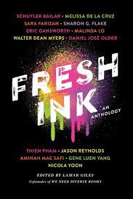
English 1 - meets graduation requirement
Available to students who have successfully completed 8th grade ELA
Year-long, full-credit 1.0 English course
Highlights of course:
Engage in a study of works in multiple genres
Thematically focused on coming of age, growing up
Hone English skill sets: reading, writing, research, language and speaking & listening skills
Core Texts: Fresh Ink, Everything Sad is Untrue, Romeo & Juliet
Demonstrate learning through multiple embedded assessments each semester
Please see the online course catalog for more details at sd308.org

Slide 4
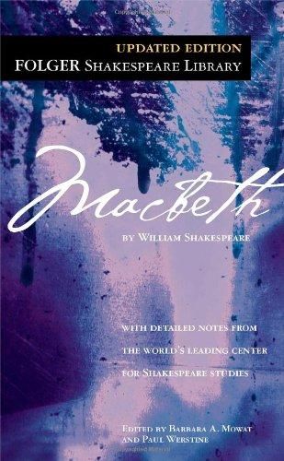

Honors English 1 - meets graduation requirement
Available to students who have successfully completed 8th grade ELA
Year-long, full-credit 1.0 English course; weighted course
Highlights of course:
Students should be motivated, independent learners who read at or above grade level
Engage in a study of works in multiple genres, thematically focused on coming of age
Hone English skill sets: reading, writing, research, language and speaking & listening skills
Core Texts: Fresh Ink, Everything Sad is Untrue, Romeo & Juliet, Macbeth
Demonstrate learning through multiple embedded assessments each semester
Prepares students to take Honors English 2
SUMMER READING REQUIRED
Please see the online course catalog for more details at sd308.org

Slide 5




English 2 - meets graduation requirement
Available to students who have successfully completed any level of English 1
Year-long, full-credit 1.0 English course
Highlights of course:
Engage in a study of fiction and nonfiction works by world authors
Thematically focused on culture
Hone English skill sets: reading, writing, research, language and speaking & listening skills
Core Texts: House on Mango Street, Things Fall Apart, Antigone, Clap When You Land
Demonstrate learning through multiple embedded assessments each semester
Please see the online course catalog for more details at sd308.org

Slide 6
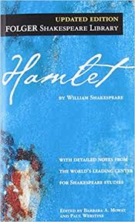
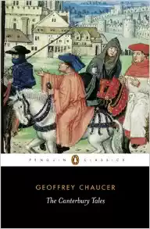
Honors English 2 - meets graduation requirement
Available to students who have successfully completed any level of English 1
Year-long, full-credit 1.0 English course; weighted course
Highlights of course:
Students should be motivated, independent learners who read at or above grade level
Engage in a study of works by world authors, thematically focused on culture
Hone English skill sets: reading, writing, research, language and speaking & listening skills
Core Texts:Things Fall Apart, Antigone, Canterbury Tales, and Hamlet
Demonstrate learning through multiple embedded assessments each semester
Prepares students to take English 3 AP Language & Composition
SUMMER READING REQUIRED
Please see the online course catalog for more details at sd308.org

Slide 7

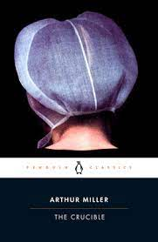
English 3 - meets graduation requirement
Available to 10th-11th grade students who have successfully completed any level of English 2
Year-long, full-credit 1.0 English course
Highlights of course:
Engage in a study of classic and contemporary American works by American
authors, as well as historical documents
Hone English skill sets: reading, writing, research, language and speaking &
listening skills
Core Texts include Their Eyes Were Watching God, The Crucible
Demonstrate learning through multiple embedded assessments each semester
Please see the online course catalog for more details at sd308.org

Slide 8
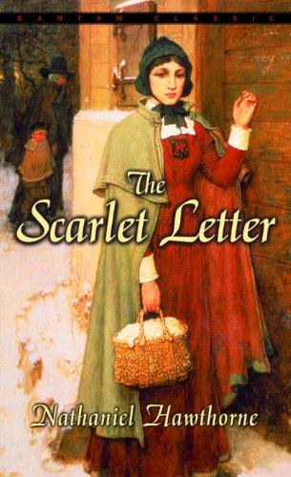


English 3 AP Language & Composition -
meets graduation requirement
Available to 10th-11th grade students who have successfully completed any level of English 2
Year-long, full-credit 1.0 English course; weighted course
Highlights of course:
Students should be motivated, independent learners who read at or above grade level
College-level course designed to help students pass the AP Language exam in May
Engage in a rigorous study of rhetoric & literary genres, styles, and themes to generate both oral and written critical discussion and analysis
Examine works by major American authors
SUMMER READING REQUIRED
Questions? Email Ms. Jamie Bechina: jbechina@sd308.org

Slide 9
English Elective Courses
  English 4 Electives:
AP Research
English 4 AP Literature & Composition
**English 4 College Composition & Literature
English 4 Contemporary American Lit & Comp
English 4 Critical Interp. of Lit Forms & Comp
English 4 Senior English
English 4 Modern World Lit & Comp
English 4 Transitional English
*Course is an elective credit
**Course is a dual credit college course
Publications Electives:
Digital Journalism *1, 2
*Yearbook Journalism 1, 2
*21st Century Journalism
Other English Electives:
Creative Writing
Spoken Word
Interpersonal Communication
**College Communication
English Directed Study
English Internship

Slide 10

AP Research
Available to 11 & 12th grade students who have successfully completed
AP Seminar; Year-long, full-credit 1.0 English elective course
Highlights of course:
Students select a research topic of their choice!
Focus on skills needed in college: research, writing, and presentation
1st semester: select research topic, development of research method
2nd semester: conduct research, write academic paper, and defend conclusion through an oral defense, perhaps be PUBLISHED!
SUMMER READING REQUIRED
Questions? Email Ms. Kristin Lavelle: klavelle@sd308.org

Slide 11

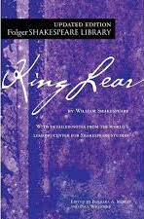
English 4 AP Literature & Composition
Available to 11-12th grade students who have successfully completed any
level of English 3 Year-long, full-credit 1.0 English elective course; weighted course
Highlights of course:
  College-level course designed to prepare for the AP Lit exam in May
  Engage in a rigorous study of literary genres, styles, and themes to generate both oral and written critical discussion and analysis
  Examine materials by new and classic voices in many genres of text
  Writing includes AP prompts, process papers, and a term paper
  SUMMER READING REQUIRED
  Questions: Email Mrs. Stephanie Stegich: sstegich@sd308.org

Slide 12

English 4 College Composition & Literature
Available to 11-12th grade students who have successfully completed any level of English 3 and who place into the course with minimum scores: ACT of 20, SAT of 540; Year-long, full-credit 1.0 English elective course; Dual Credit course (6 college credits)
Highlights of course:
Course focuses on writing: will write between 5-6 essays per semester
Read texts at a senior-college reading level; many reading assignments are completed at home; course uses college-level textbooks
The course will also include minor studies in the Humanities as well as some contemporary studies
Questions? Email Ms. Beth Prigodich: eprigodich@sd308.org

Slide 13


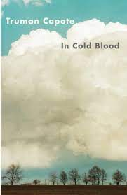
English 4 Contemporary American Lit. & Comp.
Available to 11-12th grade students who have successfully completed any tier of English 3; Year-long , full 1.0 English elective credit
Highlights of course:
  Strengthen analytical reading, writing, speaking and listening skills
  Read thought-provoking, complex texts by American authors.
  Write in-class and out-of-class expository and argumentative essays
  Actively prepare and participate in student-led Socratic seminars
  Independently read and annotate between 5-10 pages a night
  Experience senior-to-college reading level material
  Questions? Email Ms. Kelly Tobin-Martin: ktobin-martin@sd308.org

Slide 14



English 4 Critical Interp. of Lit. Forms & Comp.
Available to 11-12th grade students who have successfully completed any level of English 3 Year-long, 1.0 English elective course
Highlights of course:
  Learn how to critically analyze films and written works
  Hone analytical reading and writing skills
  Learn about film history, filming techniques, and notable genres and directors
  Course includes: a novel and a play, weekly writing, formal essays, research presentations, in-class discussions, and the at-home viewing of movies
  Questions? Please email:
Ms. Amy Severinski: aseverinski@sd308.org or Ms. Tracey Contino: tcontino@sd308.org

Slide 15


English 4 Perspectives in Lit & Comp
Available to 11-12th grade students who have successfully completed any
level of English 3; Springboard-based class; Year-long, full-credit 1.0 English elective
Highlights of course:
Apply a variety of literary criticisms to different types of texts.
Explore senior-to-college level texts through different perspective
Major texts: Othello, I’m Not Your Perfect Mexican Daughter
Projects include a photo essay and group presentation
Writing assignments include narrative, expository, and research essays
Questions? Please email:
Ms. Stephanie Stegich: sstegich@sd308.org or Ms. Paula Rossi: prossi@sd308.org

Slide 16

English 4 Modern World Lit & Comp
Available to 11-12th grade students who have successfully completed any level of English 3; Year-long, full-credit 1.0 English elective course
Highlights of course:
Learn about other cultures, strengthen analytical reading and writing abilities, and have discussions about literature and other cultures
Read thought-provoking, complex literature from all over the world
Write out-of-class and in-class narrative, argument and expository essays
Participate in Socratic Seminars at a level that is college-ready.
Independently read and annotate between 20-30 pages a night
Senior-to-college reading level texts
Questions: Email Ms. Beth Prigodich: eprigodich@sd308.org

Slide 17


English 4 Transitional English
Available to 11-12th grade students who have successfully completed any level of English 3 but need to strengthen English skill sets; Year-long, full-credit 1.0 English elective
Highlights of course:
Focus on building English skills before college
Students completing the class with a “C” or better will be
eligible for credit-bearing college coursework
Strengthen reading, writing, organization, and study skills before college
Questions? Email Ms. Evy Martin: emartin@sd308.org

Slide 18

21st Century Journalism
Available to 9-11th grade students. Semester-long, ½ credit elective
Hold class discussions about the First Amendment and issues of bias, ethics, and newsworthiness
Learn the fundamentals of producing online news, public service announcements, and news packages. This includes production planning, news writing and speaking.
Humans of OHS Project Submissions to student news publication
Course serves as a pathway to Digital Journalism 1 & Yearbook Journalism 1.
Course will help prepare students to produce the student news.
Questions? Email Ms. Sarah Hands: shands@sd308.org

Slide 19
Digital Journalism 1 (& 2)
Digital Journalism 1 (1.0 credit) is an elective credit available to 10-12th grade students who have successfully completed any level of English 1. Digital Journalism 2 (½-1 credit; English credit) is available to students who completed Digital Journalism 1. Application Required.
Highlights of Course:
Create the school news in its online media formats
Conduct interviews, take photographs, and promote advertising
Produce news packages, use social media and gather information specifically to produce content for the 42Fifty student news publication: https://oh42fifty.org/
Learn how to use Adobe Creative Suite tools
Email Ms. Sarah Hands for additional details or questions: shands@sd308.org

Slide 20

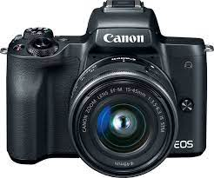
Yearbook Journalism 1 (& 2)
Yearbook Journalism 1 (1.0 credit) is available to 10-12th grade students who have successfully completed any level of English 1. Yearbook Journalism 2 (½-1 credit) is available to students who completed Yearbook Journalism 1. Application Required; Elective-only Credit.
Highlights of Course:
Learn and enhance skills in feature writing, photography, online design,
and interviewing in order to create the yearbook, The Reflector
Must have an interest in school and peers
Required to attend meetings and events outside of school hours
Meet multiple set deadlines in order to be successful in this course
Acquire marketable skills relevant to the workplace
Email Ms. Ewa Tulak for additional details or questions: etulak@sd308.org

Slide 21


Creative Writing
Available to 10-12th grade students who have successfully completed any level of English 2.
Semester-long, ½ credit English elective
Highlights of course:
Expand your creative capabilities & gain the ability to write more freely
Move beyond the science of writing and explore the art of the craft
Strengthen your voice as a writer
Share your writing with others and work toward publication
Expect to read, discuss, and write in at least five different genres
Questions? Email Mrs. Holtz: eholtz@sd308.org or Mr. Michael Leali: mleali@sd308.org

Slide 22
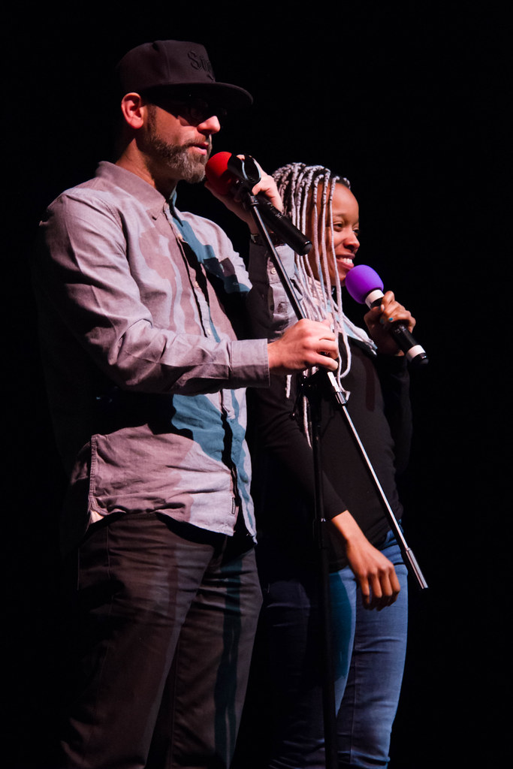


Spoken Word
Available to 11-12th grade students who have successfully completed any level of English 2.
Semester-long, ½ credit English elective
Highlights of course:
Course shaped by Young Chicago Authors program
Create and format your own authentic story
Channel your expression & speak your truth!
Heavy emphasis on creative writing choices and speaking skills
Questions? Email Mrs. Erin Holtz: eholtz@sd308.org

Slide 23

Interpersonal Communication
This course is available to 10-12th grade students who have successfully completed any level of English 2
Semester-long, ½ credit English elective
Highlights of course:
Participate in real-life scenarios
Master leadership and communication skills
Requires daily participation in group and full class discussions.
Requires oral presentations often and in front of a variety of audiences
Questions? Email Mr. Ben Spears at bspears@sd308.org

Slide 24
College Communication
This course is available to 11-12th grade students who have successfully completed any level of English 3; Semester-long, ½ credit English elective, Dual Credit course
Highlights of course:
  Master leadership and communication skills
  Participate in discussion boards and group projects
  Conduct minimum of three substantial, formal speeches
  Requires oral presentations often and in front of a variety of audiences
  Questions? Email Ms. Amy Howerton: ahowerton@sd308.org

Slide 25
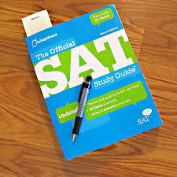
SAT Preparation Course
Available to 11 grade students who wish to prepare for the SAT
Semester-long, 0.5 general elective course (not an English credit)
Highlights of course:
  Learn SAT test preparation skills
  Practice skills and review content associated with the exam
  Learn timing and pacing helpful for exam
  Take a practice test prior to national SAT test day in April
  Questions? Email Mr. Michael Leali: mleali@sd308.org

Slide 26

English Directed Study
Available to 11-12th grade students who have successfully completed any level of English 3 and have exhausted most of the English elective offered and are planning on majoring in English; application required; Semester-long, ½ credit elective course
Highlights of course:
  Course for students who want to study a specific area of language arts.
  Students often already accepted as English majors at a university.
  Coursework and assessments are created at the time of
approval with cooperating instructor.
  Questions? Email Ms. Amy Howerton: ahowerton@sd308.org

Slide 27

English Internship
Available to 11-12th grade students who have successfully completed any level of English 3 and have exhausted most of the English elective offered; application required; Semester-long, ½ credit elective course
Highlights of course:
Course for students who want to study a specific area of English.
Students wanting to hone specific skills beyond of the courses offered.
Coursework and assessments are created at the time of approval with
cooperating instructor.
Connection to external employer or company may be possible.
Questions? Email Ms. Amy Howerton: ahowerton@sd308.org

