Slide 1
French Revolution to Napoleon
1700 - 1830

Slide 2
How did the French
Revolution alter society in Europe?
The French Revolution destroyed the entire structure of royal absolutism and ended the social order based on aristocratic privileges.
What lasting effects did it have on the rest of the world?
It set the stage for democratic movements around the world during the next century.

Slide 3
Why Absolutism Made People Angry
Stage 1: Incubation

Slide 4
Essential Question
What did Louis XIV and Louis XVI do to upset the people of France?

Slide 5
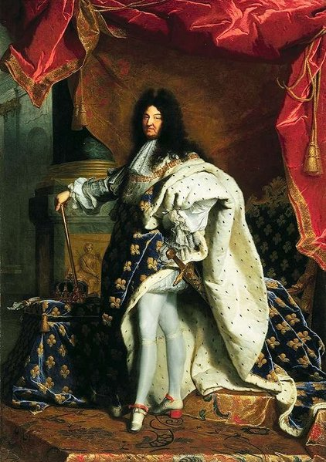
Louis XIV of France
Called himself the Sun King because he saw himself as the source of light for all of his people
What does this say about his personality & how he may have treated the people of lower social status?

Slide 6
Louis Builds a Home
A little place called Versailles

Slide 7
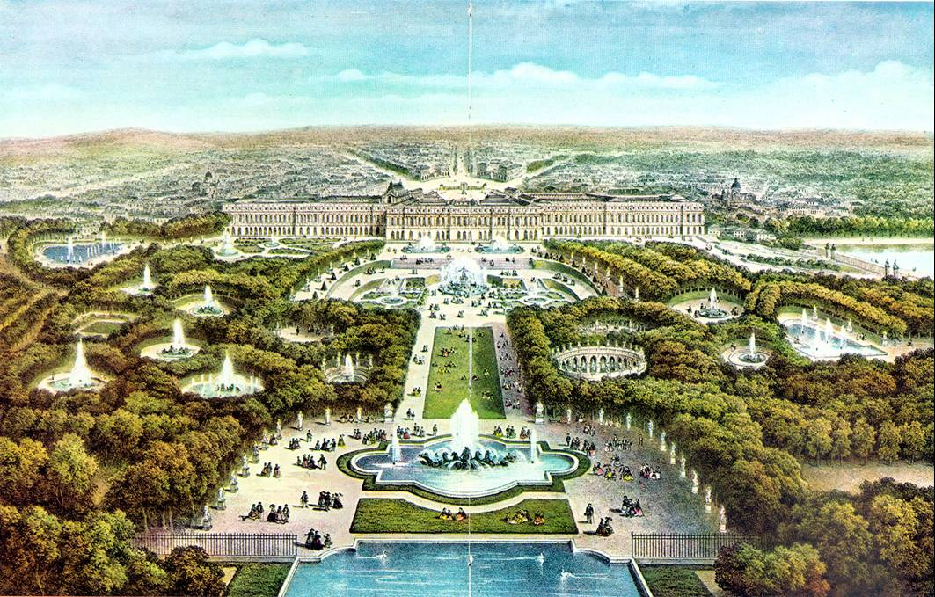
Versailles

Slide 8
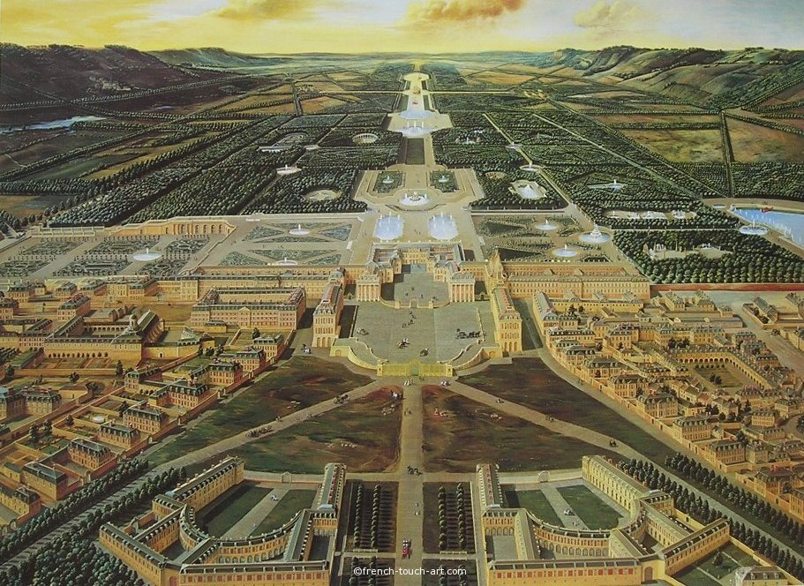

Slide 9
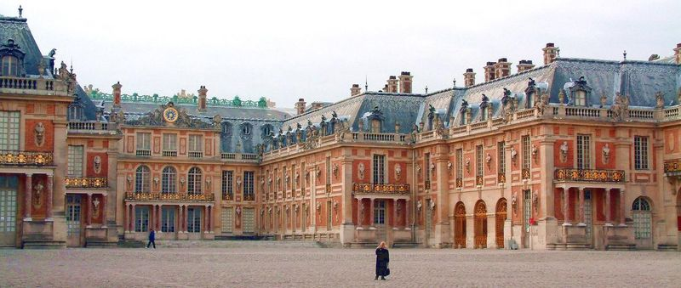
Versailles

Slide 10
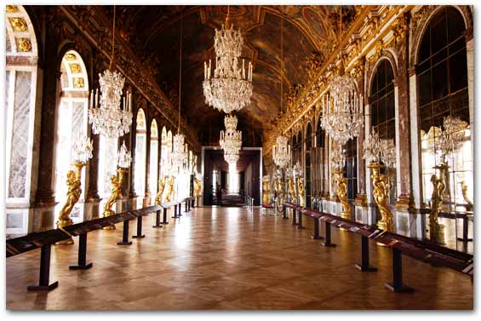
The Hall of Mirrors

Slide 11
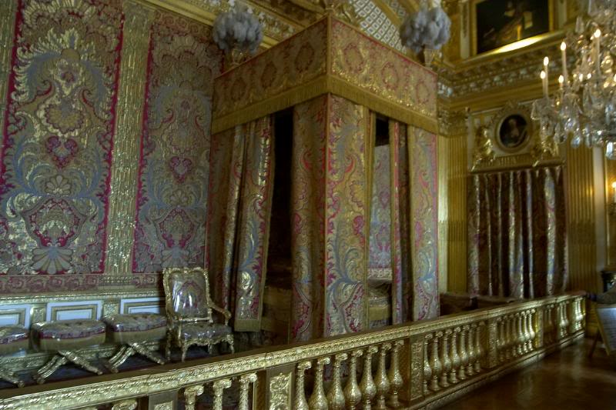
The King’s Bedroom

Slide 12
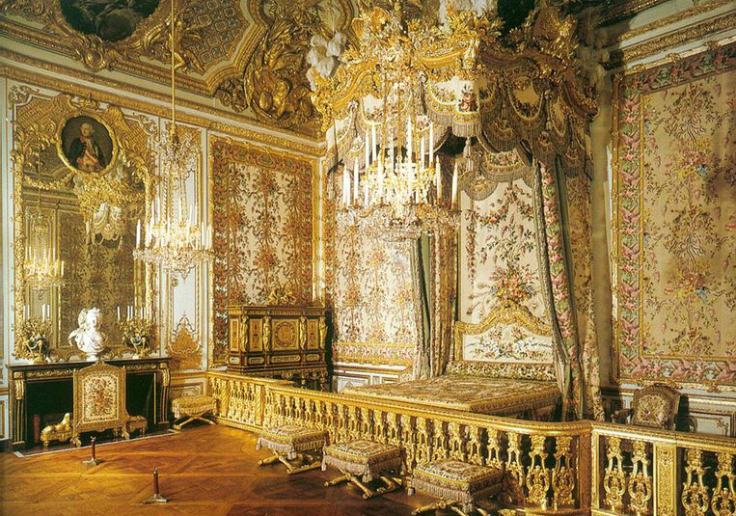
The Queen’s Bedroom

Slide 13
The 3 Purposes of Versailles
The personal household of the king
The chief offices of the state were there so Louis could
keep an eye on them
Powerful subjects came to find favors and offices for
themselves

Slide 14
Threat to Louis’s Power
High nobles and royal princes thought that they should have a say in the government of France
    Louis removes them from the royal council
    Invites them to the royal court at Versailles to keep them entertained and out of politics

Slide 15
Other Issues with Absolutism
Taking Power over Local Governments
  Louis only held control over the nationwide policy making
  His power was limited at the local level
  Louis bribed important people in the provinces to see that his policies were carried out

Slide 16
Gaining Power
Through War
Louis wished to achieve military glory befitting the Sun King
He also wanted to ensure the domination of his dynasty over European affairs
Louis developed a standing army of 400,000 in time of war
Louis waged four wars between 1667 and 1713
What does all of this cost?

Slide 17

Where does a government get its money?
Taxes
  Income
  Sales
  Property
  Tariffs – taxes on traded goods
Borrow money from
other countries
The Government Bank Account
Surplus – they have money left over
Deficit – they
over spent

Slide 18
Surplus or Deficit?
Who has the power to create taxes?
What did those taxes pay for?

Slide 19
Other Issues with Absolutism
Attack on Religion
  In an attempt to keep his power through religious harmony, Louis started an anti-Protestant policy
  Goal: to convert Protestants to Catholicism
  Louis ordered the destruction of Huguenot churches and the closure of their schools

Slide 20
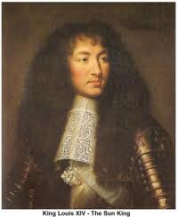
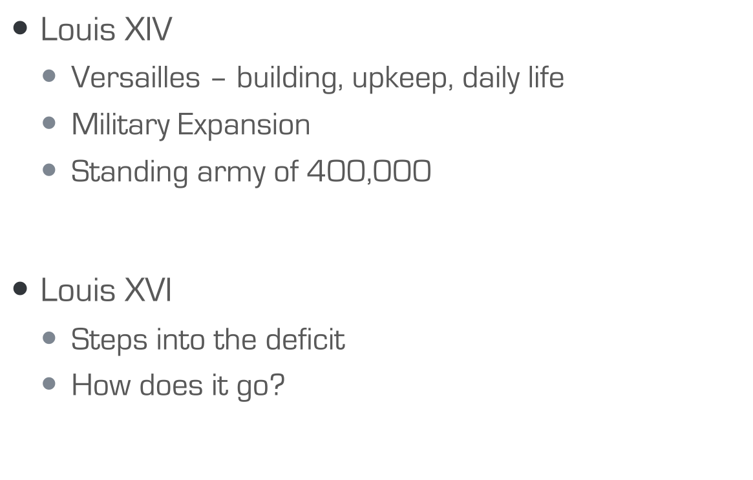
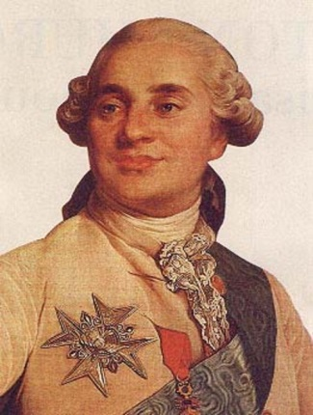
The Deficit Builds

Slide 21
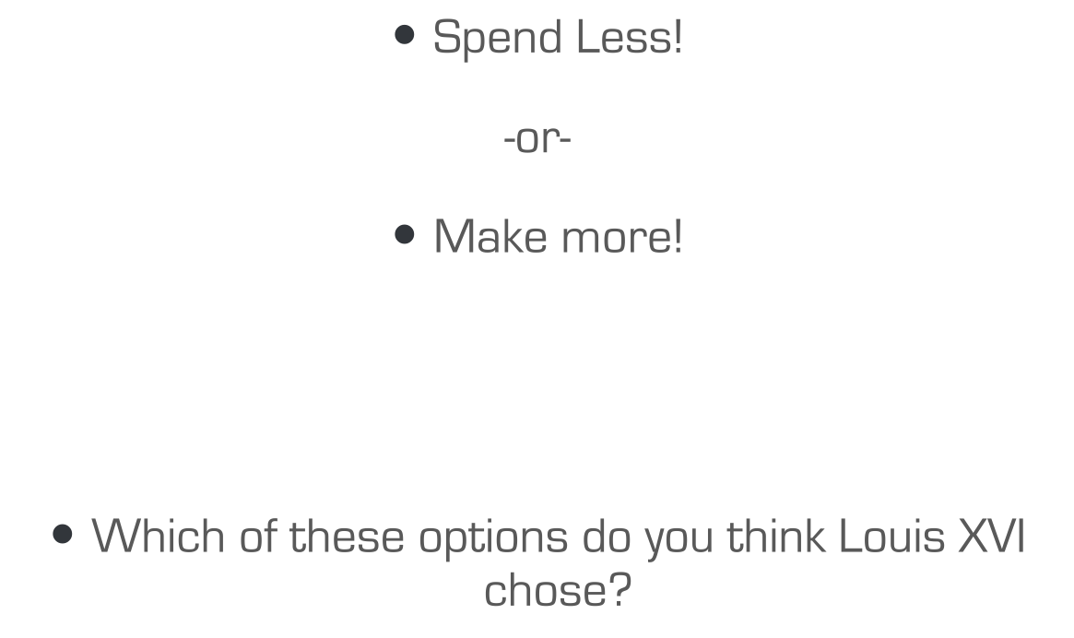
What are two ways to “cure” a deficit?

Slide 22
You guessed right! It’s time to come to the table to vote on our taxes

Slide 23
Taxation under the Old Regime
What kind of feelings would it create?

Slide 24
First…
You will be assigned into your social class and will learn a little about your status… 1st Estate 2nd Estate 3rd Estate

Slide 25
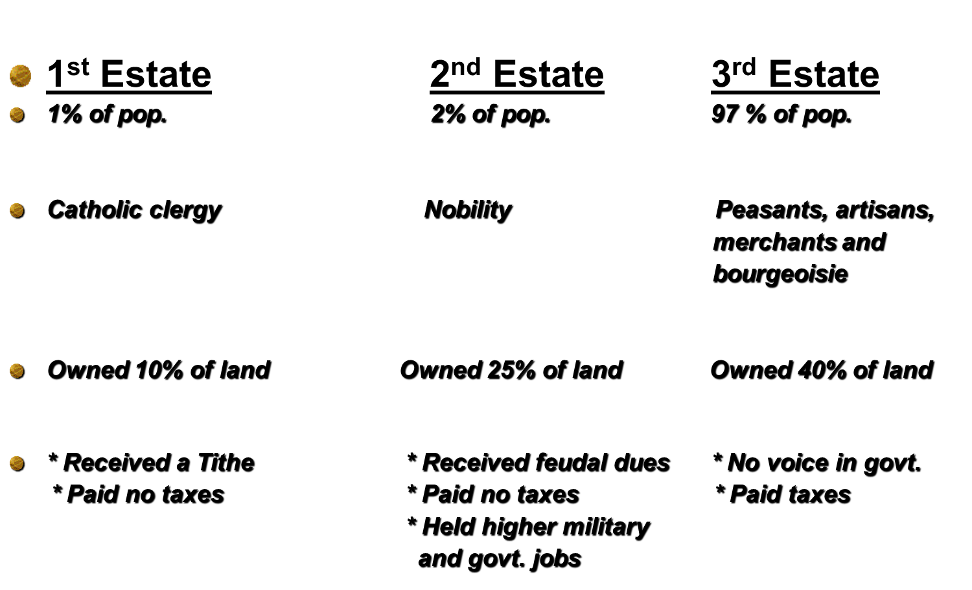

Slide 26
Next…
You will move to be with other members of your class
I, the King, will distribute your annual income
  This is how much you have made on your own in the past year
  1st Estate: 8
  2nd Estate: 8
  3rd Estate: 4

Slide 27
1st Round
Time to collect taxes
The 3rd Estate is the only social class that pays taxes
The 3rd Estate will pay the King 50% of their annual income for taxes

Slide 28
Where are the taxes going?
6%
19%
50%
25%

Slide 29
Dilemma!
It seems that the government is running out of money – …………..we have a deficit…

Slide 30
What should we do?
Reduce spending or raise taxes?
1st Estate
  Would you benefit from reducing government spending?
  How would you benefit from raising taxes? Would you suffer at all?
2nd Estate
  Would you benefit from reducing government spending?
  How would you benefit from raising taxes? Would you suffer at all?

Slide 31
What should we do?
3rd Estate
  What would you prefer? Reducing government spending or raising taxes? Why?

Slide 32
Lets take a vote…
We need to vote on raising taxes to fix our deficit

Slide 33
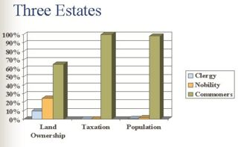
How do you feel?
Were the results of the vote fair?

Slide 34
Third estate! What should we do?

Slide 35
Causes of the French Revolution
What are the causes of the French Revolution?
Essential Question

Slide 36
background
France – richest and most powerful nation in Europe
Minority had all the wealth (nobles and clergy)
Working men and women with few rights want a better life
Class system – everyone belonged to one of the three “estates”

Slide 37
Causes
Enlightenment Ideas
  New views about power and authority
  American Rev is a sign of hope – ideas put into action
  Equality, Liberty, Democracy
Economic Failure
  Increase in population = decrease in resources/food = starvation
  Kings put France in debt – war, extravagant lifestyle
  Crop failure = bread shortages
  Supported the American Rev
Weak Leader
  Louis XVI is indecisive and lets Marie Antoinette spend what she wants
  People resent King’s power - everyone wants more political power

Slide 38
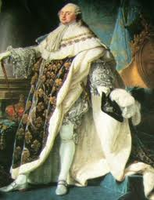
Louis xVI
Very indecisive
Paid little attention to his advisors and didn’t really like governing
Put off dealing with France’s problems
Solution was to impose taxes

Slide 39
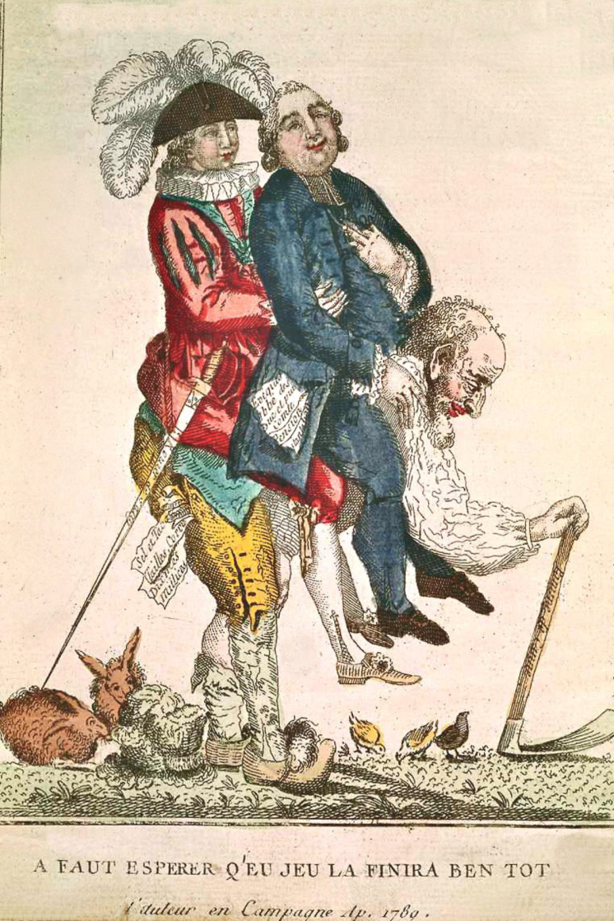
What do you notice about the cartoon?
What do the different people represent?
How did these different groups feel about the Enlightenment?
What do you think is the artist’s opinion of the peasants, the clergy, and the nobles?

Slide 40
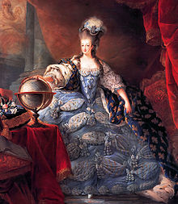
Marie Antoinette
Austrian (France’s long time enemy) nobility
Gave Louis poor advice
Gambled away money playing cards- called “Madame Deficit”
Did not want to wear the fashions of the day-insulted many French nobles
French Revolution Wife Swap
https://www.youtube.com/watch?v=dHHp6xqEc8c

Slide 41
Major Events
Estates-General called (1st time in 175 years)
  King needed $$, wants to tax other classes, 1st and 2nd estates refuse
  Estates called together to pass new taxes
    Made up of delegates representing each estate
    One estate – one vote = 1st and 2nd usually overrule 3rd
    3rd estate refuses plan – should have more say
      Want “one man – one vote”
    Estates-General deadlocked
  If you were a member of the 3rd estate how would you try to make your voice heard?

Slide 42
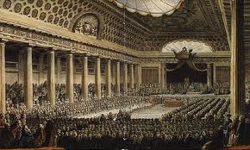
Estates-General

Slide 43
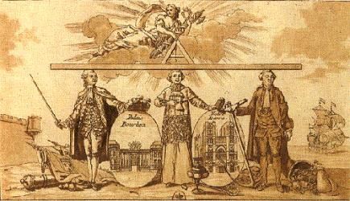
Major Events
Tennis Court Oath
  3rd estate renames itself “National Assembly” and decides to draw up a new constitution
  3rd estate arrives at EG – locked out
  Gathered at nearby indoor tennis court – take oath
    Won’t disband until a new constitution is written for France
  What impact do you think this could have?

Slide 44
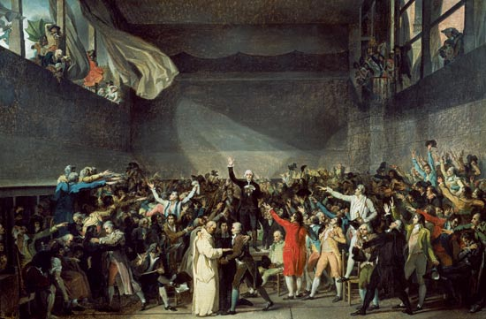

Slide 45
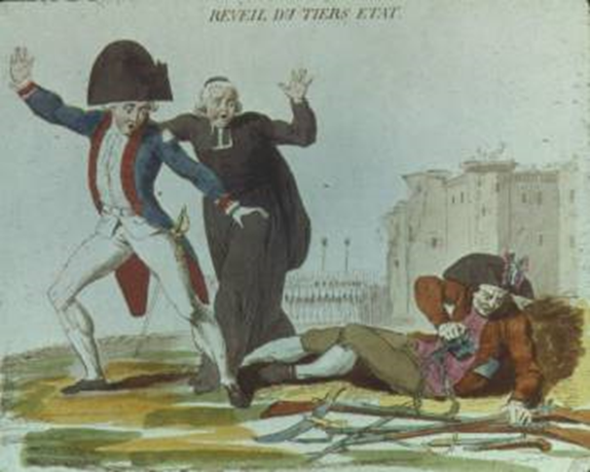
Major Events
A Call to Revolt
  King senses danger of new constitution
  Orders 1st and 2nd estates to join National Assembly – make them come to the senses

Slide 46
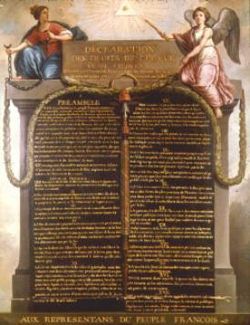
The Moderate Phase
National Assembly (1789)
  Voted to end their privileges (3)
  Wrote the Declaration of Rights of Man and of the Citizen- (3)
  Called troops to concentrate around Paris
  People are afraid the new reforms would stop and that the King would dissolve the National Assembly

Slide 47
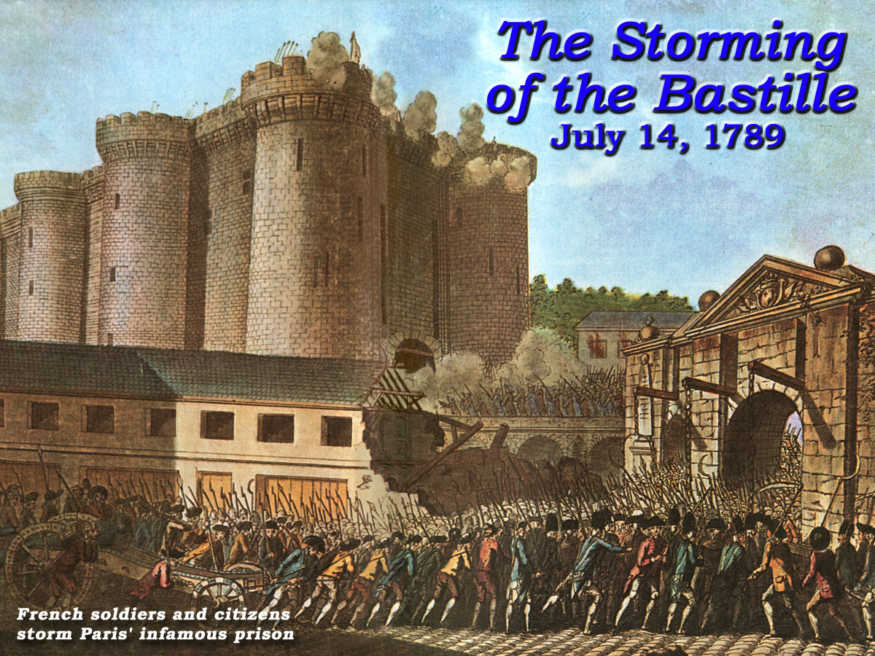
Major events
Fall of the Bastille (infamous prison and royal armory)
  Symbolizes injustices of monarchy
  Mob surrounds prison on July 14, 1789 to steal weapons to defend themselves
  Overtake the prison and kill the guards
  Celebration begins but not for long
  1st wave of the Revolution has come!

Slide 48
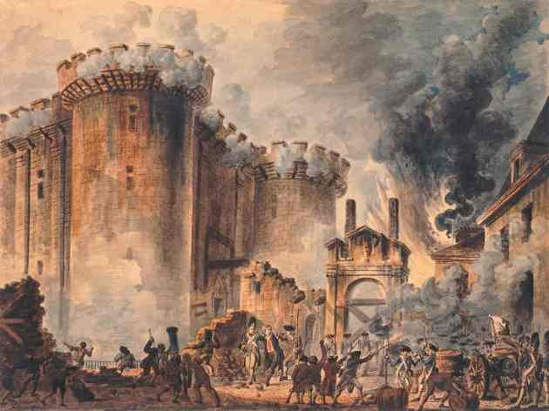
https://www.youtube.com/watch?v=I6rctsSef7U

Slide 49
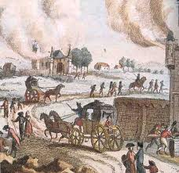
Major events
Great Fear
  Rumors that nobles had hired criminals to kill peasants & take property
  Fear turns to violence
  Peasants break into houses – rob & destroy

Slide 50
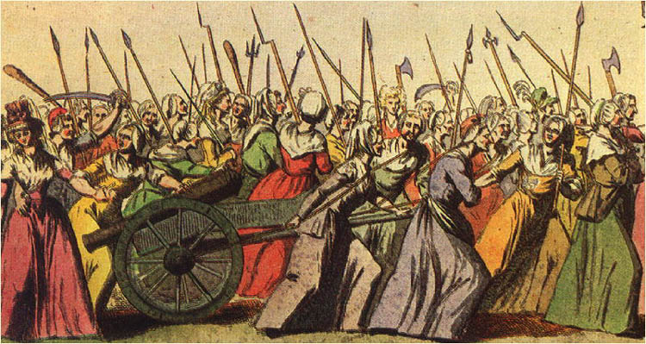
Major events
March to Versailles
  October 1789 – Parisian women riot over rising prices of bread (Why would people do that?)
  Broke into Palace of Versailles
  Demand Louis and Marie Antoinette return to Paris

Slide 51
Closer
What struggles do you predict France going through after these early events? What do you think was the most important factor that led to Revolution in France?

