Slide 1
Terrorism!

Slide 2
Terrorism Introduction
http://www.cnn.com/videos/tv/2015/11/14/paris-under-attack-cm-orig.cnn/video/playlists/paris-shootings/
Watch the video about the terrorist attack in Paris on November 13, 2015.
What should be done (by the US or other countries) to address the issue of terrorism in the world?

Slide 3
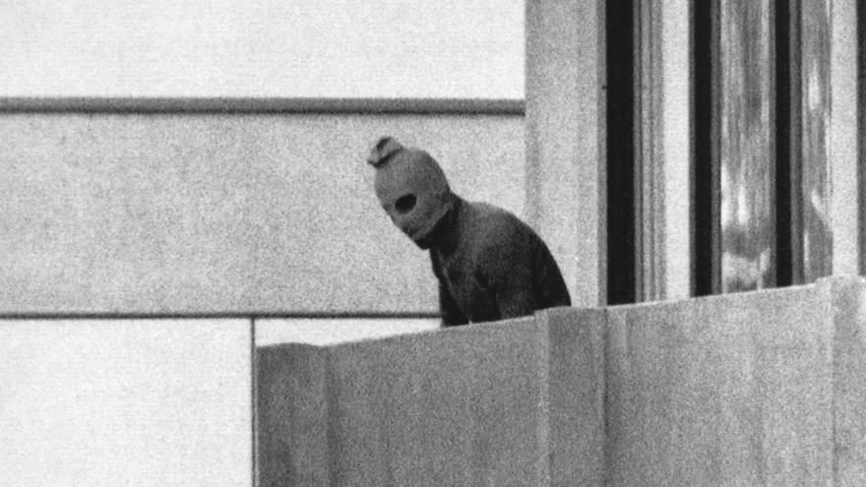
The Origins and Evolution of Terrorism
Why have experts struggled to agree on a definition of terrorism?
Why was the hostage crisis at the Munich Olympics in 1972 a turning point in terrorism?
The past twenty years have seen a sharp rise in religious terrorism. What motivates these terrorists?

Slide 4
What is Terrorism and why does it occur?
Calculated use of violent acts against civilians and symbolic targets to intimidate or coerce a civilian population or affect the conduct of government.
From the Latin word meaning “to frighten”
Use of bombing, kidnapping, hijacking, and murder to instill fear and anxiety in a population
Violence used to extreme measures. Claimed as holy wars.
Why?
History of hatred toward group…(minority).
Occurs because of resistance to power, loss of rights, cultural / social differences

Slide 5
Terrorism!
1. What are some examples of Terrorism?
2. How does Terrorism connect to the Political Geography Unit?

Slide 6
Different Types of Terrorism
International
vs.
Domestic
States Sponsored
vs.
Subnational

Slide 7
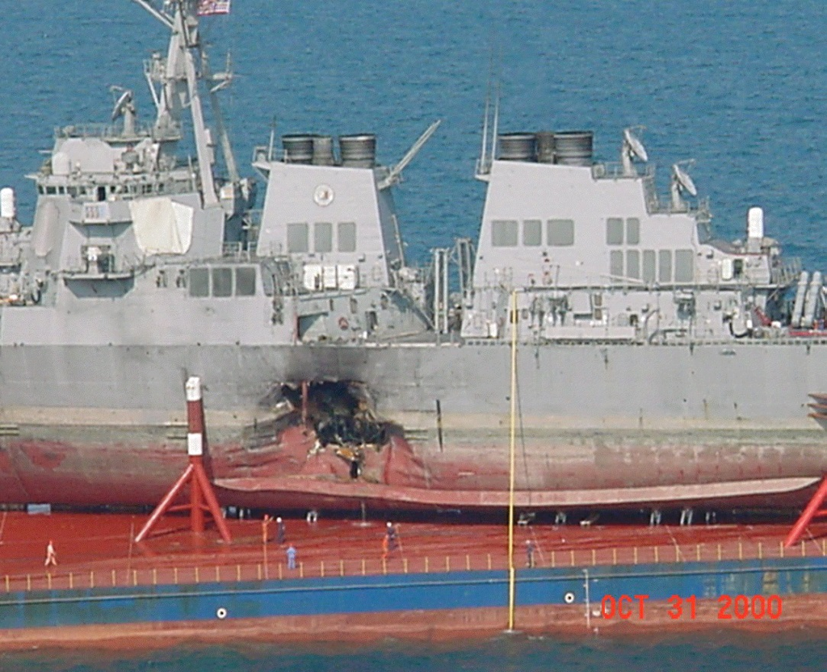
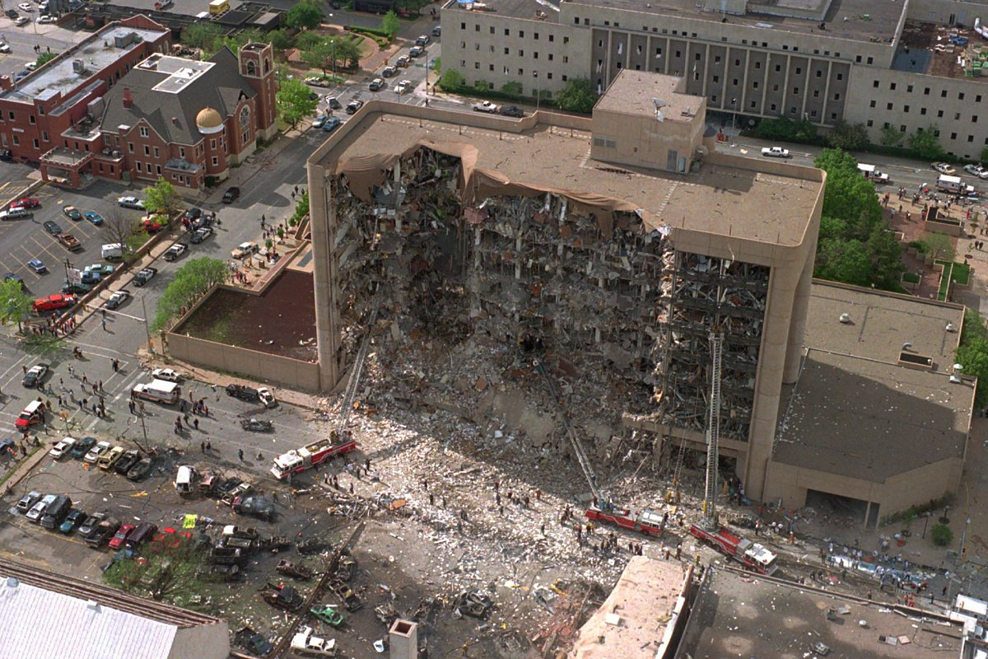
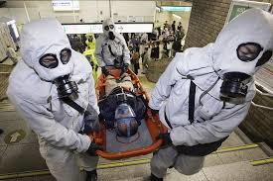
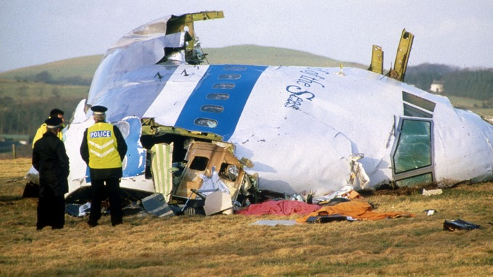
What are same examples of Terrorism?
Palestinian bombings in Israel
Taliban
9/11
Tokyo Subway
Stalin
Pol Pot in Cambodia
Oklahoma City
Al-Qaeda in Indonesia
Saddam Hussein Genocide
Paris Attacks (2015)
San Bernadino, CA
Pakistanian Insugents in Mumbai
Syrian Civil War
USS Cole: Al-Qaeda
Romans sack Carthage, burn it to ground, spread salt on soil.
ISIS
Soviets in Chechnya
Madrid Train: Al-Qaeda
Abduction of Canadian Officials by FLQ
London Bombings
LOCKERBIE SCOTLAND Pan Am 103

Slide 8
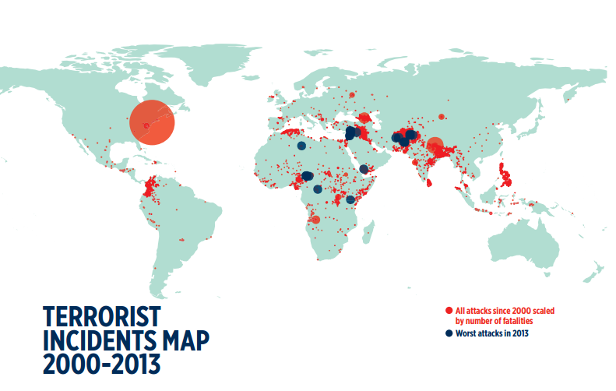

Slide 9
How does Terrorism connect to the Political Geography Unit?
Terrorist groups take over land and resources for their own benefit
Romans destroyed Carthage.
Terrorist can be state funded and often occur due to political or religious conflicts
The government can back terrorist.
Subnational terrorism came about with the rise of the nation-state because ethnicities feel threatened by government.
Terrorism occurs over borders and can result in devolution.
Terrorism is a world centrifugal force and can cause revolts against supranational organizations.

Slide 10
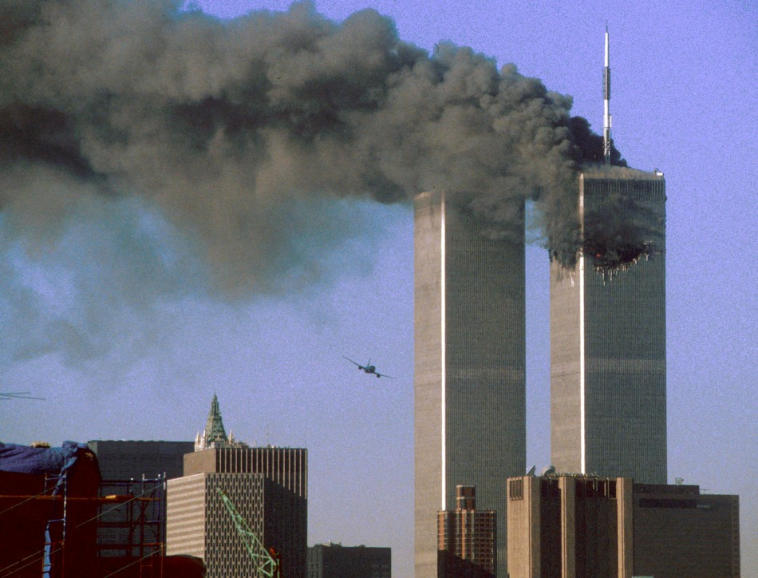

Terrorism by individuals and organizations
  American terrorists
  September 11, 2001, attacks
  Al-Qaeda
    Jihad
http://www.youtube.com/watch?v=21eaubatLGc&feature=related

Slide 11
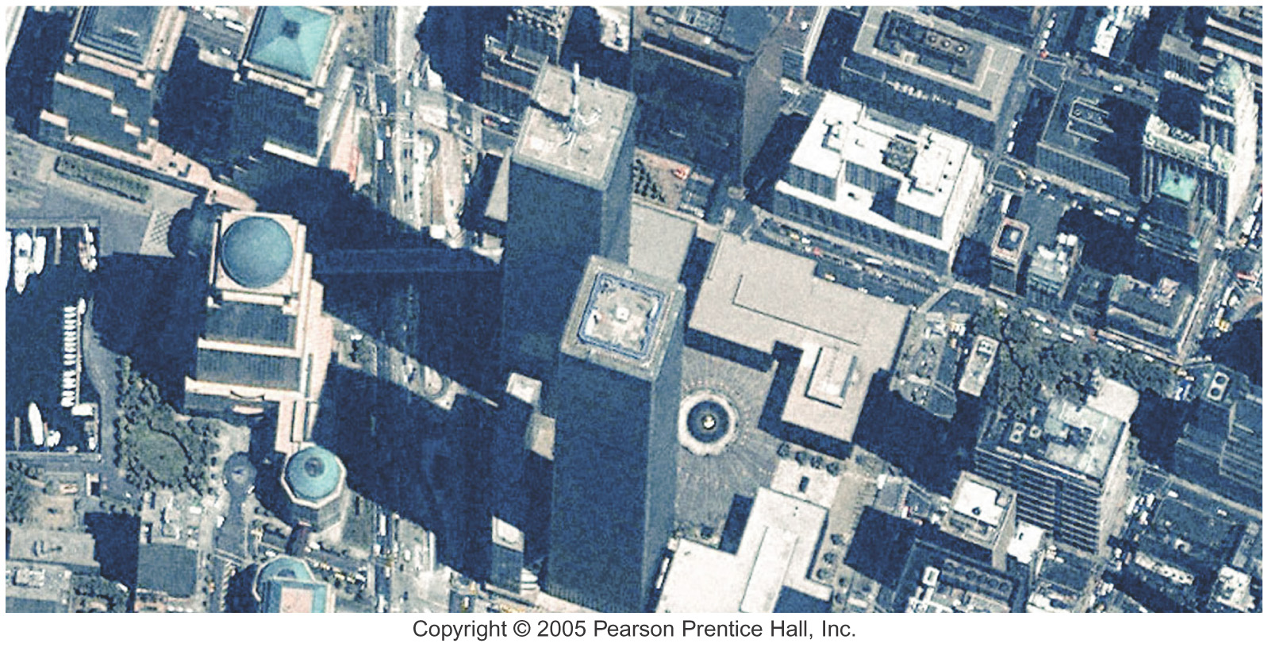
World Trade Center
Ikonos satellite images of the World Trade Center June 30, 2000, before the attack.

Slide 12
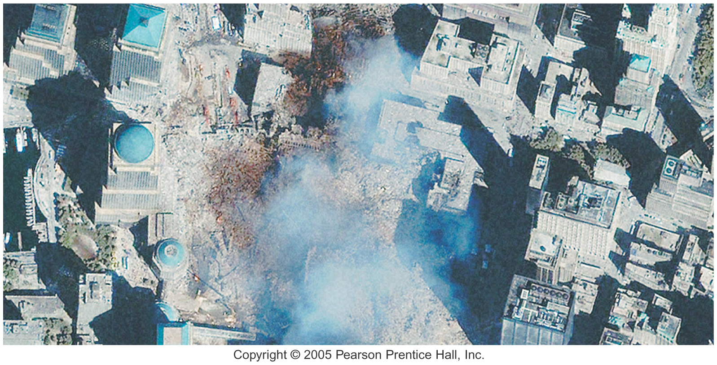
World Trade Center Site September 15, 2001
Ikonos satellite images of the World Trade Center September 15, 2001, after the attack.

Slide 13
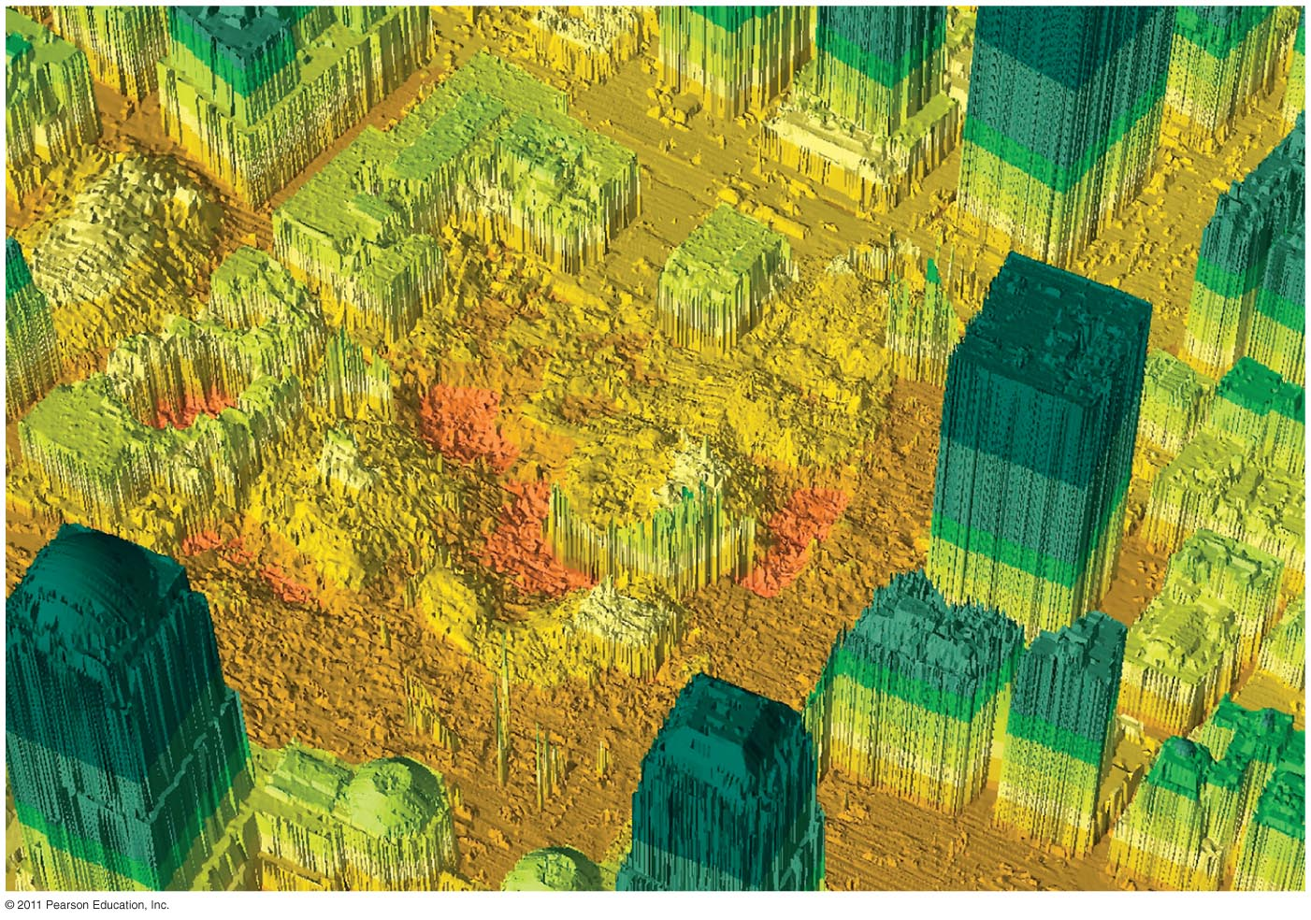
Aftermath of World Trade Center Attack
8 days after the attack, laser technology was used to create a topographic map of the WTC

Slide 14


WTC
9-11 Memorial -
Has this become a sacred place?
9-11-11

Slide 15
Why Has Terrorism Increased?
State support for terrorism
  Three increasing levels of involvement
    Providing sanctuary (Example – Afghanistan / Taliban / Al-Qaeda)
    Supplying weapons, money, and intelligence to terrorists (Iran – Yemen Houthi Rebels)
    Using terrorists to plan attacks (ISIS / Europe)
  Examples
    Libya
    Iraq
    Afghanistan
    Iran
    Pakistan
    Sudan
    Others?
https://www.youtube.com/watch?v=hdm-Qy_Ti9U

Slide 16
Responses to Terrorism?
Reduce the causes of terrorism (Devolution)
Increase international cooperation
Increase security
Use military (unilateral or multilateral)

Slide 17
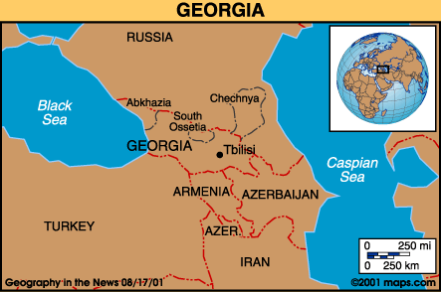
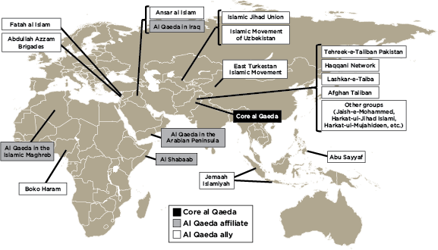
What else is important about your article we all should know?
In Iraq, the US initially focused on Al-Qaeda, but then switched to State Sponsored Terrorism.
Al-Qaeda is all over the world. Over 20,000 people.
Terrorism can cause migration: Chechnya
Nearly every country has experienced some form of terrorism

Slide 18
Things to think about…
Why doesn’t Russia just give Chechnya its independence?
Does Terrorism work?
Why do people resort to terrorism?
Does Bin Laden really matter?
How are WMD’s related to terrorism?
Is “regime change” legal?
One man’s terrorist is another man’s freedom fighter!

Slide 19

Terrorism – is any area safe?...
Think about it…

